Slide 1
Digital Dictionary Database for Slovenian unstructured, semi-structured and structured data in modern lexicography
Simon Krek
Jožef Stefan Institute, Ljubljana
Centre for Language Resources and Technologies, University of Ljubljana

Slide 2
Overview
A slide about myself
Unstructured, semi-structured and structured data
Some history (in relation to DDDS)
Digital Dictionary Database (DDDS) for Slovenian
  Organisation of data (data model)
  Public API and use cases
  Visualisation of data
Where we are and what to do next (in lexicography)

Slide 3

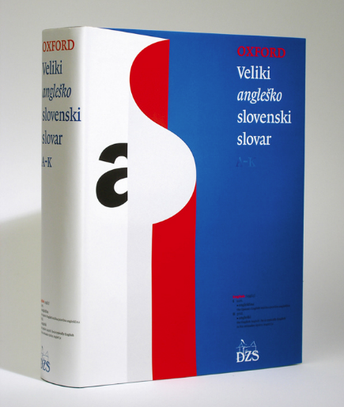













A bit about myself
1994
2004
2014
2023
LEXICOGRAPHY
LANGUAGE TECHNOLOGY
(FOR SLOVENE)
E-LEXICOGRAPHY
& LANGUAGE TECHNOLOGY

Slide 4
Wikipedia – unstructured data
Unstructured data (or unstructured information) is information that either does not have a pre-defined data model or is not organized in a pre-defined manner.
Unstructured information is typically text-heavy, but may contain data such as dates, numbers, and facts as well.
In lexicography: corpora / evidence / text

Slide 5
Wikipedia – semi-structured data
Semi-structured data is a form of structured data that does not obey the tabular structure of data models associated with relational databases or other forms of data tables, but nonetheless contains tags or other markers to separate semantic elements and enforce hierarchies of records and fields within the data.
Therefore, it is also known as self-describing structure.
In lexicography: (most of existing) dictionaries (in XML etc.)

Slide 6
ChatGPT – structured data
Structured data is information that is organized in a specific format that makes it easy to search, analyze and process by machines. It is typically stored in a database or spreadsheet, and each piece of data is assigned a specific field or attribute.
Data models are an important aspect of structured data, as they define the structure and relationships between the data elements in a database or information system. A data model is essentially a blueprint or diagram that shows how different pieces of data are related to each other.
In lexicography: (future all-encompassing) lexical data(bases)

Slide 7
Problems
How does running text (corpora/evidence) fit into structured data?
Word vs. multiword sequences – what could be useful categories (for the entire vocabulary)?
Grammar (morphology/syntax) in dictionaries (multiword expressions) and in corpora – or, how does grammar fit into tables, columns and rows?
Can we really put all types of data in only one database (and/or data model)? What should be left outside and/or linked?
Does the dissection of semi-structured text kill the traditional art and craft of lexicographic narration?

Slide 8
Ten years ago
Kind of “half way there”

Slide 9
I. LEMMA • headword svitati se (to dawn)
• part-of-speech verb
II. SENSE • indicator 1. daniti se (day) 2. dojemati (understand)
• semantic frame ko se svita DAN. če se ČLOVEKU začne svitati o nekem
začne vzhajati sonce DOGAJANJU. začne dojemati. kar prej ni vedel. ali pa je bilo to pred njim skrito
unary relations & constructions
gramrels
Slovene Lexical Database
III. SYNTAX • lable only in 3rd pers.
• structure gbz Inf-GBZ rbz GBZ
• pattern kaj se svita komu se svita o čem (sth is dawning) (sth is dawning to sb about sth)
• synt. combin.
word sketches
IV. COLLOC. • collocation [začeti. pričeti] se svitati [počasi. malo. malce] se svita
GDEX
V. EXAMPLES • example Preden se začne zjutraj Počasi se mi je začelo svitati.
svitati. je najtemnejša noč. zakaj Jasni oči tako žarijo.
Na vzhodu se je že svital Petru se pričenja svitati o nekdanji
dan. ko sta se poslovila. zvezi ned Chadom in Heather.
• multi-word unit
2013
VI. PHRASEOLOGY • phraseological units

Slide 10
I. Lexical Unit
link to the lexicon
  morphosyntactic information
  corpus frequency
  pronunciation etc.
additional grammatical information
  un/countability, part-of-speech subtypes etc.

Slide 11
II. Semantic Level
semantic indicators
  simple EFL-like explanations or synonyms forming a sense menu
  self-explanatory in relation to each other
semantic frames
  COBUILD / FrameNet / Corpus Pattern Analysis
  combination of the systems

Slide 12
III. Syntactic Level
syntactic structures (formal)
    clause and phrase level (all POS; only for NLP)
    the number of syntactic structures is finite
    source: word sketches (Sketch Engine)
syntactic patterns
    valency (mainly verbs; for lexicography and NLP)
syntactic combinations
    more than basic patterns: „pasti za X stopinj"

Slide 13
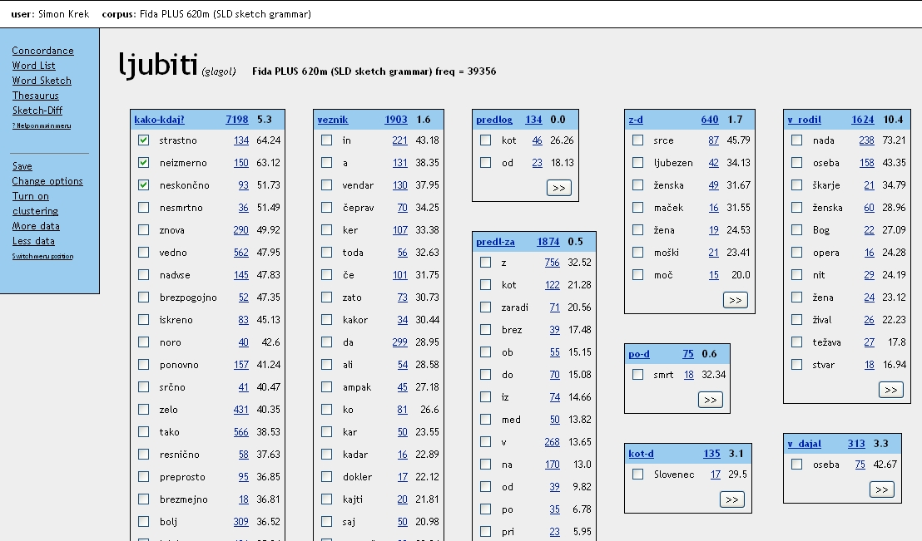
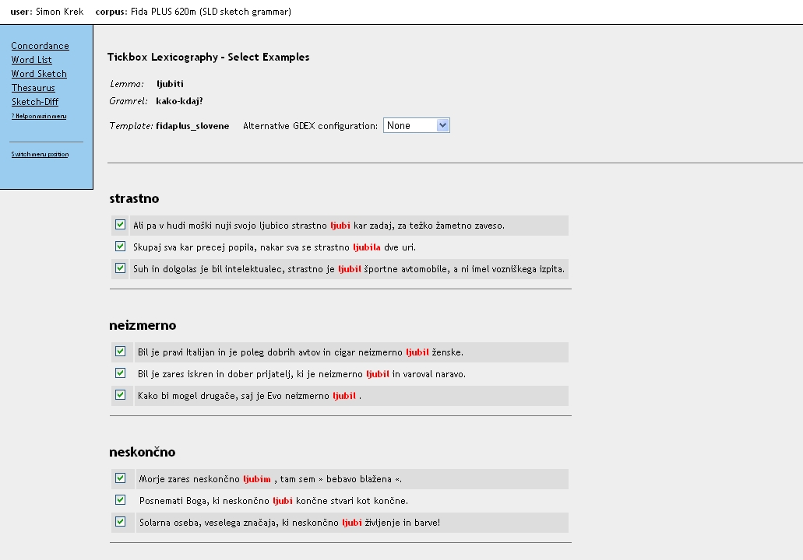
Sketch Engine (word sketch & GDEX)

Slide 14
computer
crowd-sourcing
lexicographer I
specialist
lexicographer
II
automatic data extraction + visualisation
data clean-up and sorting
sense division, definitions, compounds and phraseology
Terminology, pronunciation, tonality etymology
editing

Slide 15
Summary of happy about vs. unhappy about
Happy
Unhappy
Layered (hierarchical) organization of data
Automatic extraction
Crowdsourcing
“Corpus dementia”
“String of characters curse”
Automatic extraction (SkE) ☺
Dictionary writing systems (IDM DPS, iLex, TLex, later Lexonomy)

Slide 16
Now
Still not there but – quite a development!

Slide 17
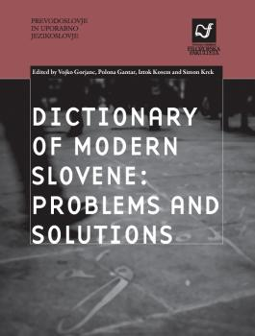
Dictionary of Modern Slovene: Problems and Solutions (2015-2018)
Vojko Gorjanc (ed), Polona Gantar (ed), Iztok Kosem (ed), Simon Krek (ed): Dictionary of Modern Slovene: Problems and Solutions
This monograph, containing 13 chapters, presents the compilation of a dictionary that utilizes different technologies available, and is conceptualised around language technologies, i.e. it uses state-of-the-art methods of language analysis, data extraction and data storage, and visualisation.

Slide 18
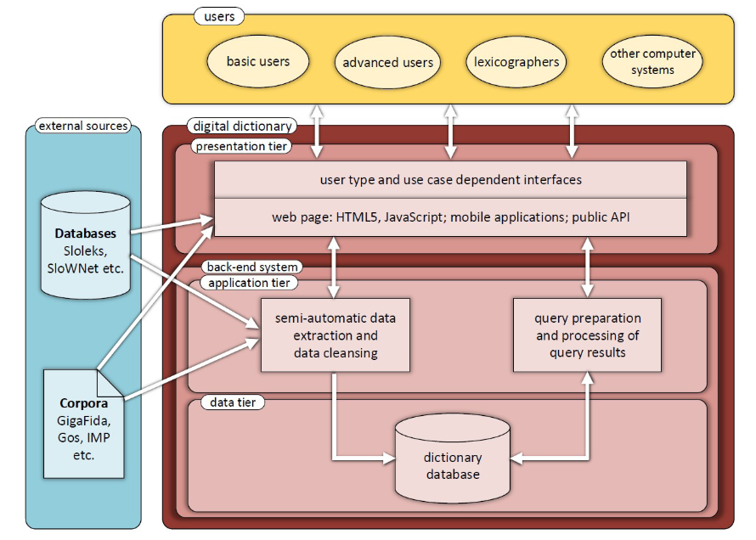
Data model (for all types of lexicographic data)
Dictionary of Modern Slovene: Problems and Solutions (monograph)
Bojan Klemenc, Marko Robnik-Šikonja, Luka Fürst, Ciril Bohak and Simon Krek: Technological Design of a State-of-the-art Digital Dictionary

Slide 19
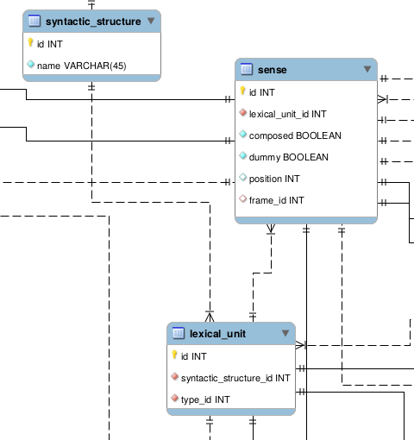
Digital Dictionary Database for Slovenian
Development of Slovene Language in Digital Environment (2020-2023)
Data model & data
Available through API service
Open Access (CC BY-SA)
In CLARIN.SI repository

Slide 20
Digital Dictionary Database Wiki
Wiki: https://wiki.cjvt.si/books/digital-dictionary-database
Application domain and data model
  Domain and data model links
  Domain overview
  Data model
REST API
  API design
  API routes
  API implementation
  API use cases

Slide 21
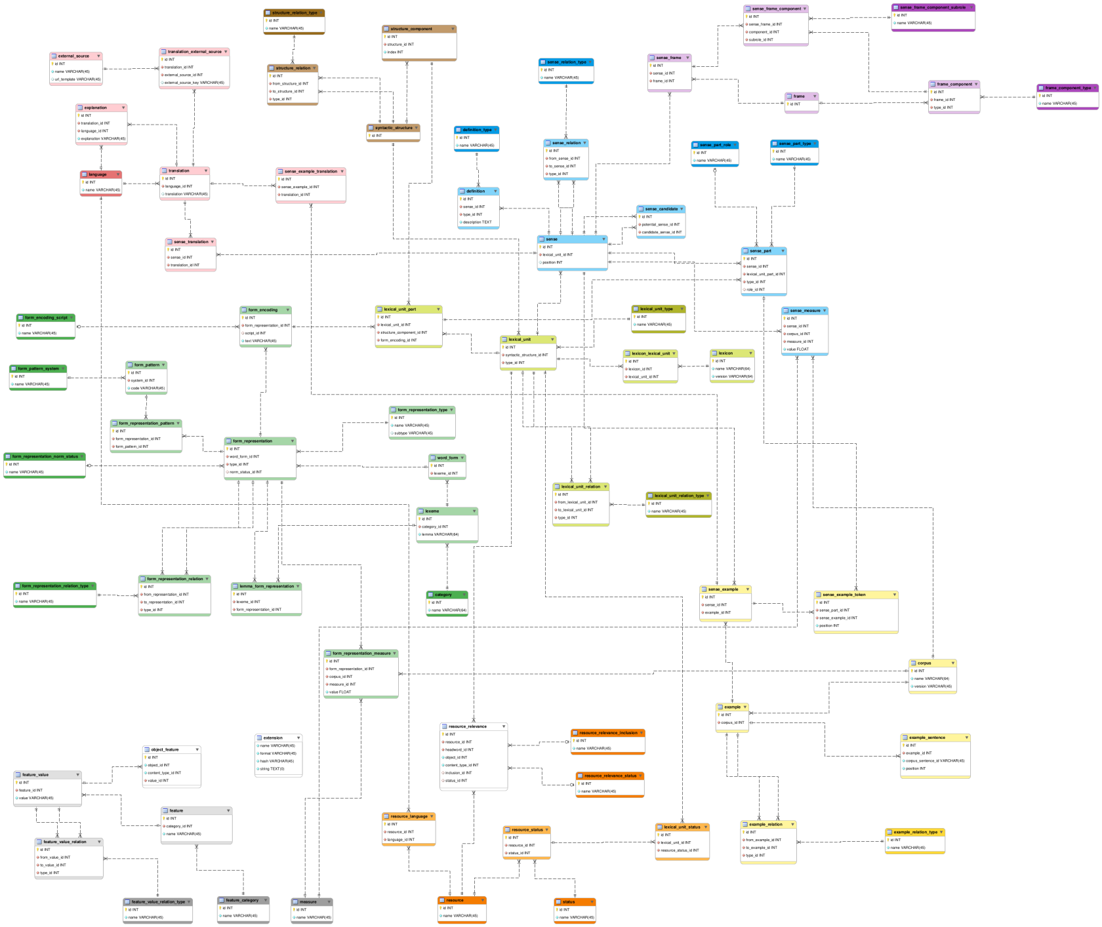
lexical units (olive green)
word forms (forest green)
syntactic structures (brown)
senses (blue)
sense frames (violet)
sense translations (red)
corpus examples (yellow)
resource connections (orange)
generic features (grey)
entity types that reference other entity types via meta-attributes (white)

Slide 22
Types of lexical units (of lexicographic interest)
TYPE | SUB-TYPES | EXAMPLE | HEADWORD
single_lexeme_unit | word - symbol | - jezik, graditi, lep, NUK, INZ, dr., npr. - %, :) (emoji) | YES
compound | - compound - contiguous - reflexive verb - phrasal verb | - okrogla miza, ad hoc, al dente, na prostem, biti mnenja - COVID-19, 1,2-dimetilbenzen, črno-bel - zdeti se, delati se - priti do, biti za | YES
phrase | - phrase | - vreči puško v koruzo, čez palec; križi in težave, od časa do časa, kapo dol, beseda je dala besedo, imeti krompir | YES
combination | - combination - contiguous - reflexive verb - phrasal verb | - šteti x pomladi, za vedno, na pamet, več kot, eden od - 64-biten, 3-leten - kregati se - skrbeti za, vstopiti v | NO
collocation | - collocation - extended | - [soboten, prijeten, filmski] večer, biti v pripravljenosti - [pripraviti, obiskati] filmski večer | NO

Slide 23
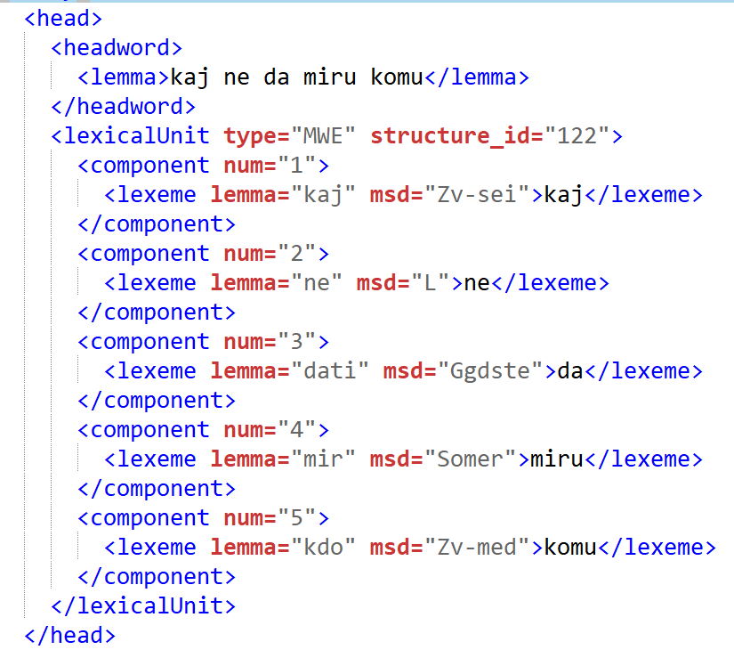
MWE (compound-phrase-collocation-combination)
Type: Multiword Expression
Syntactic structure: 122
Components: 5
Lexeme
  Lemma
  Morpho-syntactic description
  Word form
'something is bothering someone'

Slide 24
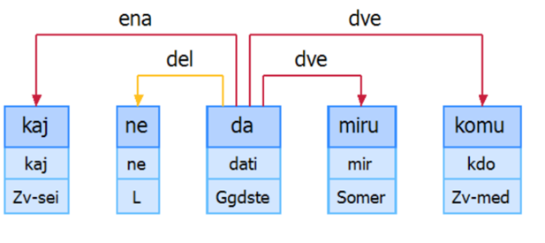
Information on syntactic structures
structure type – @type
human-readable code – @label
structure ID – @id
<syntactic_structure type="other" label="z-l-gg-s2-z" id="122">
'something is bothering someone'
pronoun (z-kaj)
particle
(l-ne)
main verb (gg-dati)
noun in genitive (s2-miru)
pronoun (z-komu)
kaj ne da miru komu

Slide 25
Definition of syntactic structures
(1) individual words or elements that form the MWE – »components«
(2) syntactic relations between the components – »dependencies«
(3) possible restrictions and other information which is needed to extract the MWE – »definition«
<components order="fixed">
<component cid="1" type="core" label="z"/>
<component cid="2" type="core" label="l"/>
<component cid="3" type="core" label="gg"/>
<component cid="4" type="core" label="s2"/>
<component cid="5" type="core" label="z"/>
</components>
<dependencies>
<dependency from="3" label="ena" to="1"/>
<dependency from="3" label="del" to="2"/>
<dependency from="#" label="modra" to="3"/>
<dependency from="3" label="dve" to="4"/>
<dependency from="3" label="dve" to="5"/>
</dependencies>
<definition>
<component cid="1">
<restriction type="morphology">
<feature POS="pronoun"/>
</restriction>
</component>

Slide 26
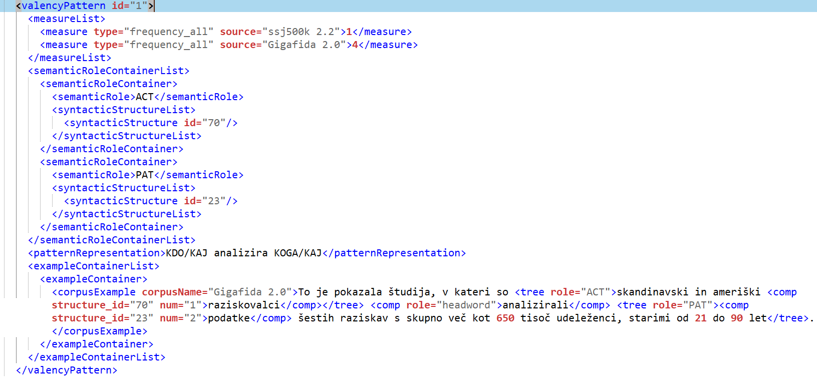
Semantic roles
PATTERN: “who ANALYSES what/whom”
Syntactic structure component
Dependency tree
COLLOCATION: “raziskovalci analizirajo podatke”

Slide 27
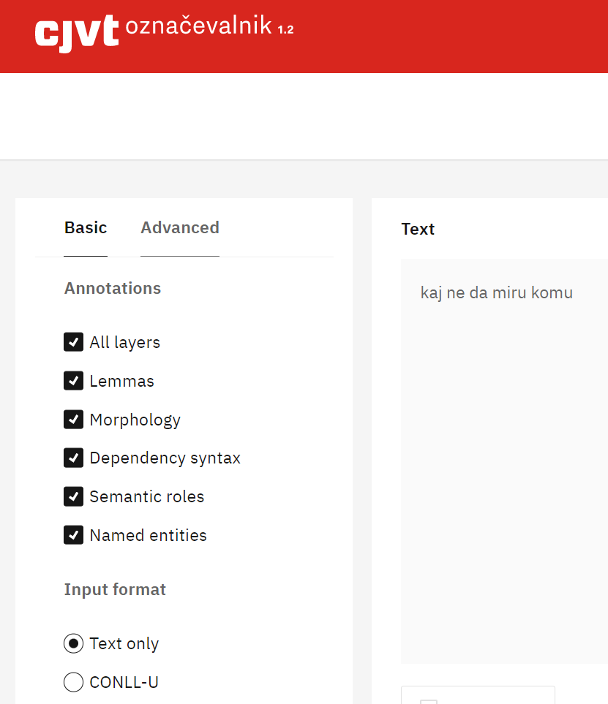
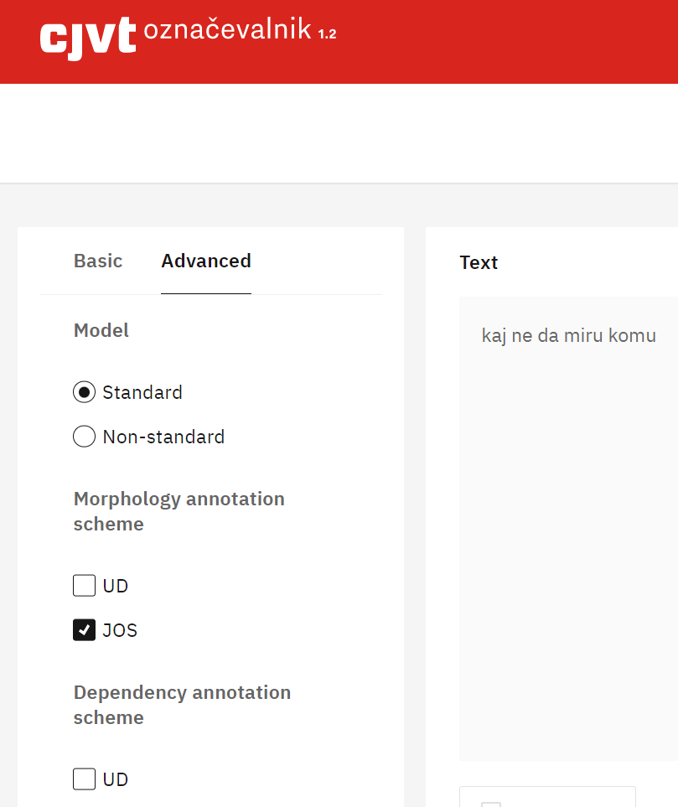
Corpus annotation levels
Universal Dependencies

Slide 28
Addressing the “unhappy” issues
“Corpus dementia”
“String of characters curse”
Automatic extraction (SkE)
Dictionary writing system
Extracted data have a direct link to the original source (with meta data)
All lexical units in DDDS have a defined structure with meta information (lemma, msd etc.)
In development (due in October)

Slide 29
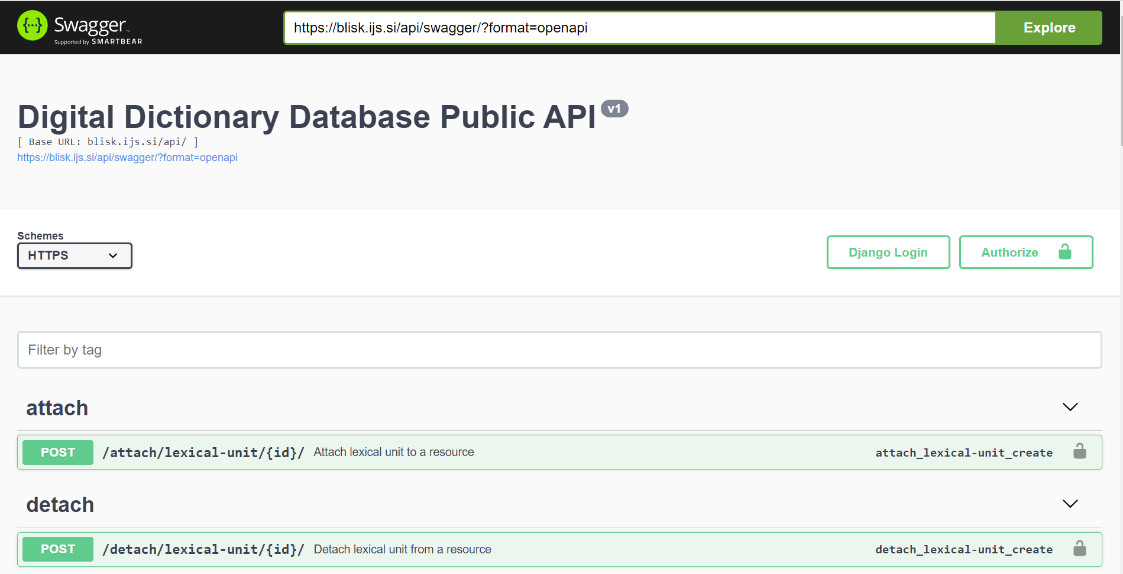
Public API

Slide 30
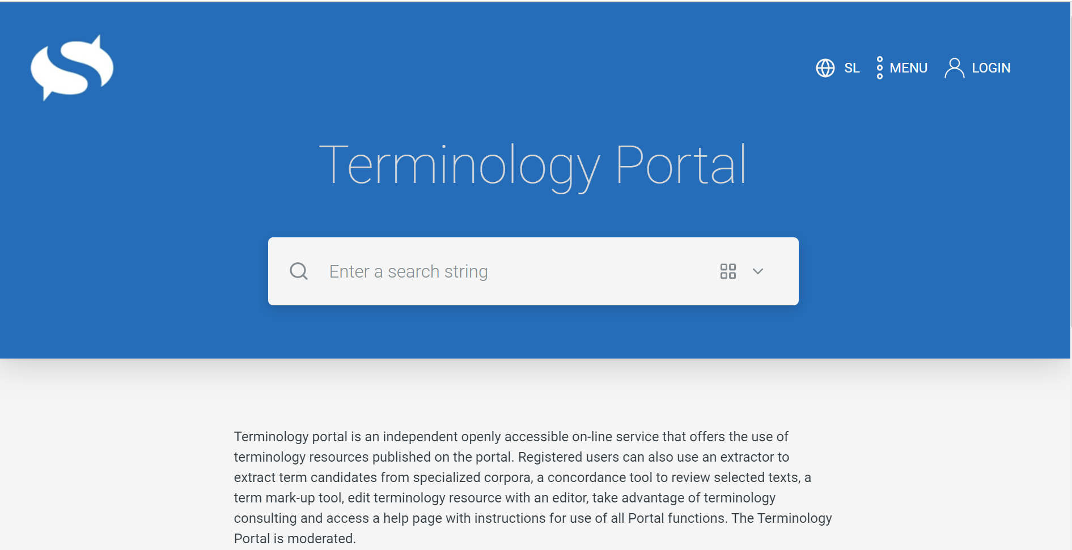
Use cases: Terminology portal & speech technology
In addition to providing general public access to the database, the REST API can also be used to integrate data and services with external organisations in a coordinated, structured and systematic way.
Two current examples of this are integration with terminology portals and speech technologies, both of which use a mix of public (read-only) and restricted (read-write) routes of the API.

Slide 31
DDDS API and Terminology portal
The portal uses API routes to register its dictionaries in the database, search and create terms, attach/detach them to/from the dictionaries, and fetch their forms and statuses. The API supports this as follows:
  Register the dictionary as a resource in the database
  Get IDs of terms in the database, creating them if necessary
  Get the word parts and their forms with statuses for a specific term
  Search for term candidates in the datasets (it does not create a lexical unit)
  Attach the lexical unit to a resource
  Detach the lexical unit from a resource

Slide 32
DDDS API and Online Notes
AUTOMATIC TRANSLATION OF LECTURES FROM SLOVENE TO OTHER LANGUAGES
The system uses API routes to preprocess text, search for different kinds of word forms, retrieve the forms of word and create new words along with their forms. The API supports this as follows:
  Parse a piece of Slovene text to get a sequence of tokens
  Search for a word form in the database
  Get all the forms of a given lexeme
  Create (if it does not yet exist) a lexeme in the database
    The API calls the Inflector tool, which generates full paradigms of different kinds of forms (orthography, accentuation, pronunciation), and then saves the new lexeme with its forms in the database

Slide 33
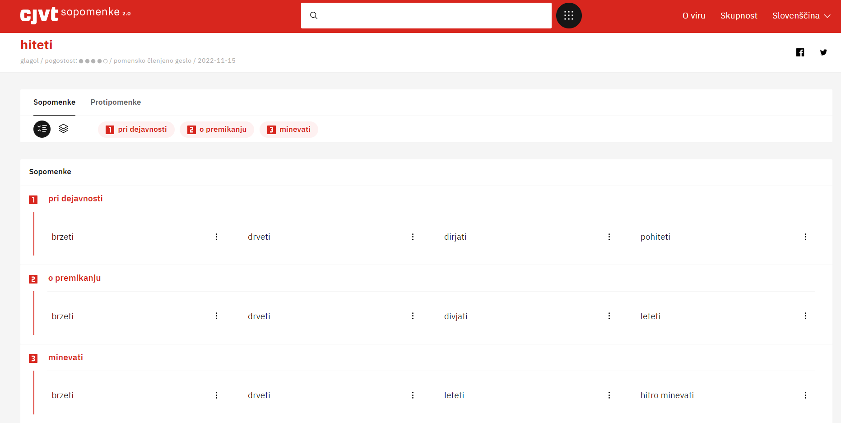
Thesaurus 2.0 (https://viri.cjvt.si/sopomenke-beta/slv/)
morphology
synonyms
antonyms
semantic indicators

Slide 34
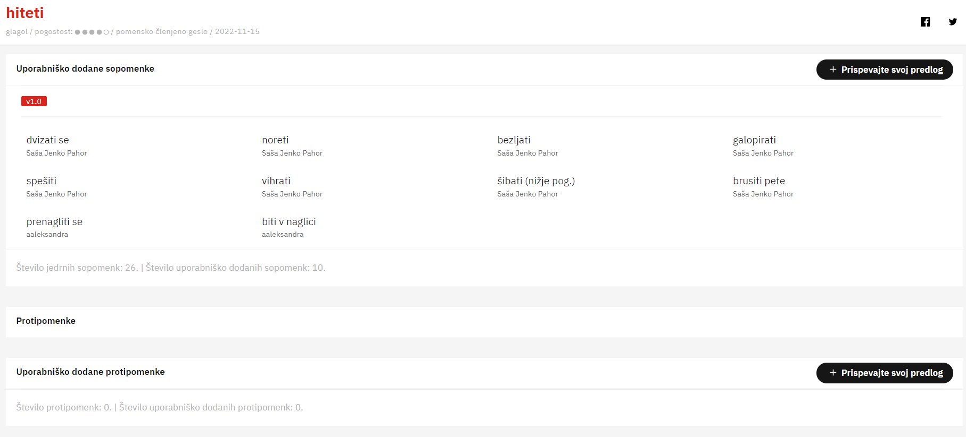
Thesaurus 2.0 (crowdsourcing from v1.0)
user-added synonyms
user-added antonyms

Slide 35
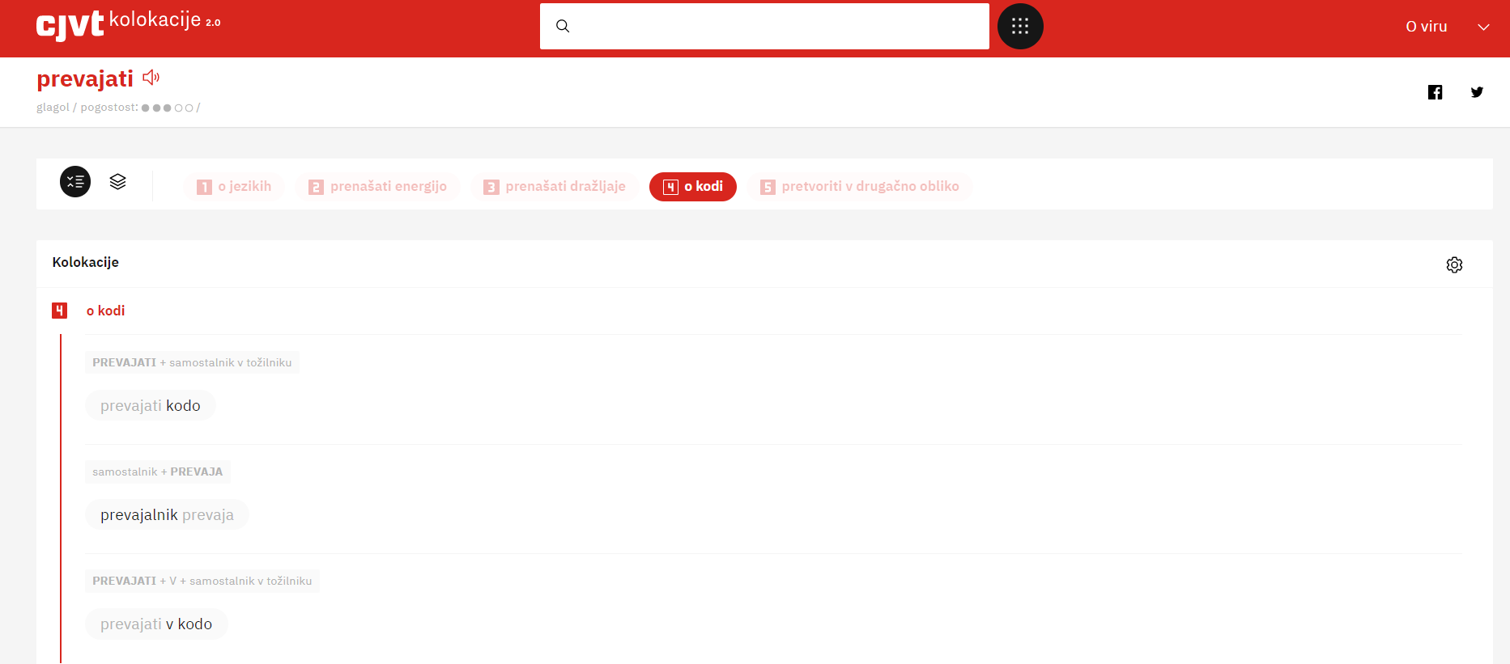
Collocation Dictionary 2.0

Slide 36
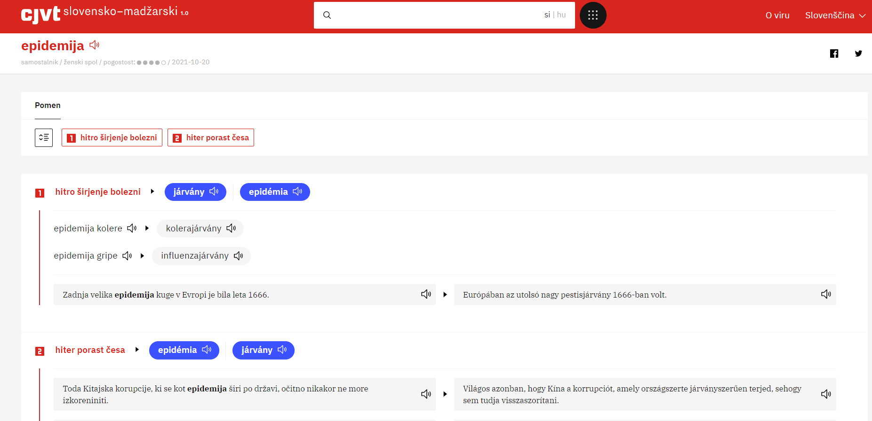
Comprehensive Slovenian-Hungarian 1.0

Slide 37
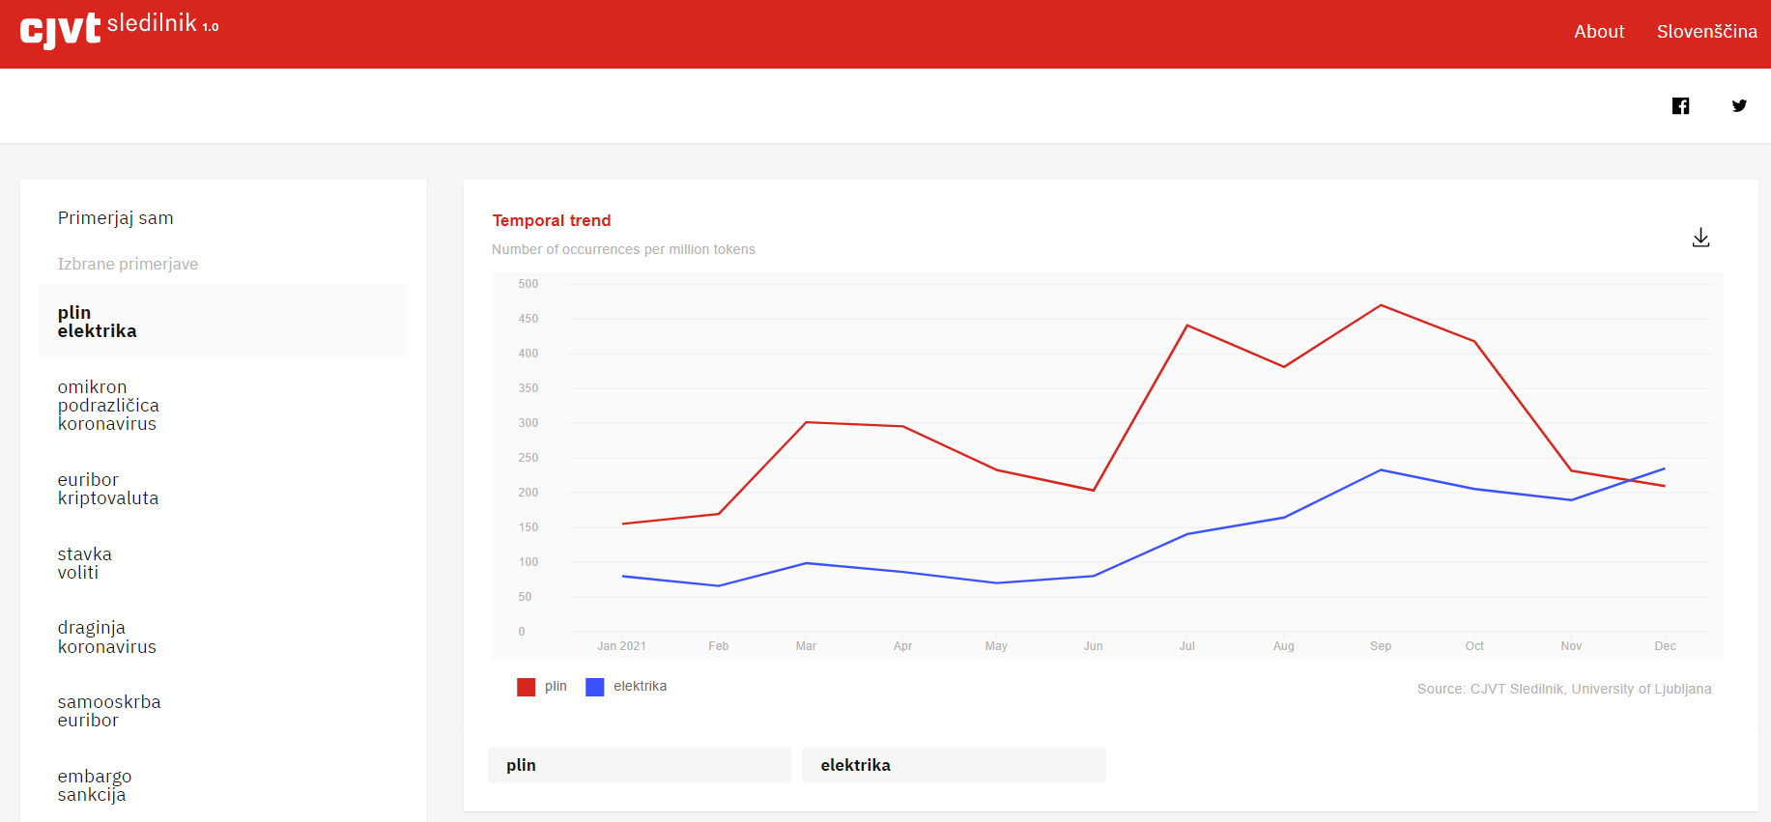
Where we are and what to do next (corpora)
We collect corpus data on a daily basis (150kW) and add data to corpus Trendi (monitor corpus) and Gigafida (reference corpus)
We can follow trends in vocabulary with Sledilnik (on the right)
We will be able to show a summary from different corpora in Korpusnik
Corpus annotation is ok (lemmatization 99.17, XPOS tagging 97.38, UPOS tagging to 98.69), next levels will be word sense induction and word sense disambiguation

Slide 38
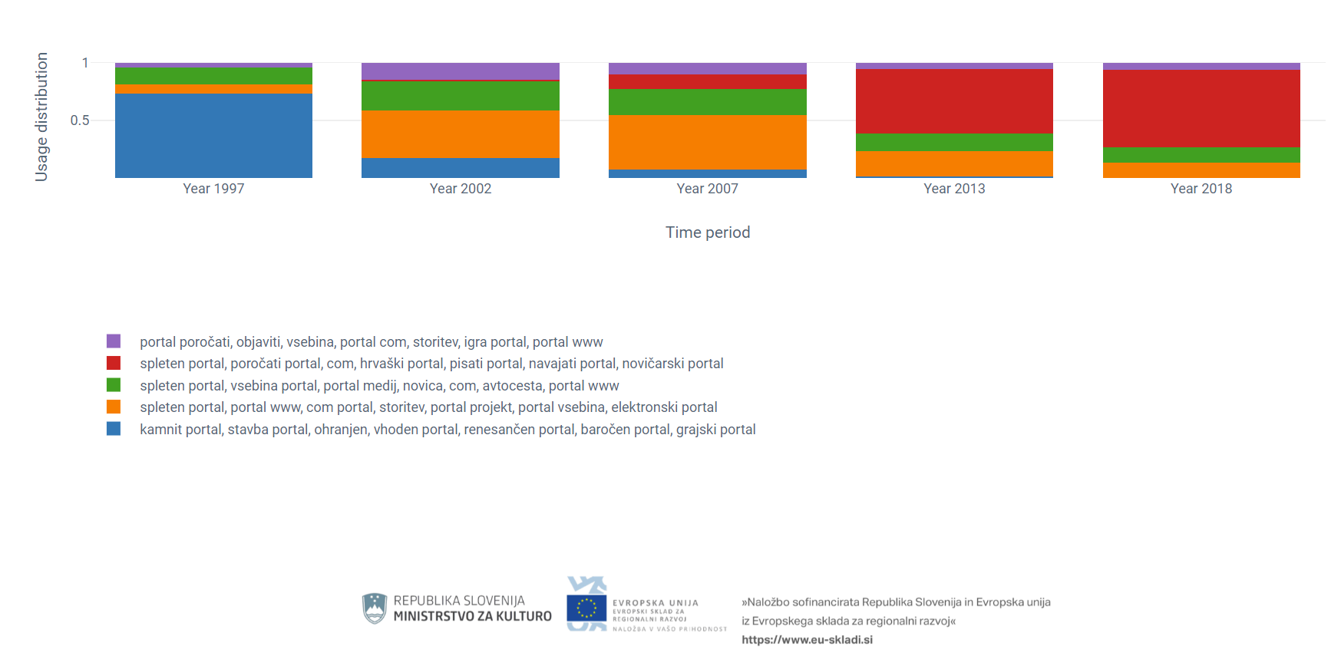
Semantic change for „portal“

Slide 39
Where we are and what to do next (DDDS)
One portal for (the visualization of) core data in DDDS (end of 2023)
Acquisition of 30 bilingual dictionaries and encyclopedias in the RSDO project – data import by summer 2023 (through the conversion to DMLex!), adding ≈25 language (including Latin, Romani etc.)
Much needed online DWS (end of October 2023)
Intense experiments with LLMs - ChatGPT, GPT-4 – generating definitions, sense structure, entire dictionary entries (Round table at eLex in Brno)

Slide 40
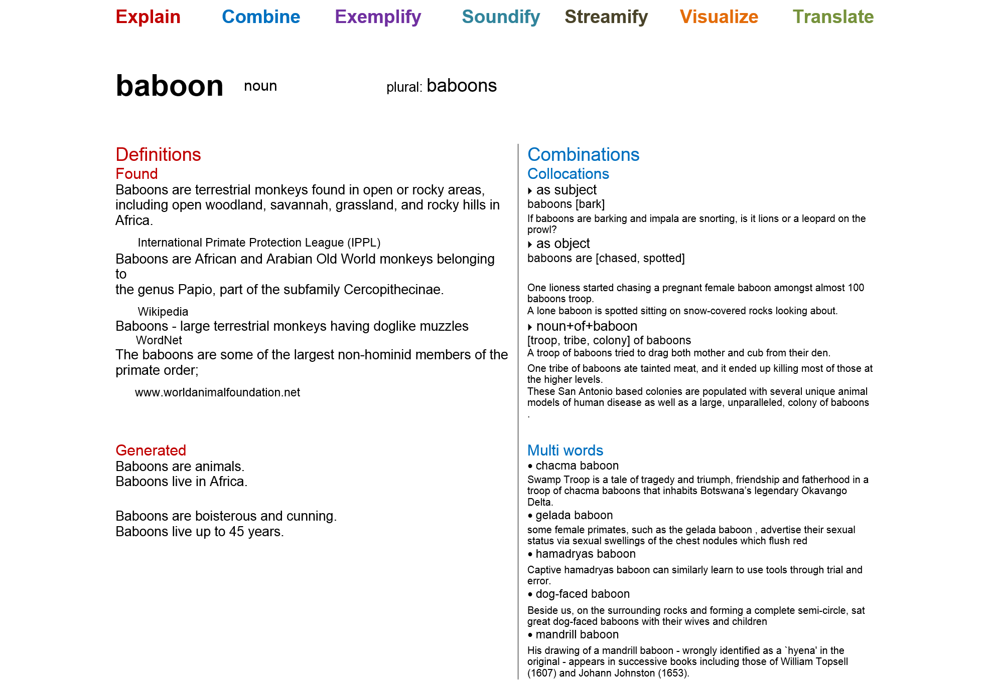
ACDC (2014 slide)
Definitions found – def extraction
Generated definitions – NL generation

Slide 41
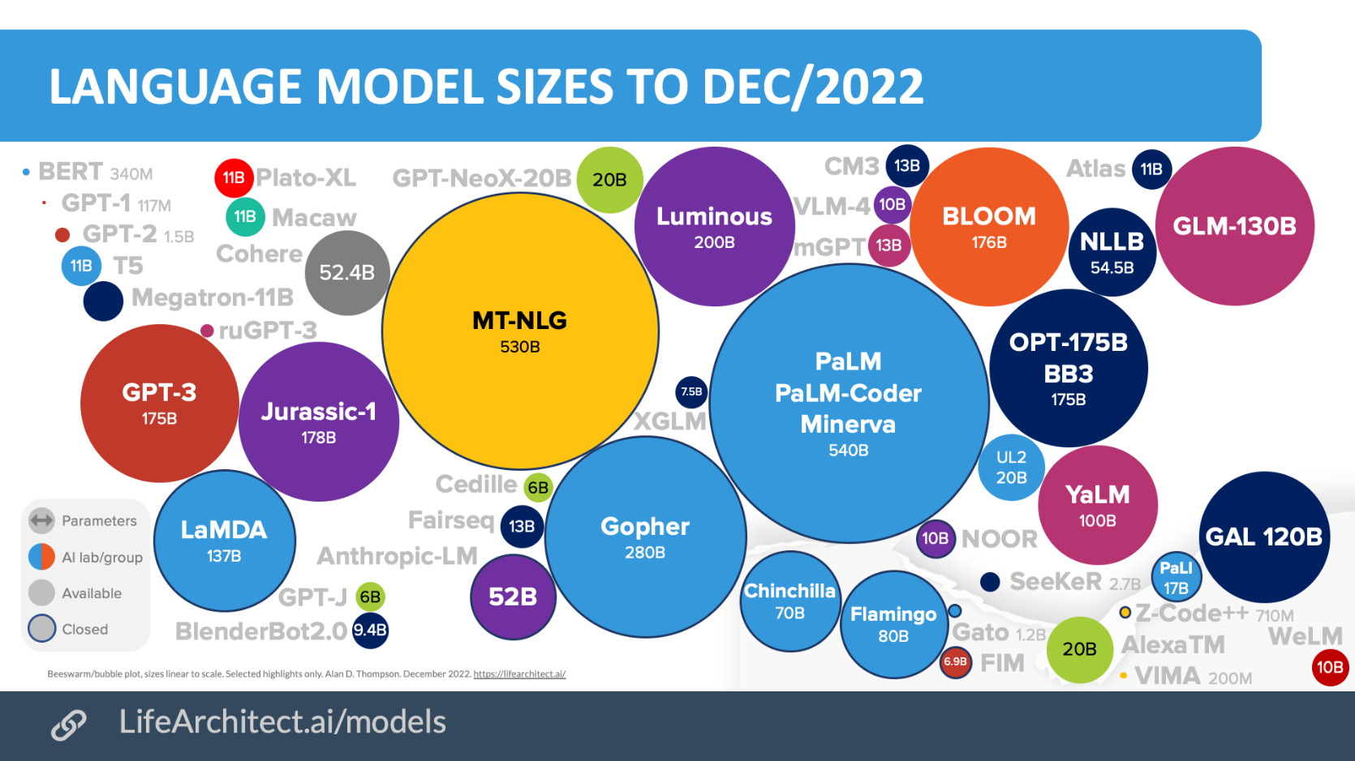
Where we are and what to do next (lexicography)

Slide 42
Thank you
simon.krek@ijs.si

