Slide 1
Building a language:
applying the traceback method to Estonian-English bilingual 2-year-old’s data
Piret Baird
Tallinn University
pbaird@tlu.ee

Slide 2
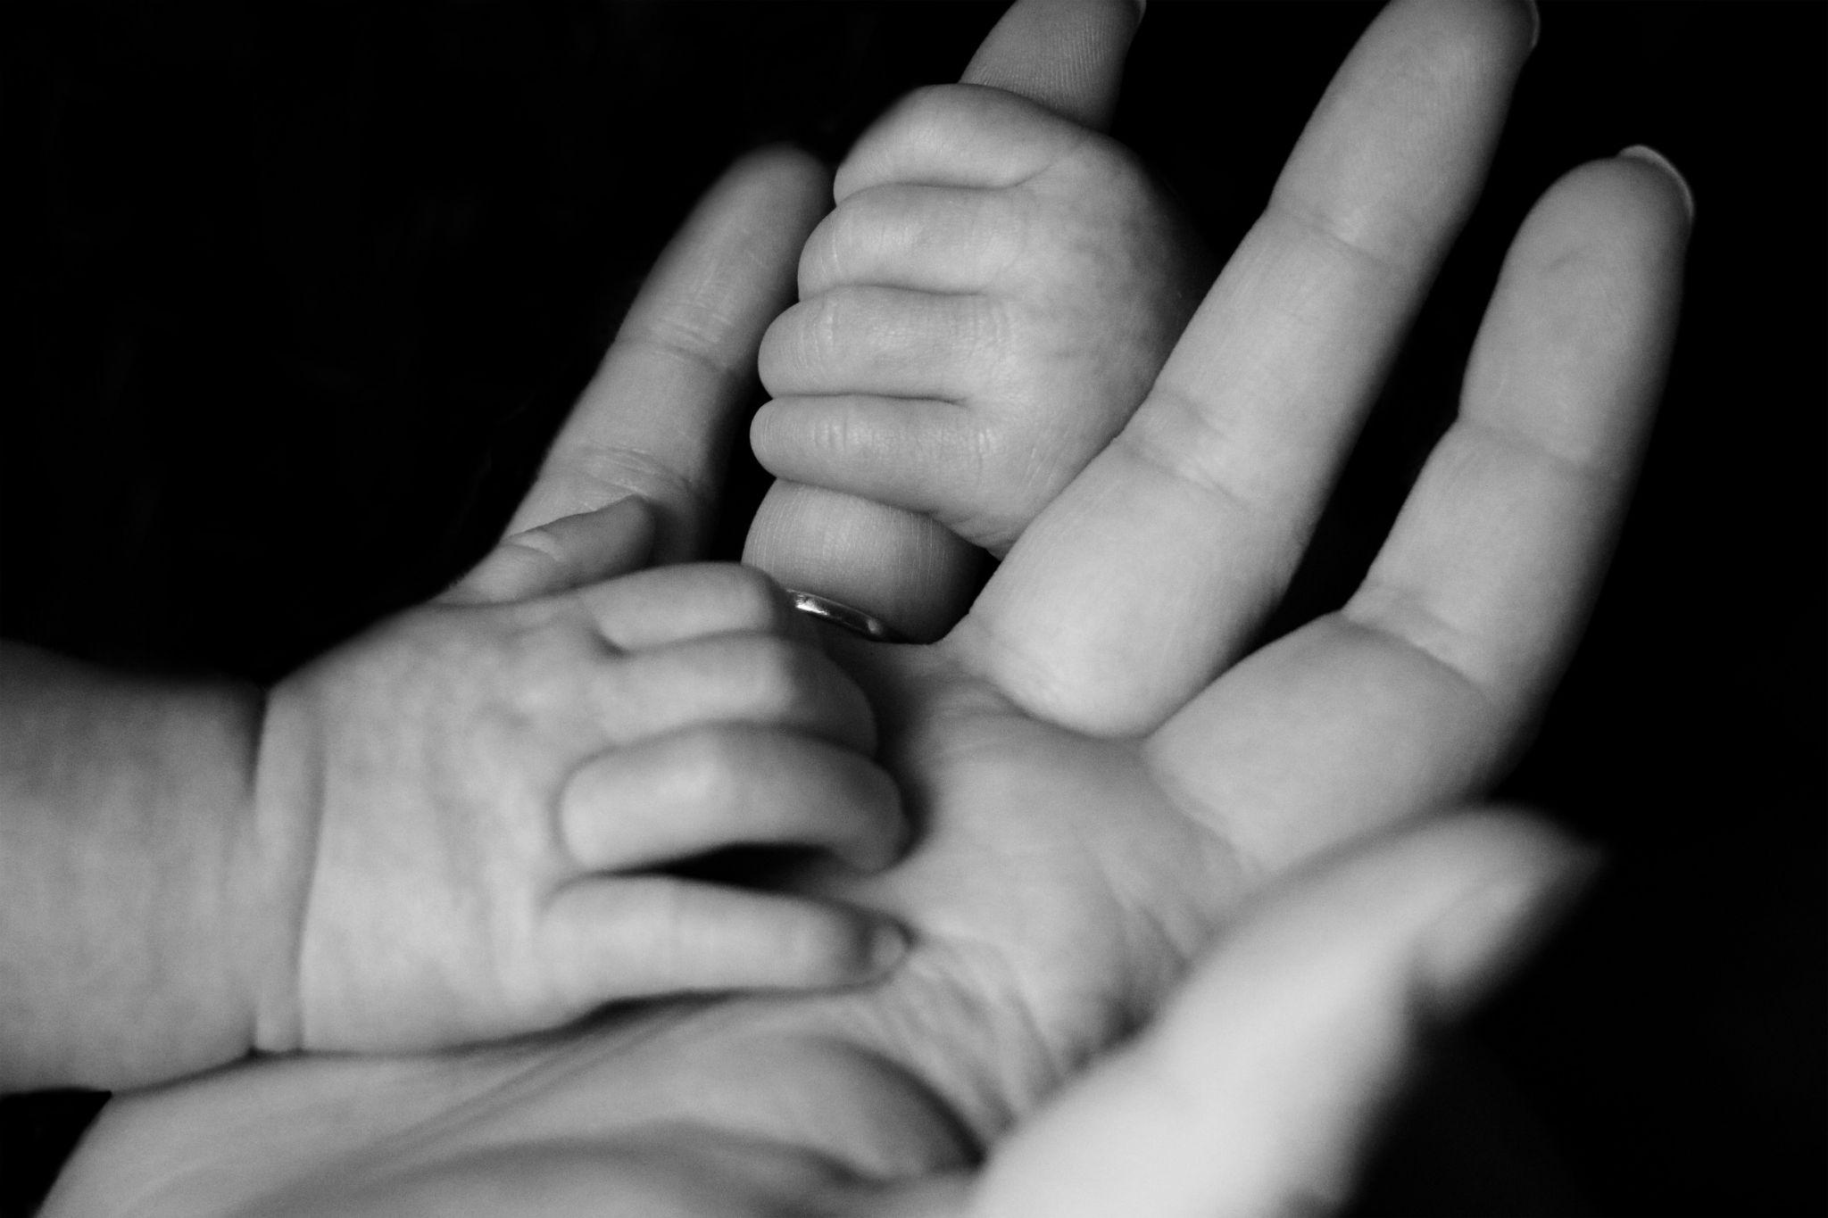
Usage-based theory and language acquisition
“Poverty of stimulus” challenged
Experience
Child-directed speech is repetitive
Entrenchement of constructions
Piecemeal fashion
Frozen chunks
Partially schematic constructions
Abstract constructions
Importance of frame-and-slot patterns

Slide 3
Research questions
1) What proportion of code-mixed utterances can be accounted for with the help of constructional patterns found in the child’s monolingual data and in the caregiver’s input?
2) To what extent do the patterns in the child’s output overlap with patterns attested in the input?
3) Which constructions in both languages attract code-mixing?

Slide 4
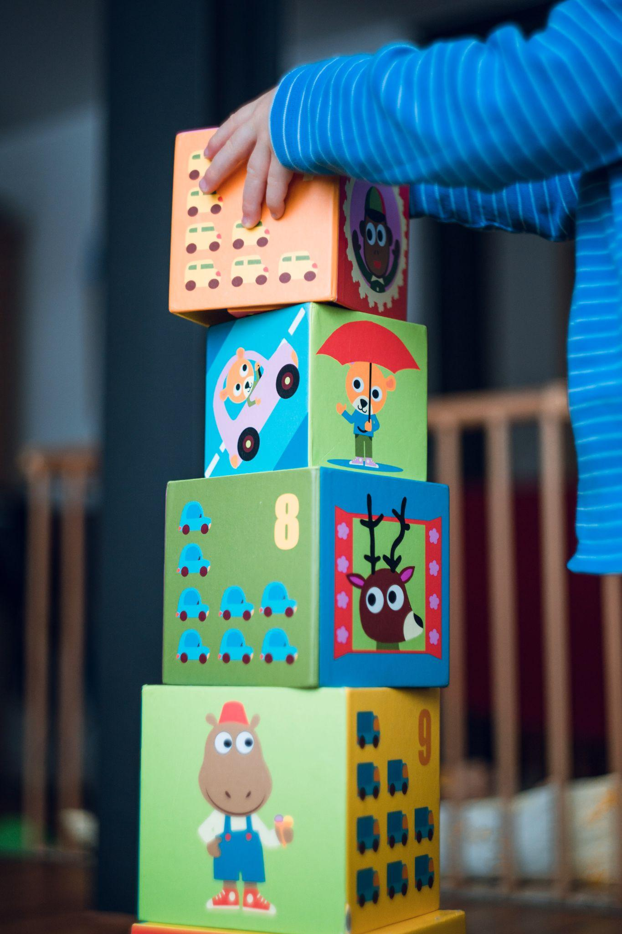
Data and the participant
46 h of data was collected
Spontaneous speech during play and snack times
2;3-2;11
Estonian and English
Languages separated by day
Occasionally older siblings also present

Slide 5
Traceback method
Verbatim match?
Frame and slot pattern, twice
Target utterance: mina ei taha cornflakes’e ‘I do not want cornflakes’
__ ei taha cornflakes’e
mina __ taha cornflakes’e
mina ei __ cornflakes’e
mina ei __
__ taha cornflakes’e
mina __ cornflakes’e
The slot filler has to be attested twice in the main corpus
Longest consecutive strings are preferred
Goal: child’s utterances are related to his/caregiver’s previous utterances
Developed by Lieven, Behrens, Spears & Tomasello (2003) and Dabrowska & Lieven (2005)
Test and main corpus
Computational implementation (followed Quick & Hartmann 2021)

Slide 6

Analyses
3 analyses:
Child’s CM utterances traced back to her own monolingual data
Child’s CM utterances traced back to caregiver’s data
All of the child’s utterances traced back to caregiver’s data

Slide 7
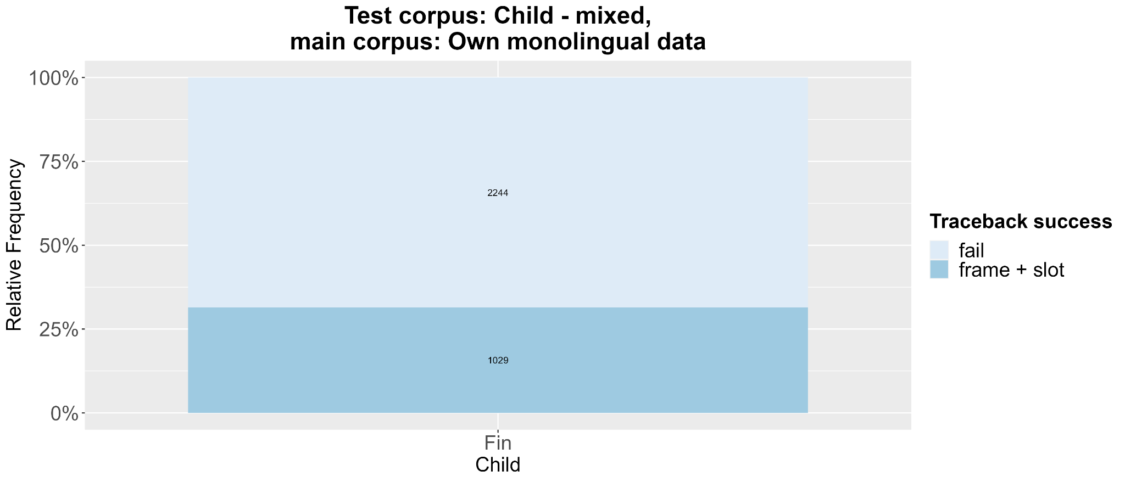
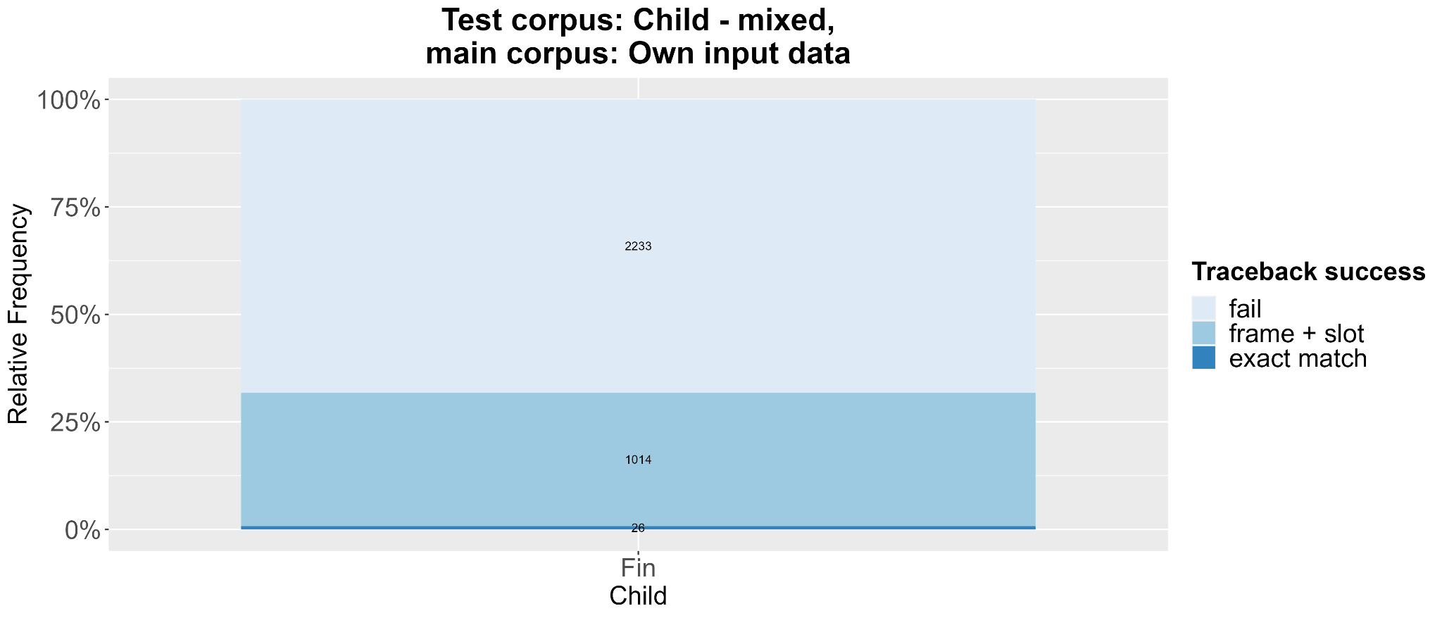
Results 1

Slide 8
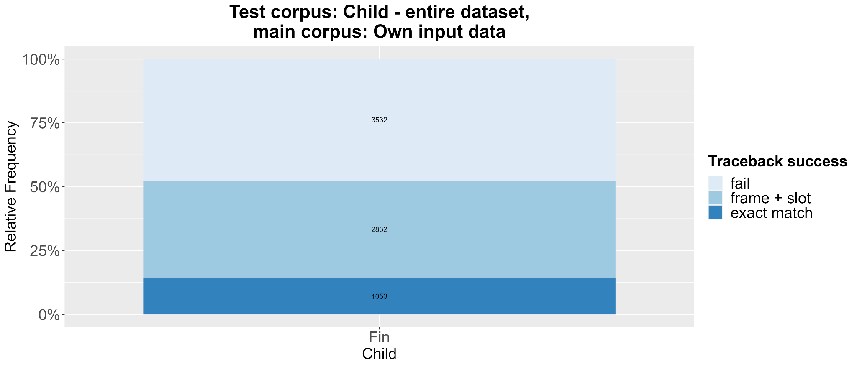
Results 2

Slide 9
Most frequent frames
Frames | Frequency
___ emme (‘___ mommy’) | 117
See on ___ (‘It is ____’) | 35
Emme ___ (‘Mommy ___’) | 29
___ look | 25
Emme ___ emme (‘mommy ___ mommy’) | 16
Siin on ___ (‘Here is ___’) | 16
___ issi (‘___ daddy’) | 16
___ siin (‘___ here’) | 13
Where is ___ | 11

Slide 10
Discussion
Traceback method can be applied to Estonian-English bilingual speech as approx ⅓ of CM utterances could be traced back
The effect of flexible word order unclear
Tantti miss’ib also two ‘Tantti misses also two’
emme miss’ib kaks also ‘mommy misses two also’
Child relies on partially schematic units in her speech

Slide 11
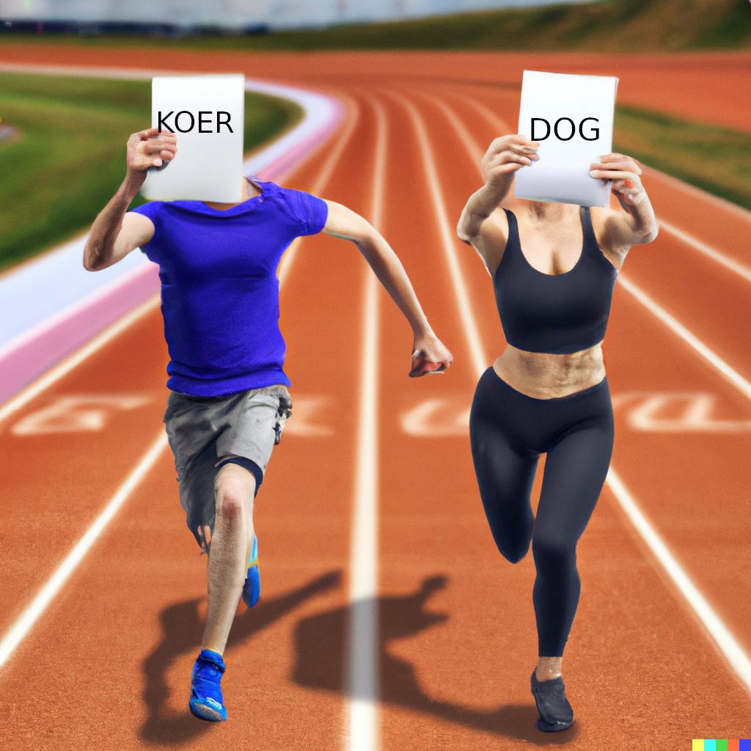
Discussion 2
Entrenchment and competing for selection
Input effects
Input balance reflected in language distribution of frames (246 est, 225 eng)
Few bilingual frames (17), no phonological proximity
X on also ‘X is also’
X want see ‘X want this’
me tahtsin X ‘me wanted X’
Generated by DALL E 2

Slide 12
References
Dabrowska, Ewa & Elena Lieven. 2005. Towards a lexically specific grammar of children’s question constructions. Cognitive Linguistics 16(3). https://doi.org/10.1515/cogl.2005.16.3.437.
Lieven, Elena, Heike Behrens, Jennifer Speares & Michael Tomasello. 2003. Early syntactic creativity: a usage-based approach. Journal of Child Language 30(2), 333–370. https://doi.org/10.1017/S0305000903005592.
Quick, Antje Endesfelder & Stefan Hartmann. 2021. The Building Blocks of Child Bilingual Code-Mixing: A Cross-Corpus Traceback Approach. Frontiers in Psychology 12. 682838. https://doi.org/10.3389/fpsyg.2021.682838.

Slide 13
Thank you for listening!

