Slide 1
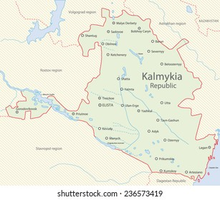
Local Russian in Kalmykia and mixed Kalmyk
Vlada Baranova (Helsinki Collegium for Advanced Studies), vlada.baranova@helsinki.fi
20. rakenduslingvistika kevadkonverents 2023 / 20th Annual Conference of Applied Linguistics 2023, 27-28 Apr. 2023

Slide 2
Background: language shift
Kalmyk or Oirat (Mongolic) broke off its contact with the rest of the Mongolic languages in the early 17th century
An increase in bilingualism and language shift to Russian during the 29th century
Kalmyk is a ‘definitely endangered language’, according to UNESCO (Moseley, 2010).
Since 1990s, there has been a revitalization movement in Kalmykia. In 2010^{ts} it became very popular among young Kalmyk

Slide 3
the speakers with different competences
the older generation (1920-1940s) are fluent in Kalmyk but their Russian has many peculiarities;
the people born in the 1950-1980s with different levels of Kalmyk but with perfect knowledge of Russian
the youth are mostly a Russian-speaking generation, but some of them have learnt Kalmyk as ‘new speakers’.
Data: interviews with speakers in Kalmyk and Russian, the mixed Kalmyk-Russian code in stand-up comedy, other online sources (blogs, videos), observations

Slide 4
aim and data
It relatively little attention has been paid to the mutual influence of languages in contact
to describe a parallel change in Kalmyk and local Russian within the bilingual community
- elicited data (questionnaires) and spontaneous conversations in Kalmyk
the parallel texts in Kalmyk and Russian collected from Kalmyk-Russian bilinguals in the rural part of the Republic of Kalmykia (2018-2019).

Slide 5
Local Russian in the Republic of Kalmykia. The case of noun reduplication
M-reduplication as the strategy of expressing the associative plurality (Stolz 2008: 116–120)
In Kalmyk, any word can be reduplicated with replacing the initial consonants
(1) tiimǝ xudǝl-mudǝl gi-ʁäd kel-ǯä-nä (Kalmyk)
such lie say-cvb.ant say-prog-prs
‘(He) tells a number of untruths’.

Slide 6
Russian in Kalmykia
(2) Мы все вот это яйца, копейки-мопейки, деньги-меньги, все забираем и идем в магазин
My vse vot jeto jajca, kopejki-mopejki, den'gi-men'gi, vse zabiraem i idem v magazin
‘We take all these things, eggs, coins, money and so on and go to the shop’
(3) Париж-мариж — везде
Parizh-marizh — vezde
‘Paris and everywhere’

Slide 7
Evidentiality
The grammaticalized marker -ǯə expressing mirativity in Kalmyk (Skribnik, Seesing 2016) or evidentiality (Brosig, Skribnik 2018).
Standard Russian: only lexical way of expressing mirativity and other evidential meaning, lack of inflectionally marked evidentiality
Russian in Kalmykia:
The constructed form okazyssa/ < okazyvaetsya ‘it turns out’
(4) У нее был туберкулез, оказысса. Никто не знал.
‘She had tuberculosis. No one knew’
the evidential meaning becomes obligatory in local Kalmyk Russian (Baranova 2021) .

Slide 8
Grammatical borrowings from Russian to Kalmyk
MAT-borrowing vs. pattern-borrowing (Matras, Sakel 2007), or pattern replication ((Matras, Sakel 2007b), or grammatical replication in (Heine, Kuteva 2005).
MAT: the transfer of Russian modal particles and adversative conjunctions
(5) gem uga no tüün-ä ömnǝ bol-xlagǝ madǝn oda ter tendǝ av-č od-sǝn
problem NEG but that-GEN in.front.of become-CV.SUCC 1 PL now take-CV.IPFV go.out-PC.PST
‘(I) worked without problem but then we moved here’.

Slide 9
Coping of Russian pattern or internal grammaticalization
Two examples of linking devices in the beginning of the subordinate clause
the marker kemər ‘if’
(6) kemər bürkəg ödr-igə söö-d tool-xla, sön^{j} olən bol-ǯ ʁar-na
if claudy day-acc night-dat count-cvb.succ night many become-cvb.ipfv go.out-prs
‘If you take cloudy days for nights, then there are more nights.’.
The marker kemər is not very frequent (N=174 in NCK)

Slide 10
New speakers
baldyr usually refers to people with mixed ancestry, from Kalmyk-Russian marriage, ‘not pure Kalmyk’, and ‘mixed language’
Cf.: euskaldunberri ‘new speaker of Basque’ (Urla 2012)
‘new speakers’: the non-family transmission
the speech of new speakers can be defined as a “non-authentic” (McLeod & O’Rourke 2015) or as a “criticized and delegitimized” variant (Sallabank and Marquis 2018).

Slide 11
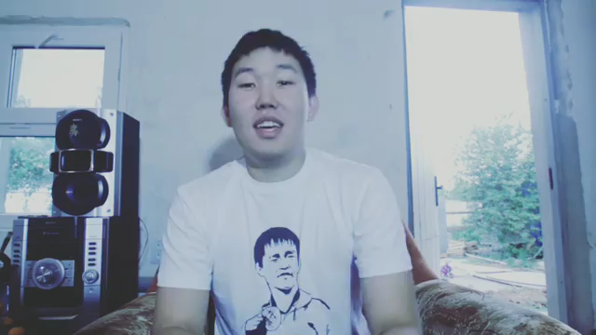

Slide 12
Mendut kün-tä mana üür-müd, kün-tä mana podpisčik-mud!
hallo man-assoc 1pl friend- pl man-assoc 1pl follower-pl
endər jir sääxn, ofigitelnyj endər bol-ǯa-na.
today very beauty fucking today become-prog-prs
Juŋgad gi-xlä mini sosed Viit^{j}ä šin maši-ʁar xul-ǯ av-na-v.
why say-cvb.succ my neighbor (name) new car-ins buy-cvb.ipf take-prs-3sg
O, jo! bi šud nevčkən zavidu-ju gi-nä.
Oh 1sg just few envy-1sg say-prs
Po sovkhoz-u šud narən-carən jov-ad, nado – ne nado – ezd-it, gi-nä.
on sovkhoz-dat just back.and.forth go-cvb.ant need neg need drive-3sg say-prs
‘Hello, all my friends, all my followers! Today is a nice, smashing day because my neighbor Vitya has bought a new car. Oh! I really am a bit envious, (I) say. He is driving around the state-owned farm (i.e. the village) back and forth, (regardless of) whether he needs or not (they) say’.

Slide 13
Conclusion & discussion
The local variety of Russian uses the Russian peripherical model for regular (and, possibly, obligatory) expressing the category of mirativity and kind of plurality
language contact at the grammatical level follows patterns of grammaticalization similar to those in language-internal changes (Heine, Kuteva 2005), see the complex predicate in Kalmyk
‘Mixed Kalmyk’ of young generation. The age and the non-family transmission among new speakers do not prevent them from acquiring fluency but their Kalmyk has some peculiarities.
They insist on possibility to speak as they can and even intentionally use mixed Kalmyk-Russian code (so-called baldyr language) in stand-up comedy, films, blogs.

Slide 14
Heine, Bernd & Kuteva, Tania. 2005. Language Contact and grammatical change. Cambridge: Cambridge University Press.
Matras, Y., & Sakel, J. (2007). Investigating the mechanisms of pattern replication in language convergence. Studies in Language, 31(4), 829–865
Matras, Y., Sakel J (2007) Grammatical borrowing in cross-linguistic perspective. Berlin.
O’Rourke, B. and Nandi, A. (2019). New speaker parents as grassroots policy makers in contemporary Galicia: Ideologies, management and practices. Language Policy 18, 493-511.
Sallabank, J., Marquis, Y. (2018) 'We don't say it like that': Language ownership and (de)legitimising the new speaker. In C. Smith-Christmas Smith-Christmas, N. Ó Murchadha, M. Hornsby and M. Moriarty (eds). New Speakers of Minority Languages. Linguistic Ideologies and Practices (pp. 67-90). London: Palgrave Macmillan.
Skribnik O. & Seesing E. Evidentiality in Kalmyk. Grammar of Knowledge: A Cross-Linguistic Typology / ed. by A. Y. Aikhenvald, R. M.W. Dixon. Oxford: Oxford University Press, 2016, pp. 148–170.
Stolz Th. Total reduplication vs. echo-word formation in language contact situations. Language Contact and Contact Languages / ed. by P. Siemund, N. Kintana. John Benjamins, 2008, pp. 107–132.
Urla, J. (2012) Reclaiming Basque. Language, nation, and cultural activism. Las Vegas: University of Nevada Press.

