Slide 1
Constructions, constructicons and constructicography Benjamin Lyngfelt, University of Gothenburg
21. Rakenduslingvistika kevadkonverents, Tallinn, April 19th, 2024

Slide 2
Menu
Starter: Constructions and constructicons
Main course: Constructicography: how do you build a constructicon?
Dessert (?): Multilingual constructicography

Slide 3
Starter: Constructions and constructicons

Slide 4
The traditional ”grammar + dictionary” model of language
≈ ’a system of general rules’
Grammar
Lexicon
≈ ’a set of individual items’

Slide 5
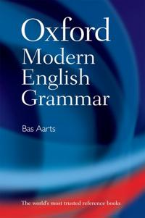

The traditional ”grammar + dictionary” model of language
’a system of general rules’
Grammar
Lexicon
’a set of individual items’

Slide 6
The traditional ”grammar + dictionary” model of language
’a system of general rules’
But what do we do with patterns that are too specific to be considered general rules, but too general to be tied to individual words?
?
’a set of individual items’

Slide 7
Phenomena ”between grammar and lexicon”
Rate constructions: 50 miles an hour; 3000 dollars a month; 20 euros a head; three times a day/week/year; etc.
Comparative correlative (the X-er the Y-er): the more the merrier; the bigger they come, the harder they fall; etc.
X as a Y: hungry as a wolf, red as a beetroot; fast as a shark; light as a feather; etc.
X by X: step by step; day by day; piece by piece; etc.
The emissions were measured car by car
A dictionary may capture the lexicalized instances of a construction, but hardly its productivity

Slide 8
The constructiconist model of language
(Grammar)
Constructicon
(Lexicon)

Slide 9
The constructiconist model of language
”The totality of our knowledge of language is captured by a net-work of constructions: a ‘construct-i-con’.” (Goldberg 2003:219; cf. Fillmore 1988)
Constructions are defined to be conventional, learned form-function pairings at varying levels of abstraction and complexity” (Goldberg, 2013:17)
words, idioms, clausal and phrasal patterns, partially schematic structures, etc.
Cf. the definition of construction in the Oxford English Dictionary: “The syntactical connection between verbs and their objects or complements, adjectives and their extensions, prepositions and objects, etc.”

Slide 10
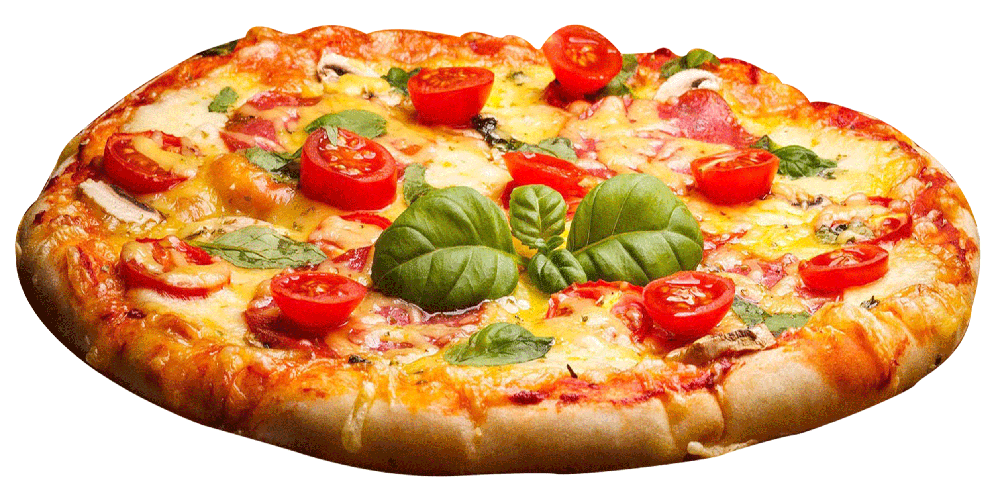
Constructions: ‘conventional pairings of form and meaning/function’
English caused motion construction
pizza
Pat loaded hay onto the truck
Frank squeezed the ball through the crack
She helped him into the car
She sneezed the foam off the cappuccino
The audience laughed the poor guy off the stage
(cf. Goldberg 1995)
Subject | Verb | Object | Oblique
Cause | cause-move | Theme | Goal

Slide 11
Constructicon in theory och practice
In constructionist theory:
a network of constructions, comprising the entire lexicogrammar of a language – a mental constructicon
In applied practice, constructicography:
the goal: a corresponding linguistic resource – a reference constructicon
current reality: a systematic (online) collection of construction descriptions
a tool for linguistic, computational and/or pedagogic purposes

Slide 12
Main course: Constructicography: how do you build a constructicon?

Slide 13
Foundational issues for constructicon builders
some
Points of departure
Purpose: NLP application or human users? For experts or laymen?
Autonomy: Autonomous or integrated with other resources?
Scope and focus: Which constructions should be covered?
Heuristics: identifying relevant constructions
Design issues
Naming and identification
Organization
Description format
Categorization and variation

Slide 14
Purpose of the constructicon
NLP application (Brazilian Portuguese; Hungarian; Fluid CxG)
requires precise, formalized representation
Foreign language education (Russian)
has to be user-friendly
Multi-purpose resource (Swedish)
catering to linguistics, language technology and L2 pedagogy
requires compromise; cannot be ideally suited for either purpose
not everything has to be displayed in the user interface
applications to pedagogy and language technology are external
dual representation: basic and extended mode

Slide 15
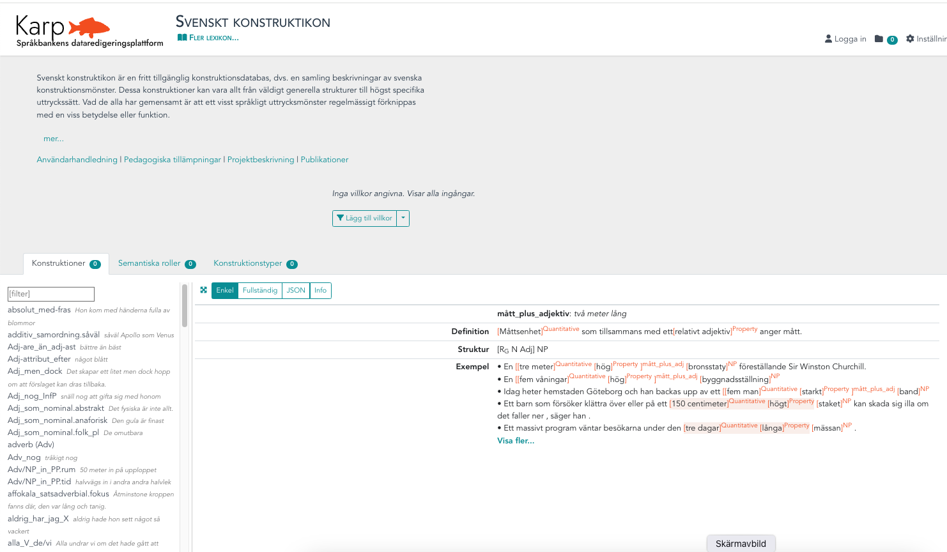

Slide 16
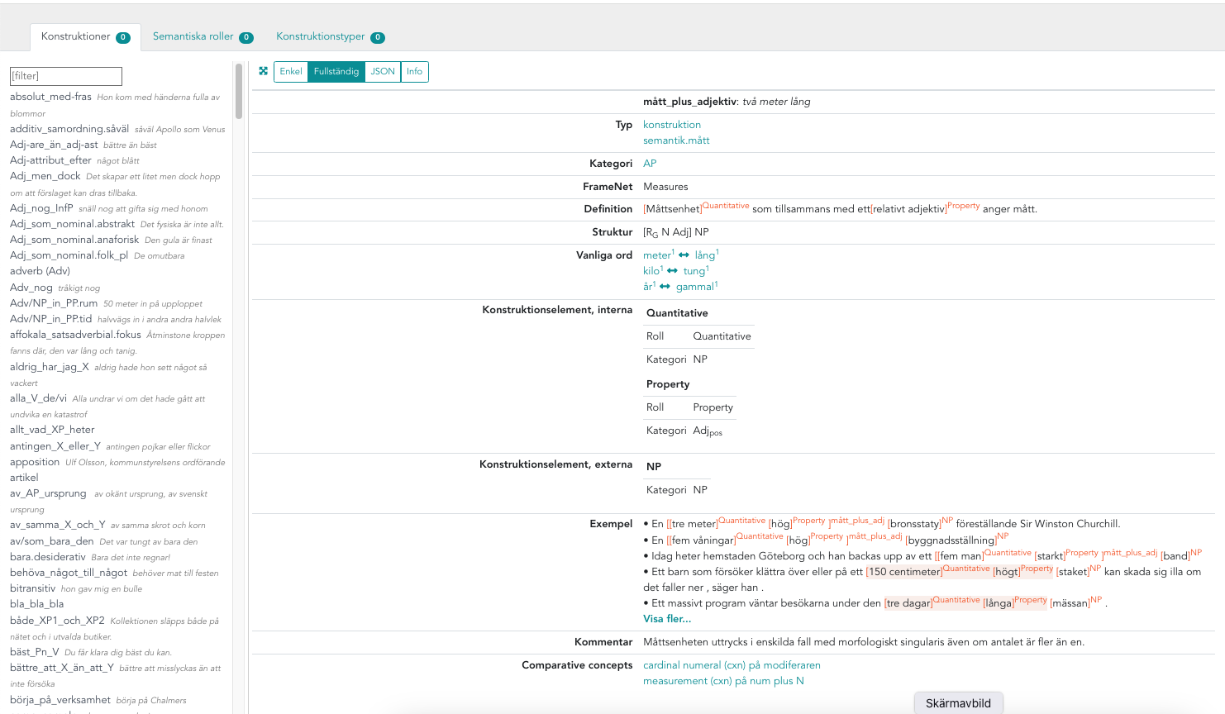

Slide 17
Autonomy vs. integration
Constructicon integrated with a framenet (English@Berkeley; German; Japanese; Brazilian Portuguese)
Constructicon based on a dictionary (English@Erlangen; English@Birmingham; Hungarian)
Autonomous constructicon (Russian, Norwegian)
Semi-autonomous constructicon (Swedish)
part of the Language Bank of Swedish infrastructure
linked to several lexical resources, and indirectly to corpora
within this infrastructure, the constructicon is an autonomous resource

Slide 18
Scope and focus: which constructions should be covered?
Theory vs. practice
In constructionist theory, the lexicon is a subset of the constructicon
In constructicographic practice, they are rather complementary
Usually, constructicon entries account for usage patterns with at least one variable element (cf., however, Sass 2023 on Hungarian)
Focus areas
Partially schematic, semi-general constructions (“filling the gaps”)
Relevance for L2 education (Russian; Swedish)
Argument structure constructions (English@Birmingham, @Erlangen)
Network ambitions
Brazilian Portuguese; Swedish; Fluid CxG

Slide 19
Heuristics: identifying relevant constructions
Adapting, and expanding, from existing construction descriptions
Secondary sources (e.g. constructional information in dictionaries)
Construction mining
using NLP tools to identify construction candidates in corpora (e.g. recurring patterns of hybrid n-grams)
For L2 relevance:
identifying problematic structures in learner texts
analyzing teaching aids
Et cetera

Slide 20
Naming and identification 1
In lexicography, a lexical entry is identified by a head word, which is effectively the name of the entry
In constructicography, the situation is less clear:
Chris gave Pat a book
Kim e-mailed Chris the manuscript
the more the merrier
The sooner we start, the sooner we’ll be done
and these are the familiar cases…
Double Object cxn?
Ditransitive cxn?
the X-er the Y-er?
Comparative correlative cxn?

Slide 21
Naming and identification 2
Naming principles:
linguistic terminology (ditransitive; comparative correlative)
schematic illustration (the X-er the Y-er; What’s X doing Y?)
key element (the let alone cxn; the way cxn)
key example (the fly-in-the-soup cxn)
Either way, the name is insufficient for identification
name + illustrative example
search by key words (of various kinds)
thematic groupings
network relations
Adjective-as-nominal.people – the rich and the poor
reflexive cxns, time expressions, compounds, causative cxns, motion cxns, interrogative cxns, passive cxns, coordination cxns, etc.

Slide 22
Organization
Alphabetical list structure
common in dictionaries
next to useless for constructicography
Thematic grouping of constructions into categories and types
common in grammars (cf. also thesauri)
crucial (but not sufficient) for constructicography
Construction networks
in accordance with constructionist theory
versatile, visualizable, work in progress

Slide 23
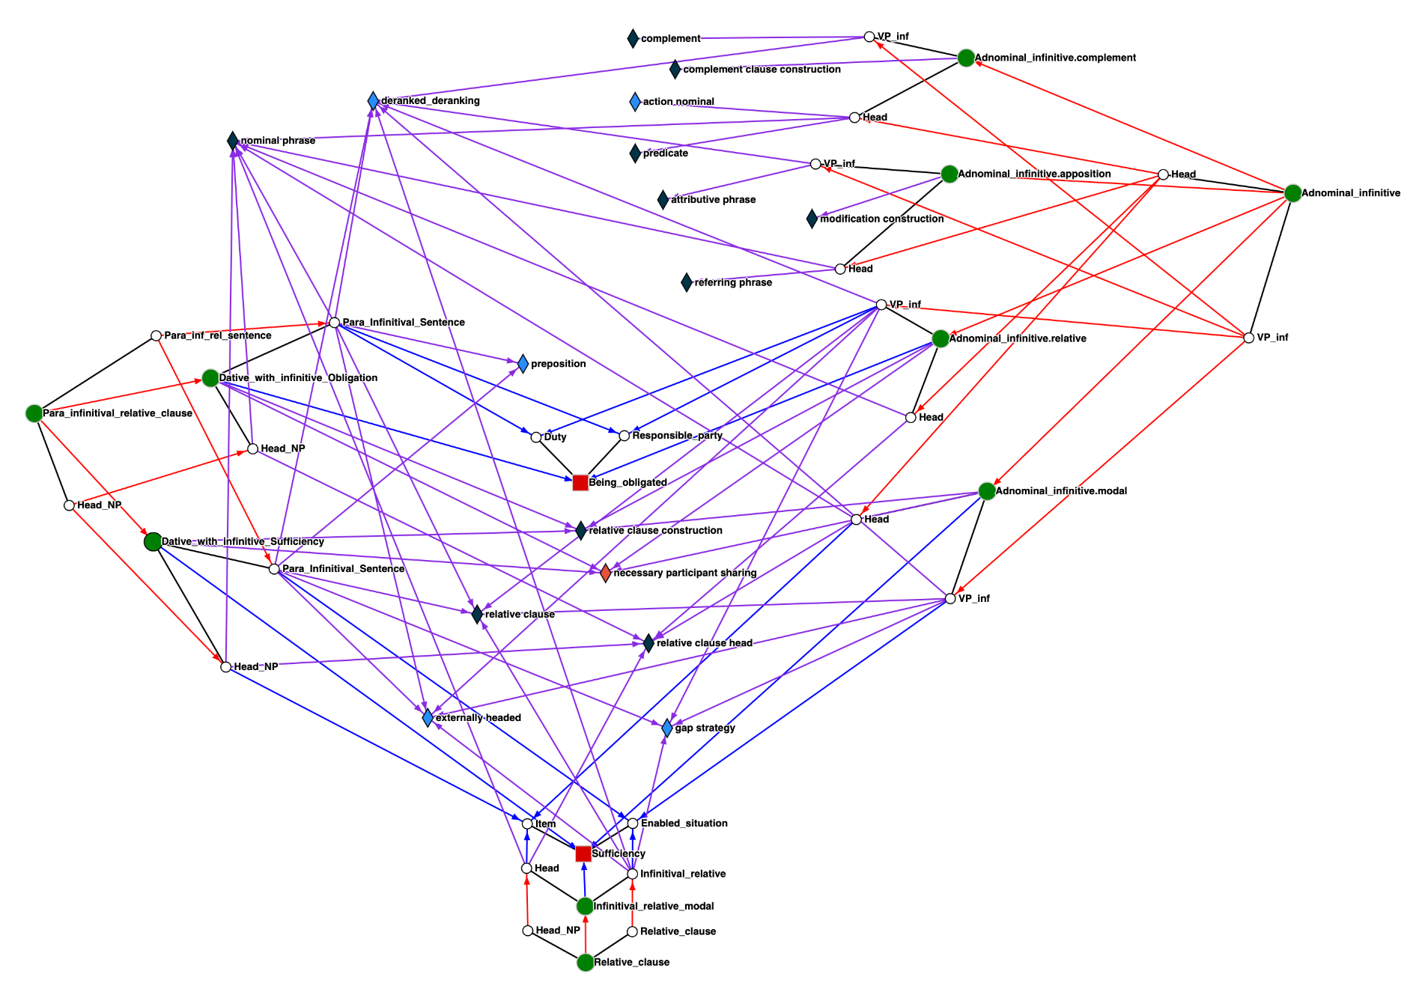
Network fragment in the
Brazilian Portuguese constructicon
(Torrent et al. 2022)

Slide 24
Description format (the Swedish constructicon)
Basic mode
name + short, illustrative example
prose definition
structure sketch (linear representation of construction elements)
annotated examples

Slide 25
Example, basic mode
(adapted from the Berkeley FrameNet Constructicon)

Slide 26
Description format (the Swedish constructicon)
Basic mode
name + illustration
prose definition
structure sketch
annotated examples
Extended mode
organization: category, types, network relations
construction elements (basic feature structure analyses)
lexical units: keywords, common words (links to other resources in the Swedish Language Bank)
external relations: FrameNet, Berkeley FN Constructicon, MoCCA
comments, references

Slide 27
Categorization and variation
Issues of (constructional) polysemy and homonymy
in many respects analogous to similar issues in lexicography
more complex, since categorization depends on both form and meaning
Caused motion cxn (roughly: NP V NP Advl; Motion event –> Goal)
Sandy drove me to the airport, The audience laughed him off the stage
Resultative cxn (roughly: NP V NP AP; Action –> Result)
Chris hammered the metal flat; Kim drunk himself silly
They voted him out of office
She drank him under the table
They drove me to the brink of despair
– Metaphoric instances of the caused motion cxn?
– Resultative cxn with the result expressed as a PP?

Slide 28
Categorization and variation
Variable realizations of the same slot fairly straightforward:
Resultative cxn: [NP V NP AP/PP]
Variable syntagmatic relations between slots more complex:
Rather than wine, Americans would drink beer
Americans would drink beer rather than wine
Americans would rather drink beer than wine
Variants are not equal: usually, one is more typical and the others less so
Represent (only) the prototypical or most common variant?
Represent all the variants (equally)?
Indicate more vs. less common/typical variants?

Slide 29
Constructicography compared to (construction) grammar
Applied vs. theoretical linguistics
 | Construction grammar | Constructicography
Purpose | investigating how human language works (from a constructionist perspective) | producing useful (construction) descriptions
Main concerns | accuracy, precision, cognitive plausibility | (approximate) accuracy, precision, user-friendliness,
Presentation | tending towards long, detailed analyses | aiming for concise, accessible descriptions
Metalanguage | heavy on technical terminology and formalism | lighter on technical terminology and formalism
Systematicty | scientific, theoretical | practical consistency

Slide 30
Constructicography compared to lexicography
Construction entries can usually not be defined and identified in terms of head words
Complexity: although both have to handle variation in both form and meaning, constructicography is fundamentally more multidimensional
(Mis)match between aims and established descriptive tools
Similar aims: both lexical entries and construction entries typically give approximate accounts of conventional usage
Lexicography is quite well equipped to accommodate prototypes, family resemblance, etc.
In grammar, however, traditional metalanguage is designed to represent discrete categories (e.g., NP, verb) and relations (e.g., word order)
Tradition: lexicography builds on millennia of experience, while we are just starting to figure out how to do constructicography

Slide 31
Dessert: Multilingual constructicography

Slide 32
Towards multilingual constructicography
Constructicon resources in development for English, German, Japanese, Brazilian Portuguese, Russian, Swedish, etc.
a situation just begging for multilingual application
Alt. 1: Establishing direct equivalence relations (as per lexicography)
Alt. 2: Indirect connections via a language-neutral base of comparison

Slide 33
Alt. 1: Establishing direct equivalence relations (as per lexicography)
Establishing equivalent expressions in different languages is challenging enough in lexicography
Full equivalence is rare, if not non-existent
Nonetheless, lexicographers have been doing so for ages, and quite successfully too
Multilingual lexicography is mainly concerned with functional equivalence, typically between units of roughly the same category
Form is usually not much of a problem
The situation for multilingual constructicography is worse

Slide 34
Alt. 1: Establishing direct equivalence relations (as per lexicography)
Multilingual constructicography has to deal with differences in both form and function
Issues of organization and granularity increase exponentially
For example, is word order treated as a property of (holistic) constructions or by particular word order constructions?
Double bias (both the source language and the source constructicon)
Limited and unevenly distributed coverage
Corresponding cxn descriptions in the target language(s) often lacking
Lack of established methodology

Slide 35
Alt. 2: Indirect connections via a language-neutral base of comparison
Constructions may be connected in terms of shared properties
category, function, meaning, morphosyntax, other
constructions may share some properties and differ in other respects
To serve as a language-neutral base of comparison, these properties need cross-linguistically applicable definitions
Different properties relevant for different cxns and different purposes
hence, we are aiming for a flexible alignment system that can be adapted to the relevant situation (either by the system or by the user)
Proposal: an alignment model based on Comparative Concepts (CCs)
employed in language typology (Haspelmath, Croft, and others)

Slide 36
Comparative Concepts (CCs)
Theoretical constructs designed specifically for the purpose of comparing linguistic structures across languages
notions like ‘appositive’, ‘bivalent’, ‘causative’, ‘deictic’, ‘reflexive’, ‘stative’, ‘topic’, ‘cleft’, ‘relative clause’, etc., defined in a language-neutral manner
based on typological research (aiming to avoid dominant-language biases)
We are using the set of CCs proposed by Croft (2022)
extensive list of CCs, aiming to cover the state of the art in language typology
originally a glossary for a textbook on morphosyntax
a constructionist approach to CCs
plus FrameNet frames as an additional type of CC

Slide 37
Example: progressive constructions
English: copula + present-participle (be V-ing): is reading
Brazilian Portuguese: copula + gerund (estar V-ndo): está lendo
Swedish: pseudo coordination (V och V): sitter och läser
Similar meaning:
durative (sem), activity_ongoing (fr)
Different (morphosyntactic) strategies:
Eng/BP: verbal copula (str), deranking (str)
Swedish: coordinate personal strategy (str)

Slide 39
MoCCA (Model of Comparative Concepts for ConstructiCon Alignment)
CCs serve as a language-neutral base of comparison and define properties shared by various language-specific constructions
Constructions may share some CCs and differ with respect to others
Connections via CCs represent partial correspondence – not equivalence
Closely related constructions share several properties (CCs)
A flexible alignment model designed for growth
Five types of CCs: may connect constructions by any kind of property (function, morphosyntax, etc.), or combination of properties, chosen by the user
Applicable both within and across languages
More constructions, and languages, may be added later
NB: depends on construction entries being annotated for CCs.
Notes:
combinations of partial correspondences

Slide 40
Thank you! Swedish Constructicon: https://spraakbanken.gu.se/konstruktikon MoCCA: https://github.com/comparative-concepts

Slide 41
References 1
Boas, H. C. (2017). Computational resources: FrameNet and constructicon. In Dancygier, B. (ed.), The Cambridge hand-book of cognitive linguistics. Cambridge: CUP, 549–573.
Boas, H. C., Lyngfelt, B. & Torrent, T. T. (2019). Framing constructicography. Lexicographica 35: 15–59.
Borin, L. & Lyngfelt, B. (In press). Framenets and constructicons. In Fried, M. & Nikiforidou, K. (eds.), The Cambridge handbook of construction grammar. Cambridge: CUP.
Croft, W. 2022. Morphosyntax: Constructions of the world’s languages. Cambridge: CUP.
Fillmore, C. J. (1988). The mechanisms of ‘Construction Grammar’. Berkeley Linguistic Society 14, 35–55.
Fillmore, C. J. (2008). Border conflicts: FrameNet meets construction grammar. In Proceedings of EURALEX13. Barcelona: Universitat Pompeu Fabra, 49–68.
Fillmore, C. J., Lee-Goldman, R. & Rhomieux, R. (2012). The FrameNet Constructicon. In Boas, H. C. & Sag, I. A. (eds.), Sign-based construction grammar. Stanford: CSLI, 309–372.
Goldberg, A. E. (1995). Constructions. A Construction Grammar Approach to Argument structure. University of Chicago Press.
Goldberg, A. E. (2003). Constructions: A new theoretical approach to language. Trends in Cognitive Science 7 (5): 219–224.
Goldberg, A. E. (2013). Constructionist approaches. In: Hoffmann, Th. & Trousdale, G. (eds.), The Oxford Handbook of Construction Grammar. Oxford: Oxford University Press, 15–31.

Slide 42
References 2
Herbst, Th. (2019). Constructicons – a new type of reference work? Lexicographica 35, 3–14.
Lorenzi, A., Ljunglöf, P., Lyngfelt, B., Torrent, T. T., Croft, W., Ziem, A., Böbel, N., Bäckström, L., Uhrig, P., Matos, E. (To appear). MoCCA: A Model of Comparative Concepts for Aligning Constructicons. LREC 2024.
Lyngfelt, B., Borin, L., Ohara, K. & Torrent, T. T. (eds.) (2018). Constructicography: Constructicon development across languages. Amsterdam: John Benjamins.
Lyngfelt, B., Torrent, T. T., da Silva Matos, E. E. & Bäckström, L. (2022). Comparative concepts as a resource for multi-lingual constructicography. In Blensenius, K. (ed.), Valency and constructions. Gothenburg: MASO, 101–129.
Perek, F. & Patten, A. (2019). Towards an English constructicon using patterns and frames. International Journal of Corpus Linguistics 24, 354–384.
Sass, B. (2023). From a dictionary towards the Hungarian Constructicon, In Medveď, M., Měchura, M., Tiberius, C., Kosem, I., Kallas, J., Jakubíček, M. & Krek, S. (eds.). Electronic lexicography in the 21st century (eLex 2023): Invisible Lexico-graphy. Proceedings of the eLex 2023 conference. Brno, 27–29 June 2023. Brno: Lexical Computing CZ s.r.o., 534–544.
van Trijp, R. (2017). A computational construction grammar for English. The AAAI 2017 Spring Symposium on Computational Construction Grammar and Natural Language Understanding Technical Report, no. SS-17-02. Stanford: AAAI, 266–273.
Ziem, A., Willich, A. & Michel, S. (eds.). (To appear). Constructing constructicons. Amsterdam: John Benjamins.

Slide 43
Croft (2022): four types of comparative concepts (CCs)
Functional CCs: semantic content (sem) and information packaging (inf)
CC-sem (what): degree, deixis/deictic, deontic modality, figure, ground
CC-inf (how): contrast, topic, core arguments, discourse deictic, generic
Hybrid CCs (form-function combinations): constructions (cxn) and strategies (str)
CC-cxn (what): clause, comparative cxn, head, oblique phrase
CC-str (how): cleft strategy, complementizer, compounding, copula
no CCs define form only

