Slide 1

GenAI in Language Education
Critical Perspectives and Critical Literacies
Dr Niall Curry

Slide 2
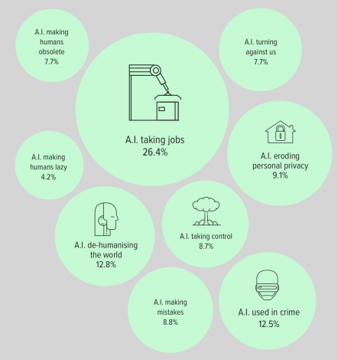
Using GenAI in academic research
Support
advances in scholarship and analytical practices (Crosthwaite & Baisa, 2023)
enhanced efficiency and research assistance (Pack & Maloney, 2023)
the possibility of developing more democratic approaches to education (Cohen et al., 2024).
Doubt
fears of obsolescence (Li et al., 2024)
falling quality in research (Curry et al., 2024)
loss of knowledge and ways of thinking (Kuteeva & Andersson, 2024)
rising inequality and forms of technological divide (Sahebi & Formosa, 2024)

Slide 3
Linguists and GenAI
LLM – Large Language Models

Slide 4
In Applied Linguistics?
An emerging perspective that is critical, reflective, and nuanced.

Slide 5
A foundation based on evidence
Conceptual and methodological developments
Rigorous and nuanced ways to study language
Language
for which the origin is known
that is contextually situated
that is naturally occurring
Pedagogy
that is situated
that is reflexive
that is evidence based

Slide 6
Question for Linguists?
Whether GenAI-based data or analytical approaches can align with our principles and if not, how much of these hard-earned principles can or should we sacrifice for the expediency that Generative AI promises?

Slide 7
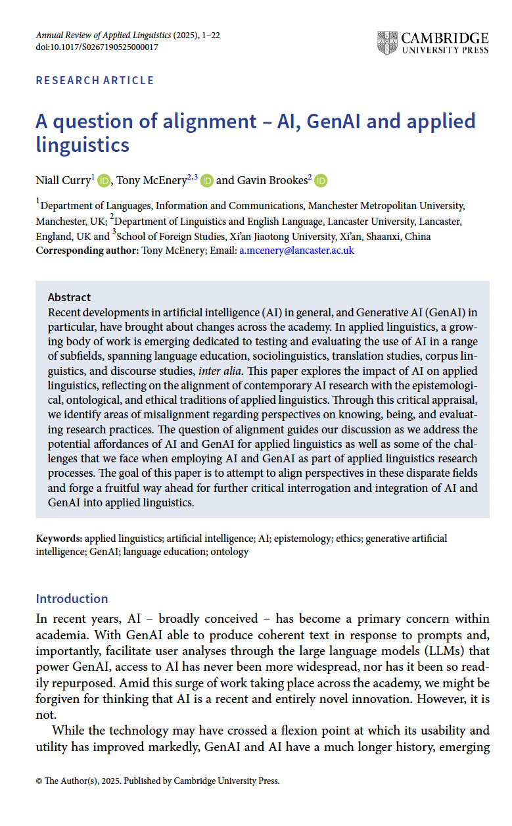

Using GenAI in academic research
Question: not whether but how
“the horse has bolted” (Sauerbrei, 2021)
Voices of excitement and trepidation
Curry, N., McEnery, T., and Brookes, G. (2025). A question of alignment – AI, GenAI and applied linguistics. Annual Review of Applied Linguistics, 1–22. https://doi.org/10.1017/S0267190525000017

Slide 8
Using GenAI in academic research
Disparate responses: a form of “science-as-process” (Curry & Pérez-Paredes, 2021, p. 492)
Collectively, can help us to see how our understanding of AI has evolved in recent years

Slide 9
Using GenAI in academic research
The “Alignment Problem”
The potential (mis)alignment of AI with human values and intelligence (Christian, 2021 among others)
Three foundational concepts:
Epistemology
Ontology
Ethics

Slide 10
Questions of Alignment: Epistemology
Epistemology theorises how we construct and make sense of our knowledge
the values by which we validate and justify knowledge and the conventions we follow and reconstruct within our wider knowledge-making community and communities of practice
Applied Linguistics: A plurality of epistemologies (Dewaele, 2019; Pennycook, 2018)

Slide 11
Questions of Alignment: Epistemology
For GenAI: “knowing” is a product of processes built on probabilities and pattern recognition, derived from training data (Cope & Kalantzis, 2024)
Such a conceptualization of knowing has little to do with the knowledge-making processes attributed to the human researcher in applied linguistics

Slide 12
Questions of Alignment: Epistemology
Kuteeva and Andersson (2024): how do AI-assisted tools respond to the differing epistemological stances employed within and across applied linguistics studies
GenAI’s inclination to standardise and simplify knowledge (Pragya, 2024)
Reproduces biases and eliminates diverse cultural and linguistic contexts (Brandt & Hazel, 2024; Choi, 2022; Putland et al., 2023)
Antithetical to wider social justice movements

Slide 13
Questions of Alignment: Ontology
Ontology is concerned with the nature of being and existence (Hall & Wicaksono, 2020)
The plurality of ontologies in applied linguistics mirrors that of epistemologies (Demuro & Gurney, 2021; Hall & Wicaksono, 2020)
Applied linguists use ontology as a critical lens to examine how language and its use are shaped by social, cultural, and political forces

Slide 14
Questions of Alignment: Ontology
In AI research, researchers seek to control ontologies as a way of simplifying the problems facing AI system developers
Ontologies facilitate the creation of formal representations of knowledge for machine processing
There is a central focus on interoperability, simplicity, and fixedness

Slide 15
Questions of Alignment: Ontology
While the appeal of being able to apply AI ontologies to a research problem is clearly great, this advantage should not be gained at the expense of distorting our view of the object of study
Further questions of misalignment surface

Slide 16
Questions of Alignment: Ethics
Macro- and Micro-ethics: Socially oriented (De Costa et al., 2021; Yaw et al., 2023)
Ethics in AI and AL research: arguably more easily aligned
Algorithmic bias, the impact of AI on society, and the complex relationship between AI and the climate crisis (Jabotinsky & Sarel, 2024; Kirova et al., 2023)
Ethics in AI and AL research: Represents and ideal

Slide 17
Questions of Alignment: Ethics
AI companies have been accused of training their models on copyrighted materials without permission (e.g. Milmo, 2024)
raised questions surrounding the legality of certain AI models (Gromova et al., 2023)
AI data: Ontologically constrained
Issues with representation and ethics
Trained on web-data
Thompson et al. (2024) argue that already 57% of online data is the result of AI generation or machine translation
risks the exponential proliferation of biases, prejudices, and dominant perspectives through GenAI tools

Slide 18
Questions of Alignment: Ethics
In practice, commercial AI has not always enacted ethical values
Poorly aligned with epistemological and ontological practices in applied linguistics
the use of GenAI tools that reinforce bias and negatively impact society may:
undermine fairness and equity in language education (Choi, 2022)
perpetuate normative or ethnocentric views (Spennemann, 2024)
and mis- and underrepresent society’s most vulnerable (Nguyen et al., 2024; Putland et al., 2023)
To develop a means for applied linguists to engage with AI ethically, such concerns must be addressed and attenuated

Slide 19
Addressing the Misalignment
We propose the use of GenAI for augmentation, not replacement, the maintenance of human oversight and critical engagement to ensure alignment with applied linguistics' values, and the development of interdisciplinary frameworks and training to support reflective, responsible integration of AI across the field.
We encourage that researchers reflect on these central facets of the research process when engaging with AI in Applied Linguistics to ensure that the expediency does not undermine the objective or the quality.
Curry, N., McEnery, T., and Brookes, G. (2025). A question of alignment – AI, GenAI and applied linguistics. Annual Review of Applied Linguistics, 1–22. https://doi.org/10.1017/S0267190525000017

Slide 20
AI and Language Learning
  AI already appears to be having a significant impact on language education, and though much of the optimism surrounding AI is tempered with caution, many educators and learners appear to be embracing AI for its perceived ability to personalize learning, provide feedback, and create engaging content for language learners (AbuSahyon et al., 2023; Betal, 2023).

Slide 21
AI and Language Education
In the context of personalized learning, research in language education has investigated the affordances of AI for:
creating customized learning experiences tailored to individual student needs (Konyrova, 2024) and immersive learning environments (Betal, 2023; Negrila, 2023).
Li and Wang (2024) claim that AI can help learners identify and select resources to support their learning which, they argue, renders GenAI tools effective and engaging language learning aids.

Slide 22
AI and Language Education
In materials and assessment development, AI has been used to:
develop interactive learning materials, including games, videos, and quizzes (Amonova et al., 2023),
support teachers in their lesson planning (Kostka & Toncelli, 2023),
create dialogic chatbots designed to provide opportunities for conversational practice and feedback (Katsarou et al., 2023; Vajjala, 2024), and
facilitate automated marking and assessment (Negrila, 2023). In many cases, the results appear promising.

Slide 23
A Question of Alignment: AI and Language Teaching
Some studies claim that AI can improve language education, by facilitating the learning of vocabulary, grammar, pronunciation, and the development of written language skills (Cohen et al., 2024; Konyrova, 2024).
Elsewhere, it has been argued that AI can:
increase learner engagement, motivation, and autonomy (AbuSahyon et al., 2023; Betal, 2023; Konyrova, 2024),
support teachers in a range of pedagogical and administrative tasks (Amonova et al., 2023; Vajjala, 2024), and
facilitate the development of critical thinking skills (Kostka & Toncelli, 2023).

Slide 24
A Question of Alignment: AI and Language Teaching
Yet, at the same time, a debate has also emerged in which alignment is a key issue.
Creely (2024) has argued for a critical approach to the use of AI, arguing that how learners are trained to engage with AI-produced texts plays a key role in governing their capacity to develop critical thinking skills, a goal that should not be abandoned.

Slide 25
A Question of Alignment: AI and Language Teaching
The potential of misalignment to perpetuate bias has also emerged as an issue in the literature. For example, there are concerns about the accuracy and authenticity of texts produced by AI, including the potential for cultural and linguistic nuances to be absent or distorted (Amonova et al., 2023; Choi, 2022; Creely, 2024).
With language education increasingly moving towards international views of language and language varieties, this propensity for GenAI technologies to reinforce standard varieties of language represents a potential challenge, ideologically, for applied linguistics.

Slide 26
A Question of Alignment: AI and Language Teaching
Studies in this area critique the data on which AI models are trained and question their capacity to meet the needs of culturally diverse classrooms.
Questions of:
ownership of GenAI’s intellectual output (Betal, 2023; Creely, 2024),
data privacy and security when using AI and GenAI in language learning (Betal, 2023; Creely, 2024), and
issues of access to technology and the digital divide (Konyrova, 2024; Li, 2023) give rise to further concerns surrounding the use of AI and GenAI in language education.
Song and Song (2023) note that the product-oriented nature of GenAI risks a lack of engagement with the processes of learning, which may lead to over-reliance on technology – a practice that may diminish the development of critical thinking skills and creativity (Amonova et al., 2023; Creely, 2024).

Slide 27
A Question of Alignment: AI and Language Teaching
In the context of data-driven learning, for example, the process of searching for, reading, and analyzing language extracts independently and autonomously is the true learning experience (Flowerdew, 2015).
What a learner finds or discovers as the end of this process is arguably of secondary importance.
The expediency and limited criticality of GenAI would likely flip this perspective, as GenAI tools focus on giving answers and responses to learners.
In such cases, we may wonder what role the action of engaging with GenAI tools can play in the learning process (e.g. Tolstykh & Oshchepkova, 2024).

Slide 28


AI and Corpus Linguistics for Language Learners
Conducted two studies: Broadening the scope of Data-driven learning (BsDDL)
Pérez-Paredes, P. Curry, N., & Ordoñana-Guillamón, C. (2025). Critical AI literacy for applied linguistics and language education students. Journal of China Computer-Assisted Language Learning.
Pérez-Paredes, P. Curry, N.. & Aguado Jiménez, P. (2025). Enriching AI literacy with corpus-based pedagogy. Computer-Assisted Language Learning. Computer Assisted Language Learning.

Slide 29

AI and Corpus Linguistics for Language Learners
Students of EFL and Linguistics in Spain
Studied their use of AI and Corpus Linguistics in vocabulary and grammar activities
Conducted focus groups with them on their use of AI and Corpus Linguistics

Slide 30
AI and Corpus Linguistics for Language Learners
Learners begin with a differing understanding (and as a consequence, expectation) of corpus linguistics and GenAI. While little is known of the former, the learners are familiar with and already using the latter in their studies.
This differing starting point leads to general reticence regarding the use of corpora compared to a tentative or, in some cases, strong optimism regarding the potential affordances of AI.

Slide 31
AI and Corpus Linguistics for Language Learners
Many well-established issues emerge through the workshops, with learners encountering difficulty with the corpus tool interfaces and the means of interpreting corpus findings, inter alia (Boulton & Cobb, 2017; Pérez-Paredes, 2022).
Many students struggled with the interface, highlighting the need for structured guidance in corpus use.
Without more extensive training, they found it difficult to extract relevant patterns, demonstrating that access alone is insufficient without instruction in data interpretation.

Slide 32
AI and Corpus Linguistics for Language Learners
The study revealed key challenges in learners’ interpreting corpus data, particularly in cases where learners relied on personal perceptions rather than empirical evidence.
This contrast suggests that corpus-based learning does not follow a single, fixed methodology but instead requires flexible strategies that can be refined through practice. However, cognitive overload may prevent learners from fully engaging with the data.

Slide 33
AI and Corpus Linguistics for Language Learners
Conversely, the learners found that using GenAI was easier, owing in part to its conversational nature, and many were confident in the quality and trustworthiness of the information provided by ChatGPT.
On an individual level, they appear satisfied with the personalised pathways that ChatGPT appears to offer, and learner engage with the tool to answer questions and share reflections.
While this perspective may lead some to argue that ChatGPT could be a more effective resource for facilitating language learning, when compared to corpus tools, a more nuanced perspective is necessary – one that teases apart key issues:
  e.g., the role of the process
  e.g., the notion of personalised learning

Slide 34
What did we conclude?

Slide 35
AI and Corpus Linguistics for Language Learners
We wonder whether these are truly personalised responses or if they are simply individualised responses?
Yet, while ChatGPT offers some learners alternatives in the form of voice changes, others in terms of synonyms, and others in terms of metalinguistic information, there appears to be no clear rationale for the decision to offer these different responses to different learners.
For teachers, the decision to offer one of several such alternatives in a class will typically be motivated by curricular aims and specific learner needs (Prain et al., 2013), while for ChatGPT, the variable of the learner seems to have no real bearing on the tool’s decision.

Slide 36
AI and Corpus Linguistics for Language Learners
Thus, it may well be that these individualised responses are not examples of personalised learning but instead are just a consequence of the tool’s non-deterministic nature.

Slide 37
AI and Corpus Linguistics for Language Learners
Critical AI literacy
Questions of critical thinking, ethics, practical application and technical understanding
Drawing on:
  Disciplinary knowledge
  Linguistic knowledge
There are gaps in their knowledge
Corpus linguistics helped them to make sense of AI and AI tool

Slide 38
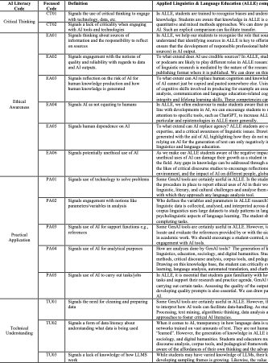
Towards Critical and Disciplinary AI Literacies
A case for combined corpus and AI approach could help develop critical corpus and AI literacies
We don’t need to start from scratch

Slide 39
Closing Reflections
AI literacies and critical AI literacies
Discipline is part of this new development, and the knowledge base is there
The future of corpus linguistics in language education?
Computations thinking?
Digital, corpus and AI literacies
Criticality, Ethics, Practical Understanding, Technical Knowledge (Marx, 2024; Pérez-Paredes et al., forthcoming)

Slide 40
Thank you
Niall Curry

