Slide 1

The orientation to the message and the use of compensatory strategies in 12-grade EFL learners’ oral interaction
Natalja Zagura
Department of English Studies, University of Tartu
natalja.zagura@ut.ee
ERÜ kevadkonverents 2026
Tallinn, 23.-24.04.2026

Slide 2
Previous research on compensatory strategies (CS)
Interactional approach (Tarone 1977,1981, Nakatani 2010): shared enterprise in which both the speaker and the listener are involved; negotiation of meaning and repair mechanisms
Psycholinguistic perspective (Bialystok 1990, Færch & Kasper 1984, Poulisse 1997): cognitive processes involved in language use; only the speaker is responsible for a CS, it is their mental plan for reaching a certain communicative goal
Oxford (1990): strategies to overcome limitations in comprehension and production - a category within language learning strategies.
Oxford et al (2014): CS benefit learning a new language
Gonzalez Castell et al (2023): effects of awareness-raising and explicit strategy instruction on the performance of young EFL learners

Slide 3
Studies considered more closely
Zagura, Natalja. 2012. Focus on the form versus focus on the message in lingua franca conversation. In: Metslang, Helle; Langemets, Margit; Sepper, Maria-Maren (Ed.). Eesti Rakenduslingvistika Ühingu aastaraamat. 8. 275−287. Tallinn: Eesti Rakenduslingvistika Ühing.
Rubis, Novalyn M., Remart Dumlao. 2018. Interference of Compensatory Strategies in Oral Production of English Language Student in an ESL Classroom: Does Compensatory Strategy Play a Role in Academic Performance? Journal of English Teaching. 4(3). 156-169.

Slide 4
Classification of CS
Product- and process-oriented taxonomies (descriptive vs analysing the process underlying language user’s strategy choice)
Categories mostly used (e.g. Brown 2007): circumlocution, approximation, use of all-purpose words, non-linguistic signals, appeal for help, word coinage, literal translation, foreignising, code-switching, time-gaining.

Slide 5
Research questions
To what extent have upper secondary school graduates reached oral communicative competence of an independent user (B2) in English as a foreign language (EFL) and whether they use compensatory strategies to overcome limitations of comprehension and production?
What types of compensatory strategies do they use?

Slide 6
Hypotheses
School graduates demonstrate at least B2 level in semi-formal oral interaction
They use compensatory strategies when needed
Language users with higher language proficiency level use a smaller number of compensatory strategies and resort to more productive ones (circumlocution, approximation)
Language users with lower language proficiency level prefer code-switching and avoidance

Slide 7
Corpus, participants, method
Semi-structured interviews in English (N=4), June 2025
Video-recorded (190 min)
12-grade students of one upper-secondary school in Tartu (N=20)
4 females and 16 males
Conversation analysis
Focus on compensatory strategies

Slide 8
Results
 | Interview 1 | Interview 2 | Interview 3 | Interview 4 | TOTAL
Students | S1, S2, S3, S4, S5 | S6, S7, S8, S9 | S10, S11, S12, S13, S14 | S15, S16, S17, S18, S19, S20 | N=20 (strategy use 12)
Length (min) | 41 | 51 | 46 | 52 | 190
Strategies total | 4 | 9 | 14 | 5 | 32
Circumlocution |  |  | ++ | +++ | 5
Approximation | + |  | +++ |  | 4
Literal translation |  | + |  |  | 1
Code-switching | ++ | +++ | (+)+++++++ |  | 12 (13)
Appeal for help |  | + | + | + | 3
Avoidance: |  |  |  |  | (5)
a) Dropping message | + | ++ |  |  | 3
b) Dropping form |  | + | + |  | 2
All-purpose words |  | + |  | + | 2

Slide 9
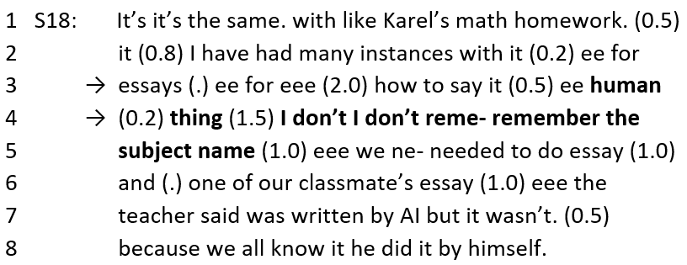
Example 1: circumlocution + all-purpose word
i4_42:06

Slide 10
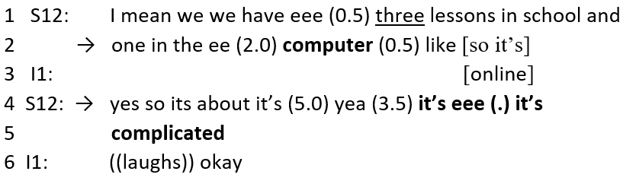
Example 2: approximation + avoidance (message)
i3_20:50

Slide 11
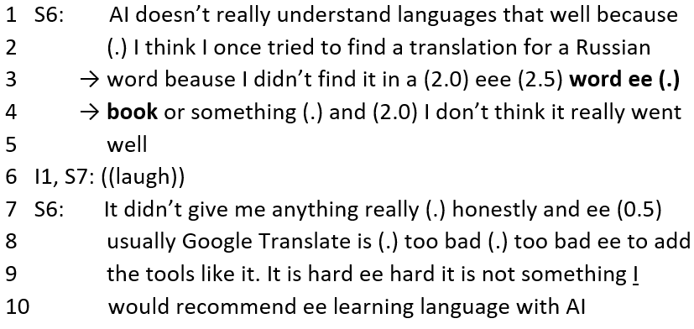
Example 3: literal translation
i2_39:30

Slide 12
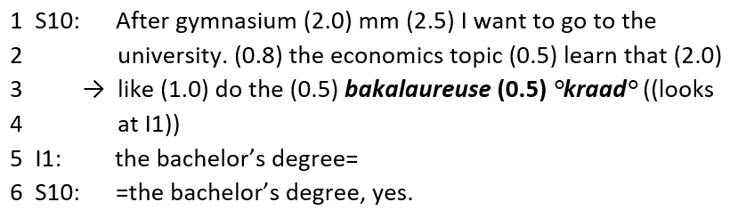
Example 4: code-switching (L1) + appealing for help
i3_34:50

Slide 13
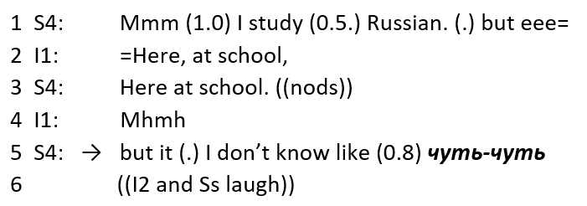
Example 5: code-switching (L2)
i1_12.12

Slide 14
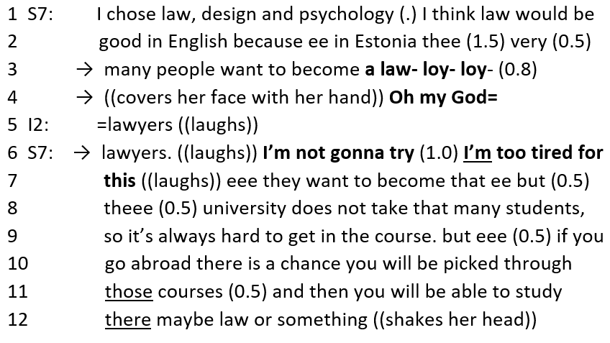
Example 6: avoidance (dropping form)
i2_29:59

Slide 15
Conclusions
School graduates participating in the case study demonstrate B2.1 - C1.2 level in EFL in semi-formal oral interaction
12 participants out of 20 used compensatory strategies to compensate for limitations in oral interaction (production), all in all 32 cases of compensatory strategy use were documented
Language users with higher language proficiency level tend to use a smaller number of compensatory strategies and often resort to more productive ones (circumlocution, approximation)
Language users with lower language proficiency level seem to prefer code-switching and avoidance (message, form)
Code-switching (to L1 and L3) is most actively used, no matter what the proficiency level of the speaker is

Slide 16
Further implications
Code-switching can be a productive strategy, it is in accordance with the notion of plurilingual competence (CEFR CV 2020: 30-31)
Learners should be aware of the possible shortcomings of code-switching to L1
At lower proficiency level compensatory strategy instruction could be applied to prevent excessive use of code-switching and avoidance strategies
(cf on strategy instruction Gonzalez Castell et al 2023, Amari 2020)

Slide 17
References
Amari, A. 2020. The Impact of Teaching Compensatory Strategies on IranianEFL Learners’ Speaking Skill: the case of Approximation, Appealing for Help, Code-switching and Time-gaining. Journal of English Language Teaching and Applied Linguistics. 3(1), 01-07. https://doi.org/10.32996/jeltal.2021.3.1.1
Bialystok, E. 1990. Communication strategies: A psychological analysis of second language use. Oxford: Basil Blackwell.
Brown, P. 2007. The effect of class size on the teaching of pupils aged 7-11 years. School Effectiveness and School Improvement, Institute of Education, University of London, UK, 18(2), 147-172.
González Castell, M.P., Codina Espurz, V. and Jara P. Jiménez. 2023. The effect of awareness-raising and explicit instruction of compensatory strategies on young learners’ EFL oral and written production. Electronic Journal of Foreign Language Teaching [e-FLT], 20(1), 3–21. https://doi.org/10.56040/vcpj2011
CEFR CV= Common European Framework of Reference for Languages: Learning, Teaching, Assessment. Companion Volume. 2020. Available at https://rm.coe.int/common-european-framework-of-reference-for-languages-learning-teaching/16809ea0d4
Færch, C. and G. Kasper. 1984. Two ways of defining communication strategies. Language Learning, 34, 45-63. https://doi.org/10.1111/j.1467-1770.1984.tb00995.x
Nakatani, Y. 2010. Identifying strategies that facilitate EFL learners’ oral communication: A classroom study using multiple data collection procedures. The Modern Language Journal, 94, 116-136. https://doi.org/10.1111/j.1540-4781.2009.00987.x
Oxford, R. 1990. Language learning strategies. What every teacher should know. Boston: Heinle ja Heinle.
Oxford, R.L, Rubin, J, Chamot, A.U., Schramm, K., Lavine, R., Gunning, P. and C. Nel. 2014. The learning strategy prism: perspectives of learning strategy experts. System, 43, 30-49. https://doi.org/10.1016/j.system.2014.02.004
Poulisse, N. 1997. Some words in defense of the psycholinguistic approach. Modern Language Journal, 81, 324-328. https://doi.org/10.1111/j.1540-4781.1997.tb05489.x
Tarone, E. 1977. Conscious communication strategies in interlanguage: A progress report. In H.D. Brown, C.A. Yorio and R.C. Crymes (eds.) On TESOL 77: Teaching and learning English as a second language. Trends in research and practice, 194-203. Washington DC: TESOL.
Tarone, E. 1981. Some thoughts on the notion of communication strategy. TESOL Quarterly, 15(3), 285-295. https://doi.org/10.2307/3586754

Slide 18

Thank you for listening!

