Slide 1
Designing Video-Based Microlearning Materials for EFL Instruction
A Case Study with Secondary Learners
Anna Mazepa
Liina Tammekänd
University of Tartu · Department of English Studies
23rd EAAL Spring Conference
Tallinn · 24 April 2026

Slide 2
The classroom reality
1
2
3
Adolescent attention
Working memory limits
The 45-minute lesson
Cognitive control networks are still maturing.
Prolonged focus is more demanding than for adults.
Focus of attention holds ~4 items.
Learners reach cognitive overload faster.
EFL exposure is limited by timetable.
Materials must work within this constraint.
Steinberg 2008 · Ophir et al. 2009
Miller 1956 · Cowan 2001 · Sweller 1988
Estonian basic school · I Love English 6
In this study: microlearning in formal education = brief, self-contained units designed for a specific learning outcome within a short timeframe, delivered digitally or face-to-face.

Slide 3
A gap between two literatures
MICROLEARNING LITERATURE
SLA LITERATURE
Oriented to corporate training & instructional design
Kapp & DeFelice (2019)
Corbeil et al. (2021)
Kohnke (2023) — only ESL/EFL book;
references SLA theories in passing,
without developing design implications.
Developed psycholinguistic principles
Krashen (1985) — Input Hypothesis
Schmidt (1990) — Noticing Hypothesis
VanPatten (1996) — Input Processing
Long (1991) — Focus on Form
Paivio (1986) — Dual Coding
Not systematically linked to
microlearning design for EFL.
Missing: systematic SLA-informed microlearning design for EFL

Slide 4
Research questions
What theoretical connections can be established between SLA principles and the design of video-based microlearning materials for teenage EFL learners?
RQ1
Theoretical
How do teachers perceive the designed materials in terms of structure, accessibility, and fit with the textbook?
RQ2
Teacher perception
How do 8th-grade learners perceive the materials in terms of accessibility, engagement, and difficulty?
RQ3
Student perception

Slide 5
Five design principles
Derived from SLA research · inform both current materials and future microlearning design
1
Brevity and self-containment
Each unit is short and complete in itself, focused on a single learning outcome.
Sweller 1988 · Kapp & DeFelice 2019
2
Multimodal comprehensible input
Video presents language through verbal and visual channels, supporting dual coding.
Krashen 1985 · Paivio 1986
3
Staged task sequence
Tasks organised across three phases: preparation → noticing → consolidation.
Schmidt 1990 · VanPatten 1996
4
Focus on Form through task design
Linguistic features highlighted within meaning-focused tasks — for formulaic sequences, not discrete grammar.
Long 1991 · Wray 2002
5
Scaffolded learner production
Production tasks help learners use target language in personally meaningful contexts.
Harmer 2015 · cognitive load theory

Slide 6
Nine microlearning units
Supplementary materials for I Love English 6 · two thematic units · each ≈6–10 min within a 45-min lesson
#
Title
CEFR
Target formulaic sequences
Video source
1
Greetings
A2+
hiya · you alright · how's things
British Council / VBP
2
Identity
B1+
go with the flow · offer solutions · lock yourself away
MBTI explainer
3
True Friendship
A2+
mutually beneficial · backhanded compliment · mentally drained
YouTube creator
4
Different Kinds of Friends
B1
be there for someone · have your back · walked into your life
Three authentic clips
5
Friendship Review
B1
consolidation of units 1–4
— (review)
6
The Power of Goals
B2
without a shadow of a doubt · put the blinders on · be relentless
Chaunté Lowe (Olympic)
7
What Sport Teaches Us
B1+
a sense of belonging · test your limits · reduce stress
YouTube explainer
8
Sports at School
B1+
making memories · back each other up · life lessons
Six US teen athletes
9
Sports Review
B1+
consolidation of units 6–8
— (review)
Target sequences verified against Sketch Engine frequency data.

Slide 7

Materials available
All nine revised worksheets — ready for classroom use
Nine ready-to-use worksheets
freely available for teachers
[ insert QR code here ]
Two thematic units
Friends (units 1–5) · Sports (units 6–9)
Levels
A2+ to B2 · for 8th-grade EFL learners
Fits I Love English 6
Aligned with textbook topics — or used independently
Format
Video + worksheet · fits one 45-minute lesson
Scan to access all worksheets

Slide 8
Three-stage task sequence
Example: Unit #6 — The Power of Goals (B2, Chaunté Lowe, Olympic high jumper)
Matching task
BEFORE
Students match target expressions to their meanings. Activates prior knowledge and directs attention to target expressions before the video.
viewing
Schmidt · VanPatten
Comprehension MCQs
WHILE
Multiple-choice items that keep attention on meaning while target expressions appear in authentic context.
viewing
Krashen · Paivio
Gap-fill + scaffolded production
AFTER
Gap-fill brings attention back to form — students retrieve expressions. Production task: 3-4 sentences on a personal goal, using at least two expressions.
viewing
Long · Wray · Harmer

Slide 9

Worksheet example
Unit #6 — The Power of Goals (B2, Chaunté Lowe, Olympic high jumper)

Slide 10
Methodology
Materials-design study · perceived accessibility (not learning outcomes)
TEACHERS
STUDENTS
22
169
total participants
responses
7 used materials in 8th-grade classes
15 reviewed as expert raters
14-item Google Forms questionnaire
5-point Likert + open-ended comments
Two groups of 8th-grade learners
≈16 students per group
Collected across 8 worksheets
9-item questionnaire per worksheet
Completed immediately after activity
Anonymous · voluntary
Analysis: descriptive statistics · thematic grouping of open responses · classroom observations during piloting

Slide 11
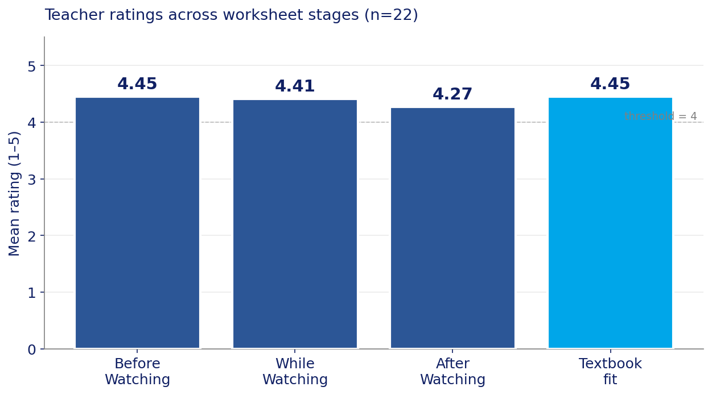
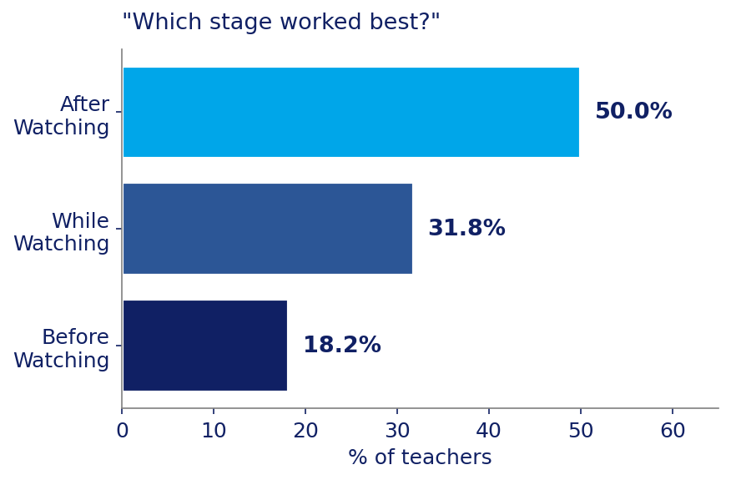
Teacher feedback
All three stages rated above 4/5 · strong fit with I Love English 6
Key findings from open comments
• Structure and logical flow were consistently praised
• Post-viewing stage identified as most effective (50% of teachers)
• Recurring concerns: missing pre-viewing tasks in some units · QR code placement · while-viewing density in Unit #8
• Teachers who used materials in class rated While-Watching higher (4.71) than expert reviewers (4.27)

Slide 12
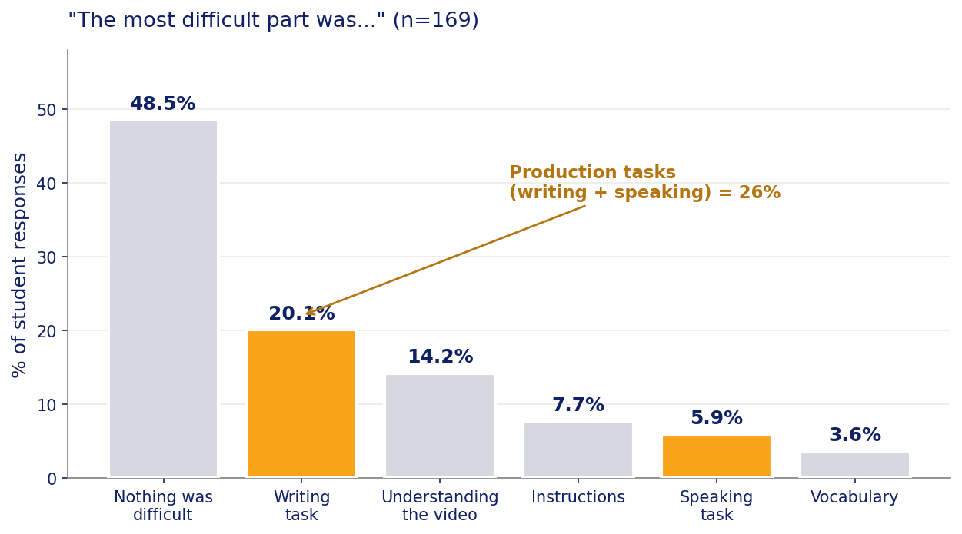
Student feedback
Materials rated as accessible and engaging · production tasks consistently hardest (Sweller 1988)
94%
88%
63%
found the video easy
or OK to understand
found instructions
clear or mostly clear
rated the activity
interesting or very interesting
Theoretically consistent
Production tasks (writing + speaking) were identified as hardest by 26% of responses.
This aligns with Cognitive Load Theory:
production requires coordinating form, meaning, and retrieval — heavier load than receptive tasks.
Sports units (WS 6–8):
50% "just right" · higher than Friends units (39%).
Staged task sequence scaffolds higher-level content.

Slide 13
Revisions to materials
Feedback-driven changes based on teacher and student input
Issue identified
Revision made
Theoretical rationale
Missing pre-viewing matching tasks in units #2, #4, #6, #7, #8
Matching tasks added to all 5 affected units
Noticing (Schmidt) · Input Processing (VanPatten) — without preparation, target sequences are filtered out
QR codes placed before pre-viewing tasks — students skipped ahead
QR codes relocated next to while-viewing instructions
Preserves staged sequence integrity
Unit #3 (True Friendship) rated too easy at A2+
Replaced with B2-level video in revised version
Better fit with i+1 (Krashen) for 8th-grade learners
While-viewing questions too dense for multi-narrator video (#8)
Reformulated with reading time cue
Working memory capacity (Miller · Cowan)
Design principles themselves worked as an evaluation rubric during revision.

Slide 14
Contributions
THEORETICAL
PRACTICAL
Five design principles
systematically linking
SLA research to
microlearning design
Nine ready-to-use
worksheet units for
I Love English 6
A connection not previously developed in microlearning literature.
Integrates:
• Schmidt · Noticing
• VanPatten · Input Processing
• Long · Focus on Form for chunks
• Paivio · Dual Coding
• Wray · Formulaic sequences
• Sweller · Cognitive Load
Each unit is self-contained and can be used independently or alongside the textbook.
Features:
• Fits within one 45-minute lesson
• Minimal teacher preparation
• Authentic video (Edpuzzle + QR)
• Supports I Love English 6 topics
• Tested in Estonian basic school
Principles transferable to grammar, pronunciation, other targets.
SLA-informed microlearning is feasible, theoretically grounded, and classroom-ready.

Slide 15
Limitations and next steps
LIMITATIONS
NEXT STEPS
Revised materials were not re-piloted
Effectiveness of revisions cannot be evaluated empirically.
Questionnaires measured perceived accessibility
No conclusions can be drawn about language acquisition itself.
Uneven worksheet coverage
Not all teachers reviewed every unit. Sample sizes varied across worksheets.
Re-pilot the revised materials
Assess whether structural changes translate into better classroom outcomes.
Measure acquisition, not just perception
Pre/post assessments to evaluate retention of target formulaic sequences.
Extend design principles
Apply to other EFL targets: grammar patterns, pronunciation, discourse features.

Slide 16
References
SLA and psycholinguistics
Microlearning and pedagogy
Krashen, S. 1985. The Input Hypothesis. London: Longman.
Schmidt, R. 1990. The role of consciousness in second language learning. Applied Linguistics, 11(2): 129–158.
VanPatten, B. 1996. Input Processing and Grammar Instruction. Norwood, NJ: Ablex.
Long, M. 1991. Focus on Form: A Design Feature in Language Teaching Methodology. In de Bot et al. (eds), Foreign Language Research in Cross-Cultural Perspective, 39–52. Amsterdam: Benjamins.
Paivio, A. 1986. Mental Representations: A Dual Coding Approach. New York: Oxford University Press.
Wray, A. 2002. Formulaic Language and the Lexicon. Cambridge: Cambridge University Press.
Cognitive foundations
Miller, G. 1956. The magical number seven, plus or minus two. Psychological Review, 63(2): 81–97.
Cowan, N. 2001. The magical number 4 in short-term memory. Behavioral and Brain Sciences, 24(1): 87–114.
Sweller, J. 1988. Cognitive load during problem solving. Cognitive Science, 12: 257–285.
Kapp, K. and DeFelice, R. 2019. Microlearning: Short and Sweet. Alexandria, VA: ATD Press.
Corbeil, J., Khan, B. and Corbeil, M. (eds). 2021. Microlearning in the Digital Age. New York: Routledge.
Kohnke, L. 2023. Using Technology to Design ESL/EFL Microlearning Activities. Singapore: Springer.
Harmer, J. 2015. The Practice of English Language Teaching. 5th ed. Harlow: Pearson.
Adolescent development
Steinberg, L. 2008. Adolescence. 8th ed. New York: McGraw-Hill.
Ophir, E., Nass, C. and Wagner, A. 2009. Cognitive control in media multitaskers. PNAS, 106(37): 15583–15587.
Tools and methods
TextInspector. CEFR-based lexical profiling.
textinspector.com
Sketch Engine. English Web 2021 corpus (enTenTen21, 52B tokens).
sketchengine.eu
Edpuzzle. Interactive video platform.
edpuzzle.com
Full reference list available in the MA thesis

Slide 17
Thank you
Questions and discussion welcome
CONTACT
MATERIALS
Anna Mazepa
MA student, English Language and Literature
Department of English Studies
University of Tartu
Supervisor: Liina Tammekänd, PhD
All nine worksheets (revised)
freely available for teachers.
QR code on handout
Or on request from the authors

