Slide 1
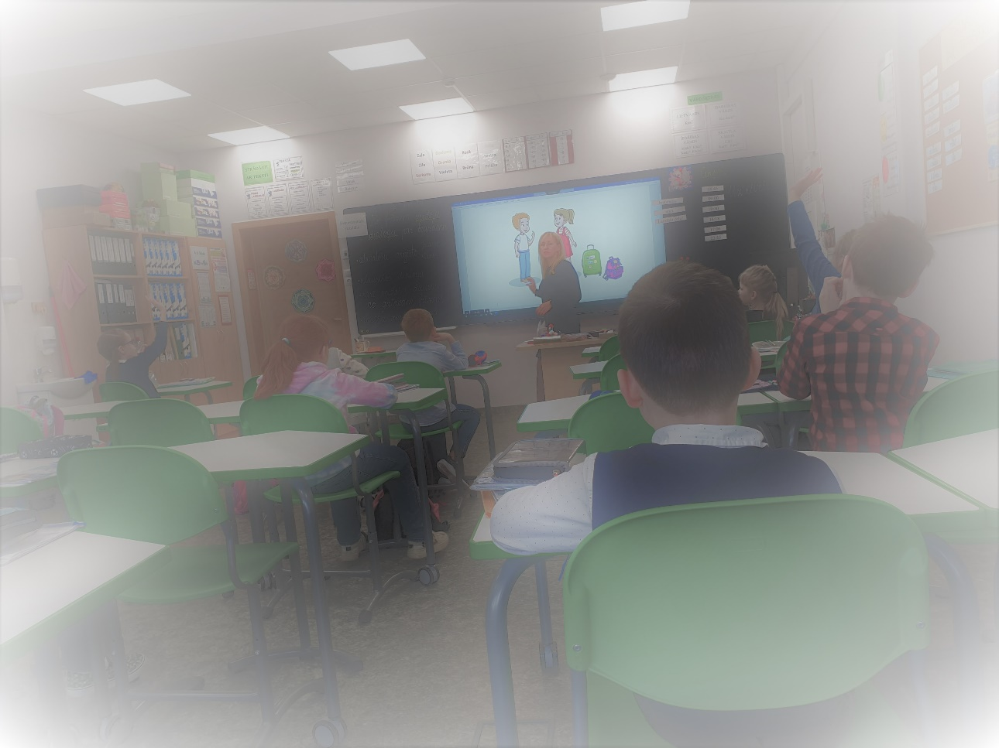



Latvian as Medium of Instruction for All:
Official Discourses & Lived Experiences at Schools since the Latest School Reform
prof. Sanita Martena
Riga Technical University, Rēzekne Academy
23. rakenduslingvistika konverents
KEEL(EÕPE) MUUTUVAS MAAILMAS / LANGUAGE (TEACHING & LEARNING) IN A CHANGING WORLD
23.-24. aprill 2026 – Tallinn

Slide 2
Overview
Background: changes in language-in-education policies in Latvia since 2022
Official policy discourses – how was the reform framed?
Implementation in practice – lived experiences at schools
3.1 Empirical data
3.2 Data analysis within theoretical frames
Cognitive aspects: emergent bilingualism, receptive & expressive language skills, linguistic silence, language exposure from teachers
(Socio)emotional aspects: social silence, students‘ self-evaluation, language anxiety
4. Language practices and exposure at home
5. Conclusions / Take-away messages

Slide 3
1. Background:
Timeline of Changes in Policies on Language of Instruction
February 24, 2022 – Russia’s full-scale invasion of Ukraine
Latvia
June 7, 2022 – the government approved amendments to the Education Law and the General Education Law enabling the transition to education exclusively in Latvian within 3 years
Sept 29, 2022 - Saeima supports transition to Latvian as the only language of instruction
Amendments to the Education Law and the General Education Law
This affects ~ 20% of schools in Latvia which had previously operated bilingually (mostly, students with Russian as their family language)
According to 2023 data, Russian is the native language of 37.7% of the population in Latvia (Oficiālās statistikas portals, 2023).
Estonia
Oct 13, 2022 – the government approved the action plan prepared by the Ministry of Education for transitioning to Estonian-language education;
Dec 12, 2022 – Riigikogu adopted the amendments for the transition
Amendments were made to the Basic Schools and Gymnasia Act, Preschool Child Care Institutions Act, Vocational Educational Institutions Act, Private Schools Act, and Language Act, they mainly concern the language of instruction and the language requirements for the teaching staff.
Notes:
decisions that have recently been made by the parliaments, regarding the language of instruction AND Russian as a language subject taught in schools

Slide 4
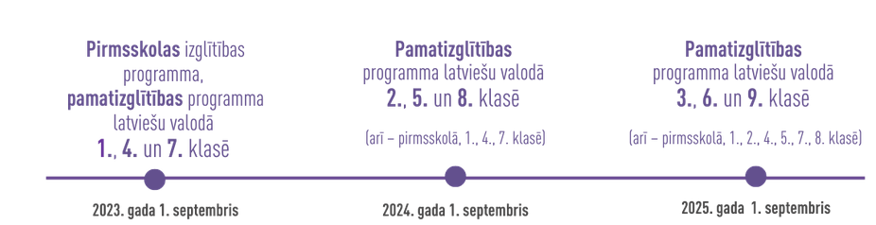
What Does the Transition to Education in Latvian Mean?
2023-2025
Sept 1, 2023 – in preschools + in grades 1, 4 and 7.
Sept 1, 2024 – grades 2, 5, 8
Sept 1, 2025 – grades 3, 6, 9
In comparison with Estonia – differences?
https://www.izm.gov.lv/lv/pareja-uz-vienotu-skolu
https://likumi.lv/ta/id/330669-noteikumi-par-valsts-valodas-zinasanu-apjomu-valsts-valodas-prasmes-parbaudes-kartibu-un-valsts-nodevu-par-valsts-valodas-prasmes-parbaudi

Slide 5
The Role of Russian in Schools after the Reform
Russian as an extra-curricular subject
Russian as a second foreign language
At the primary and lower-secondary education level, ethnic minority students will be able to learn the language and cultural history of ethnic minorities within the framework of the extra-curricular education programme.
The programme will be funded by the state through a grant to local authorities, as well as by the local authorities themselves.
Currently, students may refuse to learn Russian as a second foreign language
For students who have begun learning Russian as a second foreign language by the 2025/2026 academic year, the educational institution shall ensure the opportunity to continue learning it until the end of the primary education level, but no longer than until the end of the 2029/2030 academic year.
(Amendments to the Education Law, in force since May 2024)

Slide 6
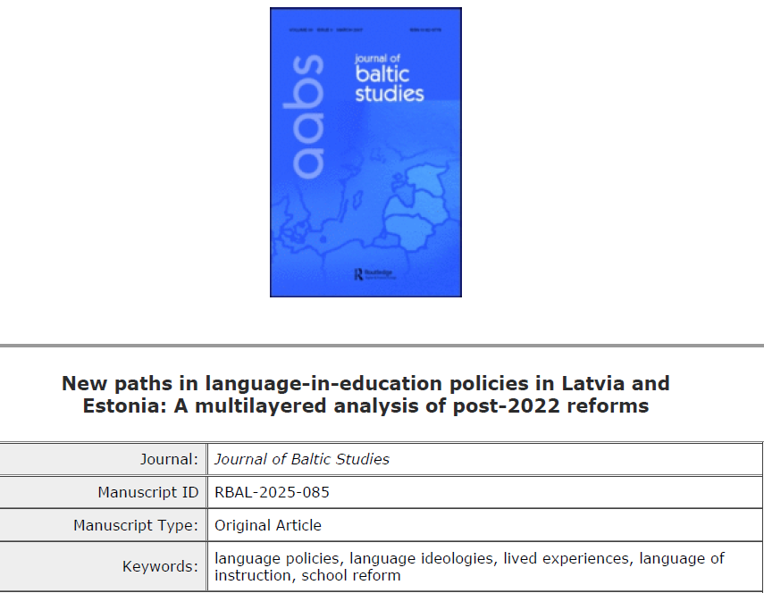
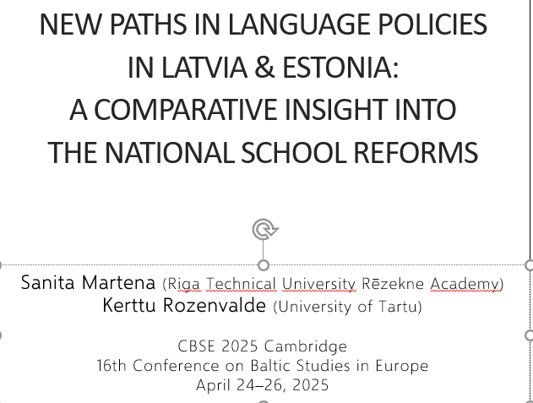
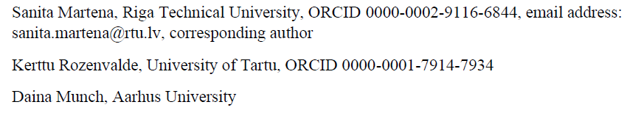
2. Official Policy Discourses – how was the Reform Framed?

Slide 7
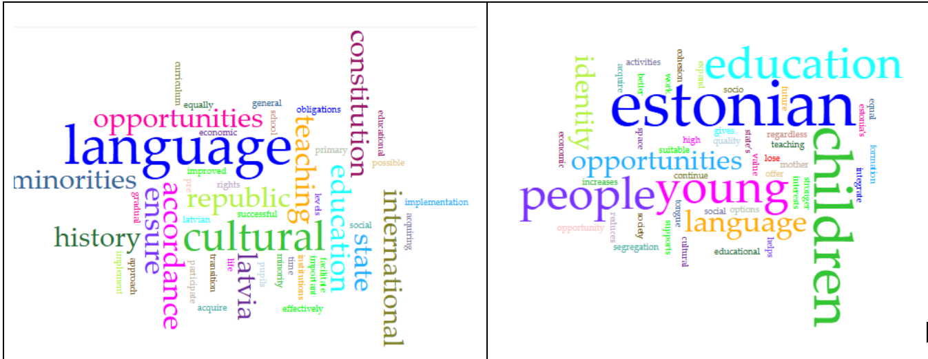
Data (collected in February 2025):
Official communication channels of the ministries of education, webpages concerning the transition, press releases concerning the changes in language-in-education policies since 2022
Texts in the original versions (Latvian, Estonian)
Comparative content analysis: pupils – society – state – international requirements

Slide 8
Official Policy Discourses:
How are the Changes Communicated?
In Latvia:
the state is positioned as actor in language policy in congruence with nation-state ideologies (state language; reform is necessary for implementation of better education)
perspective of linguistic authority (vs. minority pupils)
changes are not openly related to Russia’s war (although this is the “elephant in the room”)
In Estonia:
Estonian as a language is clearly named
focus on qualitative education, not language
distinction majority-minority is hidden, instead the young generation is in focus

Slide 9
3. Implementation in Practice –
Lived Experiences at Schools

Slide 10
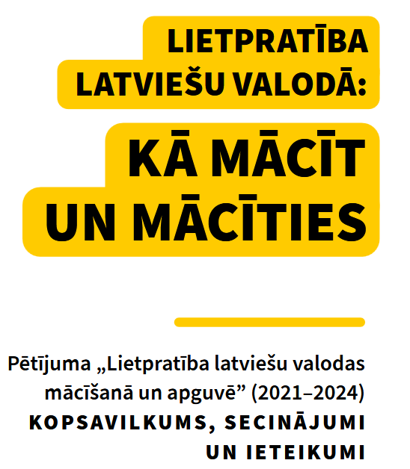


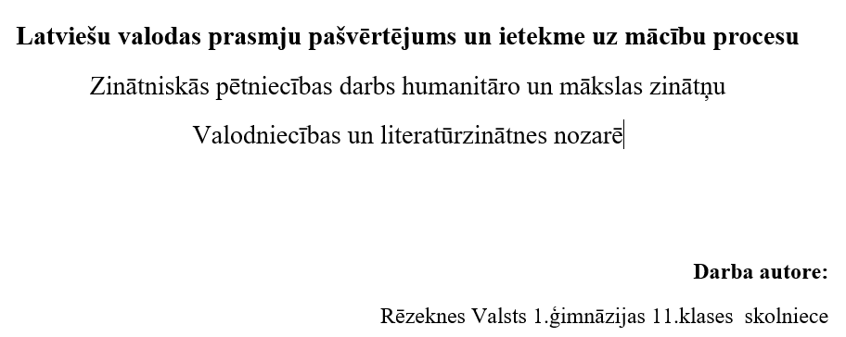
3.1 Empirical Data
Classroom observations (2022-2026)
Interviews (2025) with parents with different family languages
  Russian
  Ukrainian
  Russian-Latvian
Secondary data:
  Daina Munch – MA thesis, 2025
    3 months of ethnographic research in a school in Riga)
  Data from cooperation with students (supervising)
    1 PhD thesis (Agnese Cera)
    1 MA thesis (Kristīne Malacanova),
    2 BA theses (Evija Brokāne, Ieva Puzirevska)
  Jūlija Igaune – research work, highschool student in 11th grade
    focus group discussions with classmates

Slide 11
3.2 Data Analysis within Theoretical Frames
1. Cognitive aspects:
emergent bilingualism
receptive & expressive language skills
linguistic silence
language exposure from teachers

Slide 12
Year 8 pupils understood Latvian but still talked in Russian. It was difficult for them to create full sentences.
Munch 2025
It’s very easy for me NOW to understand Latvian; I find it easy to write in Latvian—well, with mistakes, but still—but expressing my thoughts verbally—well, that’s a huge problem (Student, Grade 10, Rēzekne).
Martena 2023
The results of the focus group discussions indicate that minority students more often experience anxiety, insecurity, and emotional exhaustion, especially in situations requiring oral expression in Latvian. This negatively affects their participation in class.
Igaune 2026

Slide 13
Cognitive Aspects
The pre-production phase: language learner is not passive but builds their language competence through active listening, developing the vocabulary, observing others and absorbing the language they hear.
Legitimate peripheral participation (Lave & Wenger, 1991)
Silent – active participation through verbal thought (Ohta 2001; Munch 2025)
Silent period (Krashen 1981) – receptive skills
Expressive (productive) language skills: orally and in written form (very subjective)
Emergent bilingual learners
Russian-language dominant students – in a gradual process of becoming bilingual
Lessons in Latvian increase their Latvian language exposure

Slide 14
Cognitive Aspects: Qualitative Language Exposure from Teachers
In most Russian schools, where all teachers were supposed to start teaching in Latvian, it seems to me that in most schools the teachers are unable to teach in Latvian and do not teach the subjects in Latvian. They can’t conduct an entire lesson [in Latvian]. They might use some terms or words from the textbook, but if they speak in Latvian, they can’t express their thoughts correctly. It doesn’t make sense. The students might misunderstand them, or perceive the information as something strange.
Student, Grade 10
Rēzekne, 2023, classroom observation (Martena)

Slide 15
Data Analysis within Theoretical Frames
2. (Socio)emotional aspects:
social silence
students’ self-evaluation
language anxiety

Slide 16
(Socio)emotional Aspects
(..) it helped her to reduce anxiety to speak if she was in a situation where mistakes were accepted; it helped to speak when she was with somebody, she trusted (Grade 8).
S5 emphasized that depending on the “mood of the teacher”, the pupil had an opportunity to follow the learning process or stay silent.
(..) being forced to speak and a judgmental attitude reduce the desire to actively participate.
(..) even to talk about NOT BEING AFRAID. I remember myself in my first year of university. I cried for the first three months. I thought how I am going to study for all four years? Coming from a rural school, where they also had bilingual education. No, the language [Latvian] went very quickly, and it was also very specific, studying engineering, yeah. Now it seems, it was easy.
(TŽ, 33 years old, Rēzekne)
Munch 2025
Igaune 2026
Martena 2025

Slide 17
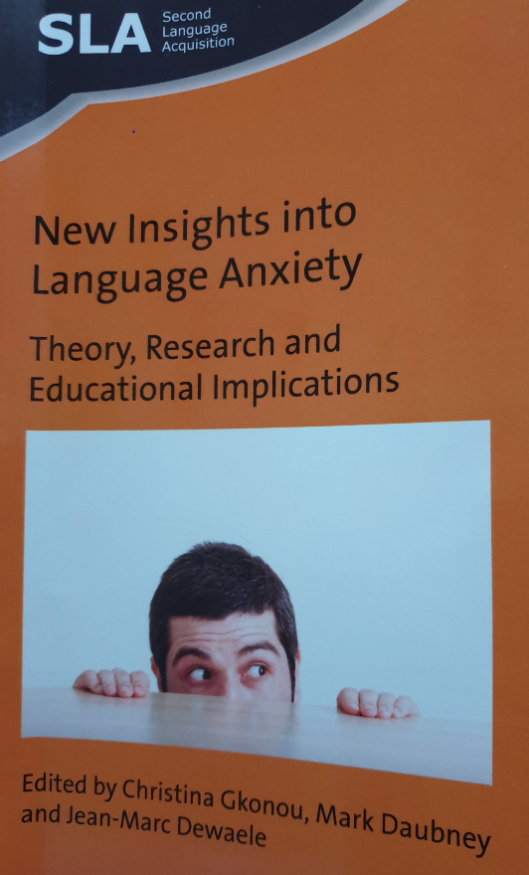
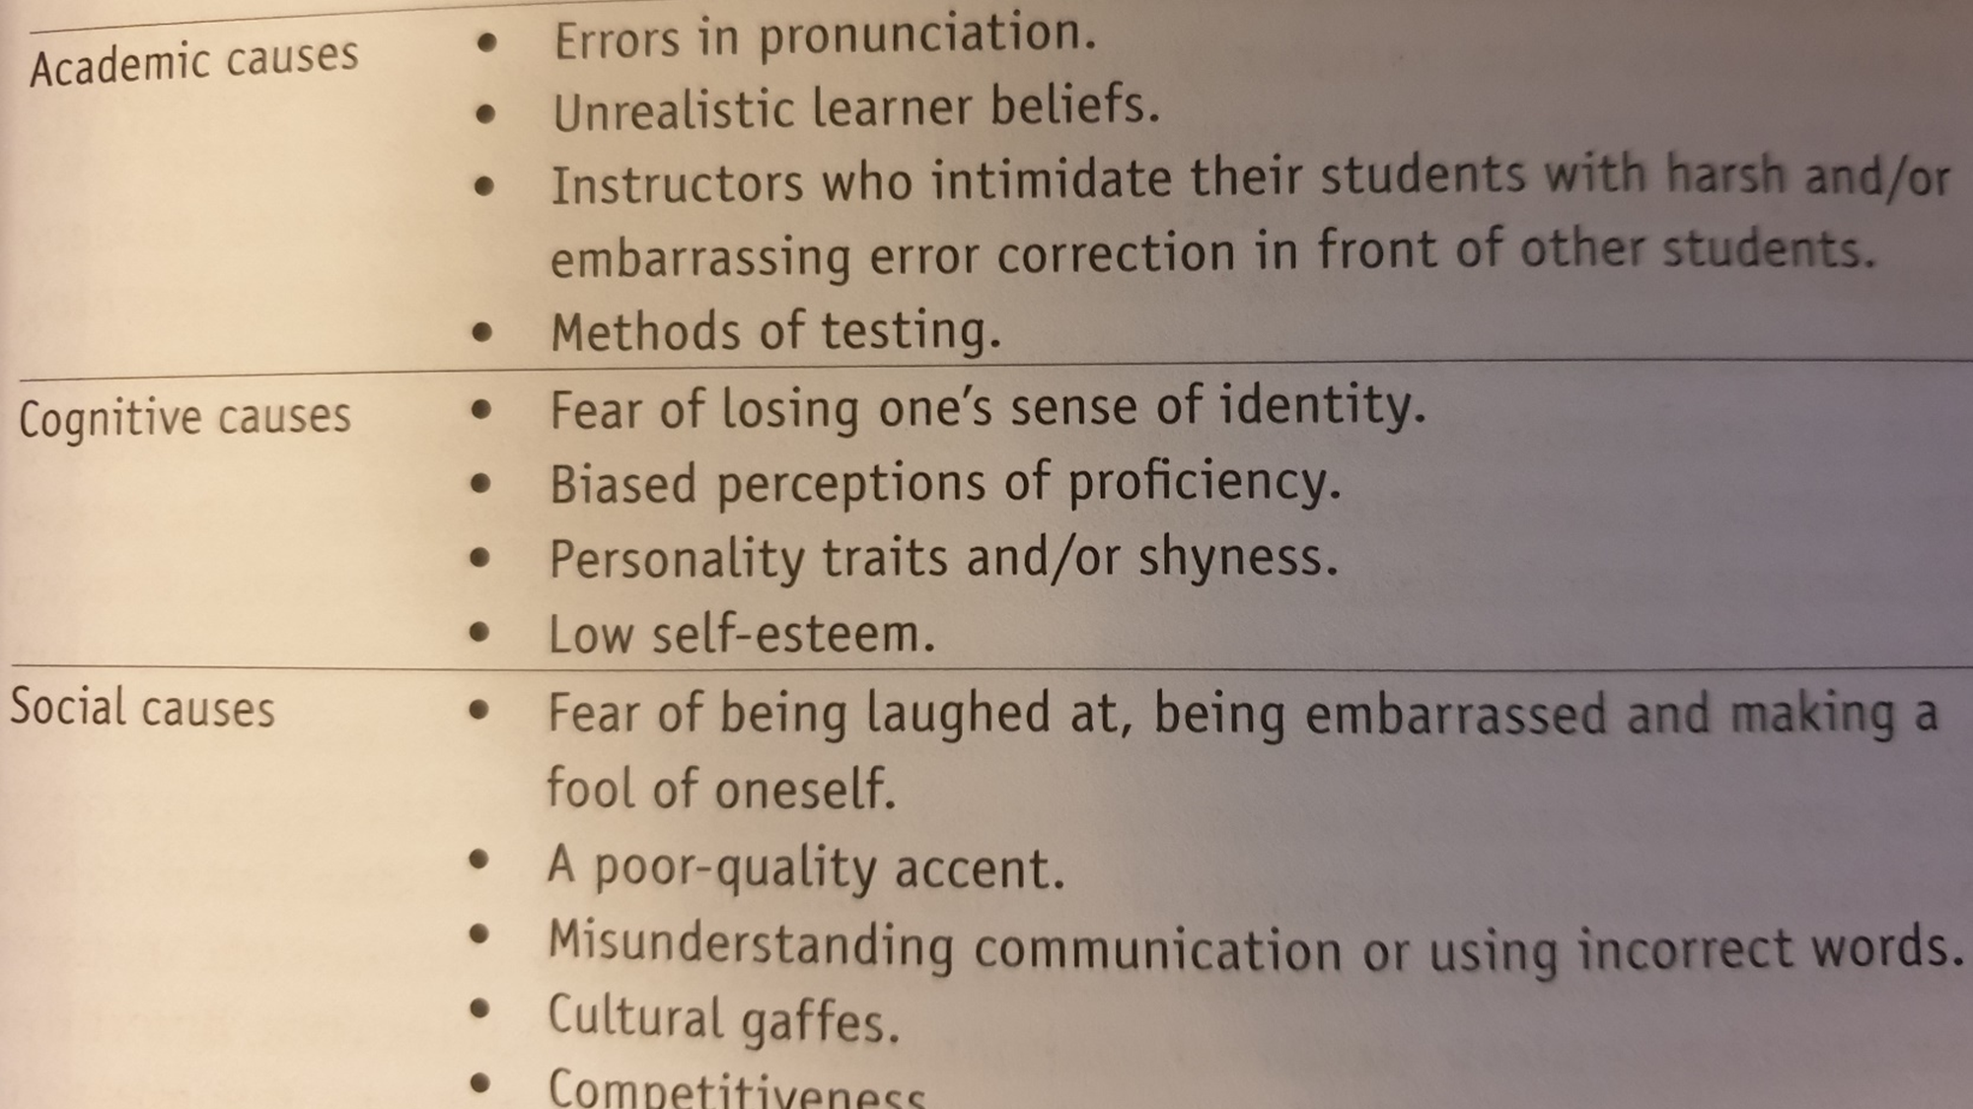
(Socio)emotional Aspects
Language anxiety =
lack of agency, lack of a sense of hope, a sense of positive expectations
(Martena 2020; 2025)
Students’ positive view of teacher support helps to ease their frustration and anxiety.
Age differences: the need for support and positive enforcement especially for students from older age groups; increased anxiety for Year 8 pupils. (Munch 2025)
Students’ self-assessment of their Latvian language proficiency does not always accurately reflect their actual level of language proficiency. Language anxiety leads to underestimating one’s abilities and avoiding active participation. (Igaune 2026)

Slide 18
Identity, Ethnicity, Social Silence
Social silence
Does not depend on the linguistic ability to produce the language
May be used as a tool to show agency and protest
Can be connected with identity issues and language as a significant identity marker
Teacher of a Year 8 class: from 20 pupils there were only 5-6 who could understand Latvian. Everybody else had difficulties to learn, everybody was sitting in the lessons as silent protest.
Ethnicity there was silent. For example, Mil8 admitted that nobody talks about their nationalities or who they are because it was not relevant.
Mil8 used the term “Russian-Latvian”, but NasC8 expressed fear of being identified as Russian in Latvia and therefore being hesitant to use the term “Russian”: “I kind of …live in Latvia, but I speak more in Russian. I…don’t understand who I am…more. (laughs). Maybe I am both”.
(Munch 2025)

Slide 19
4. Language Practices and Exposure at Home

Slide 20
Asymmetric Bilingualism at Home
Bilingual Latvian-Russian families (data from Rīga and Rēzekne; Munch, Brokāne, Martena 2025)
MČ, children 14 and 12 years old;
DiMo, children 18 and 9 years old;
KJ, children 24, 18, 6 years olds;
AM, children 6 and 4 years old;
OG, children 19 and 15 years old
Home language mostly Russian
Due to the reform, mothers (who grew up in Latvian-speaking or bilingual families) have started to speak Latvian with their children (fathers’ knowledge of Latvian is very low)
OG2025: My story is that I’m practically the only one in my family, among my relatives, who actually speaks Latvian [smiles], because the others, UNFORTUNATELY, well, let’s say, my mom and grandparents, well, they probably, well, didn’t have a need for it, because they lived and also worked in the Soviet Union, and so there probably wasn’t a need. So they never learned it. Basically, with the others… So with my husband in Russian, and with the others—my parents and, well, other relatives—basically only in Russian.

Slide 21
Preschool Replaces and Compensates a Latvian-Language Environment
OG2025:
So the nanny… that was one of the requirements—to be able to speak freely with the children in Latvian. That’s basically how it all started. Then we also sent both of our daughters to a Latvian preschool, to a Latvian group. That was also, well, a choice, a deliberate one. Then, of course, logically, to a Latvian school. Well, so there’s that ENVIRONMENT where the children speak. Because I realized that, well, everyone around me speaks only Russian [smiles], so I’m the only one who can talk to them [in Latvian].

Slide 22
Family Literacy Activities
Family literacy activities: both an interactive and educational way of spending time together (Lungoci, Niţă 2024)
Two pupils, Year 8, speaking in fluent Latvian, said that their parents had trained them since childhood.
An8: “They checked me on words … asked “How is that in Latvian? How is that in Latvian?”.
Munch 2025
Every day, when I go to and from the kindergarten, I ask my son to tell me his whole day [in Latvian], what he did, but it's literally what he did. He tells me, I waved to you through the window, then I took a book, looked at the book, then I went to Aleksandr, then we played with Lego, then we went to breakfast, for breakfast we ate porridge, bread with cheese, drank water or tea, came back to the group…
Husband of YM (38), son: 7 years old; Cera, Martena 2025

Slide 23
Use of Latvian within Family Outside Home
OD2025:
When we’re at an event… at school. So I speak Latvian with my daughter, too. That’s the environment there—we speak Latvian there. Then… oh! When we go on trips, exactly… well, among other people, we speak Latvian. Well, hoping that no one will understand us [laughs]. Especially last year when we were in Turkey.

Slide 24
Children and Parents in L2: Change of Roles
Children: Language brokers for societal language
- They mediate, bridging language gaps
- Proficiency in a language as a means of social control
OD2025:
When I need to write a message [in Latvian]—well, for example, I send it to my daughter to proofread [laughs]. She then corrects my mistakes.
(Martena 2025)
(Very similar stories from Latvian or Ukrainian diaspora)

Slide 25
5. Take-away Messages
Emergent bilinguals – gradual process
Fluent teachers
(in formal school settings)
TIME
Receptive & expressive language skills
EXPOSURE
Social interaction
(in informal settings)
Linguistic silence – active participation through verbal thought
Input through daily
routines (after-school activities, home)

Slide 26
Take-away Messages (2)
EMOTIONS
Language anxiety
(low self-evaluation, lack of agency, lack of hope)
Positive language use experiences,
recognition of individual learner differences
Social silence as a form of protest
IDENTITY
Multiple/bilingual identity (harmonious bilingualism)
A sense of accomplishment in being able to speak both Latvian and mother tongue
Home language maintenance – emotional topic for parents

Slide 27
References
Gkonou, C.; Daubney, M., Dewaele, J.-M. (eds) (2017). New Insights into Language Anxiety: Theory, Research and Educational Implications. Multilingual Matters
Igaune, J. (2026). Latviešu valodas prasmju pašvērtējums un ietekme uz mācību procesu. Zinātniskās pētniecības darbs humanitāro un mākslas zinātņu Valodniecības un literatūrzinātnes nozarē. Rēzeknes Valsts 1.ģimnāzija
Krashen, D. (1981). Second Language Acquisition and Second Language Learning. Pergamon Press.
Lave, J., & Wenger, E. (1991). Situated Learning: Legitimate Peripheral Participation. Cambridge: Cambridge University Press.
Lungoci, C., Niţă, D. M. (2024). Family literacy activities and their role in developing studens' critical thinking. Journal of Educational Sciences 50(2): 8-24. DOI: 10.35923/JES.2024.2.02
Martena, S. (2020). Jaunākie pētījumu virzieni par valodu un tās apguves jautājumiem. Skolotāja portfolio latviešu valodas integrētai apguvei. Metodiskais līdzeklis. Latviešu valodas aģentūra
Martena, S. (2025). Valodu jauda: no ģimenes līdz sabiedrībai. J.Rozes apgāds
Munch, D. (2025). Lived experiences of schooling in a second language for Russian-speaking pupils in Latvia. Master’s Thesis in Anthropology of Education and Globalisation. Aarhus University, Denmark
Ohta, A. S. (2001). Second Language Acquisition Processes in the Classroom: Learning Japanese. New York: Routledge.

Slide 28
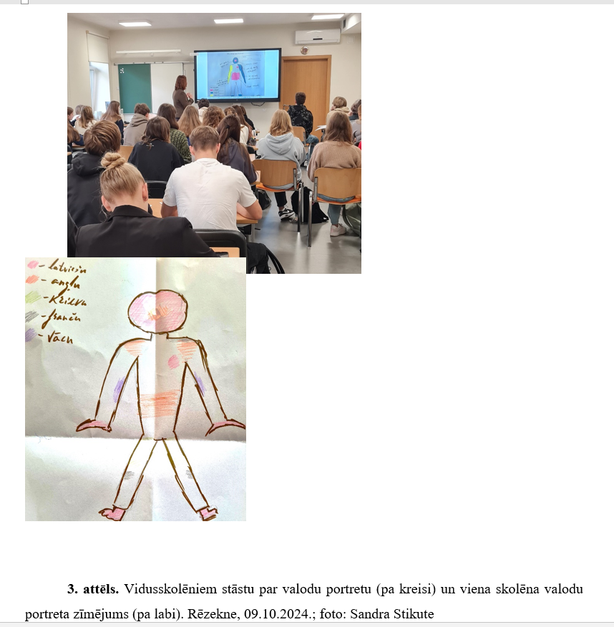

AITÄH! PAĻDIS! PALDIES! THANK YOU!
sanita.martena@rtu.lv
Riga Technical University Rēzekne Academy

