Slide 1

Verb Usage in Estonian Children’s Narratives
ALPA Kids Child Speech Corpus Analysis
Kelly Lilles
Institute of the Estonian Language
Spring conference of the Estonian Association for Applied Linguistics
24th of April 2026

Slide 2

Definition of a Narrative
“We define narrative as one method of recapitulating past experience by matching a verbal sequence of clauses to the sequence of events which (it is inferred) actually occurred.” (Labov 1972)
”[...] storytelling is difficult for children.” (Kütt 2018)

Slide 3
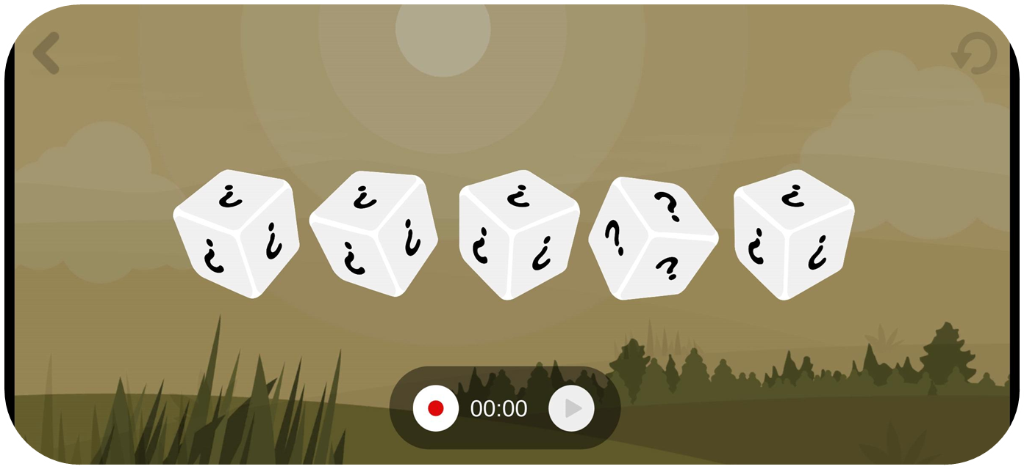

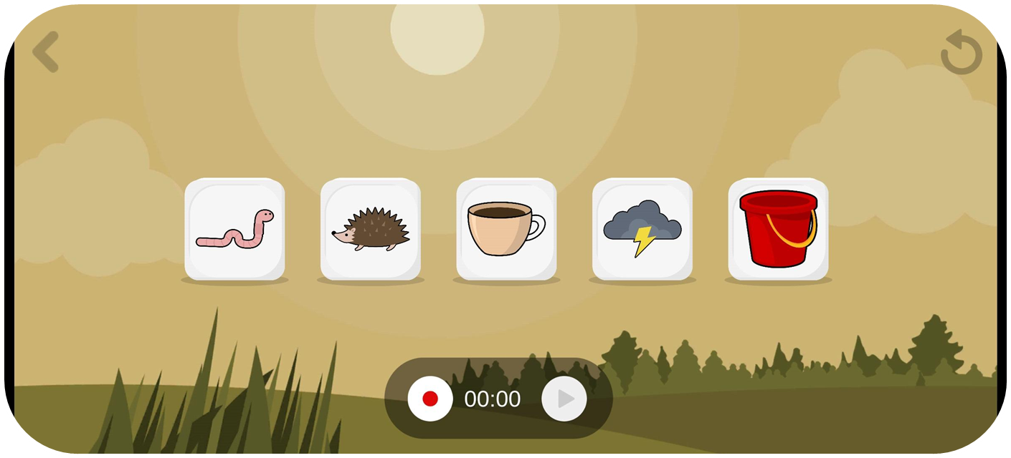

Data Collection Method
Crowd-sourcing via ALPA Kids App:
Interactive educational platform for ages 3–8
Storytelling Game: 5 randomly generated visual icons as stimuli
Audio recordings with optional humorous voice filters for engagement and motivation
Naturalistic family settings

Slide 4
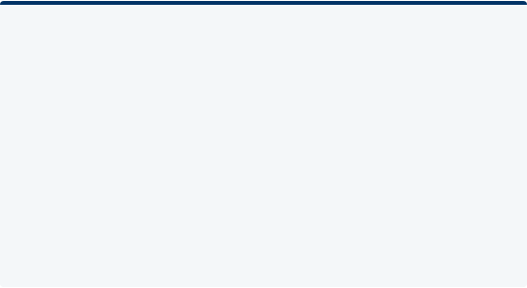


Dual Value of the Corpus
Technological Innovation
Linguistic Research
Improving Estonian children's automatic speech recognition (ASR) systems by providing diverse, high-quality training data.
Developing an L1 and L2 Estonian speech corpus for linguistic and Second Language Acquisition (SLA) analysis.

Slide 5

Scale of Data
Current investigation focuses on 4,108 orthographically transcribed narratives.
This represents a targeted sub-corpus of the 100,000+ narratives collected through crowd-sourcing to date.

Slide 6
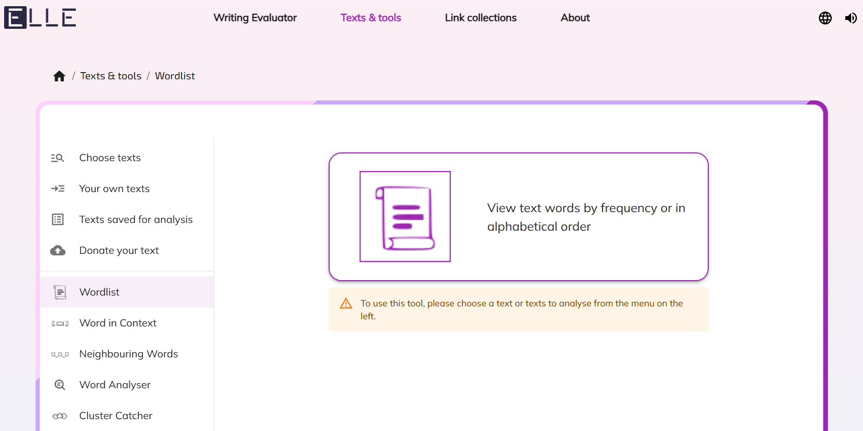
The ELLE Analytical Tool
Estonian Language Learning and Analysis Environment:
Developed at Tallinn University (Allkivi et al., 2024)
Automated lemmatisation (e.g., läks → minema)
Grammatical form filtering for frequency analysis
Source: https://elle.tlu.ee/

Slide 7
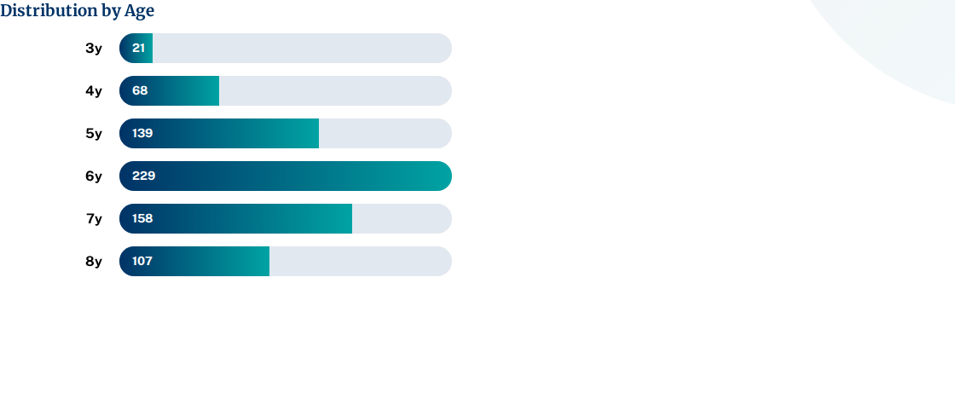
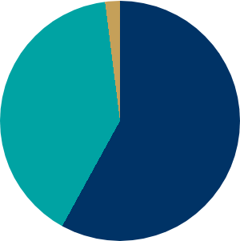
Participant Overview (n=722)
Gender Split
■ Female: 58%
■ Male: 40%
■ Unspecified: 2%

Slide 8
Average Length of Narratives (sec)
Age Group | Avg. Length (Total) | Females (Avg) | Males (Avg) | Unspecified (Avg)
3y | 51.76 | 35.96 | 60.98 | n/a
4y | 31.81 | 32.70 | 34.60 | 15.87
5y | 33.71 | 34.87 | 31.40 | 22.45
6y | 37.88 | 41.08 | 34.34 | 33.40
7y | 36.76 | 38.12 | 34.80 | 54.91
8y | 42.35 | 40.95 | 49.36 | 24.86

Slide 9
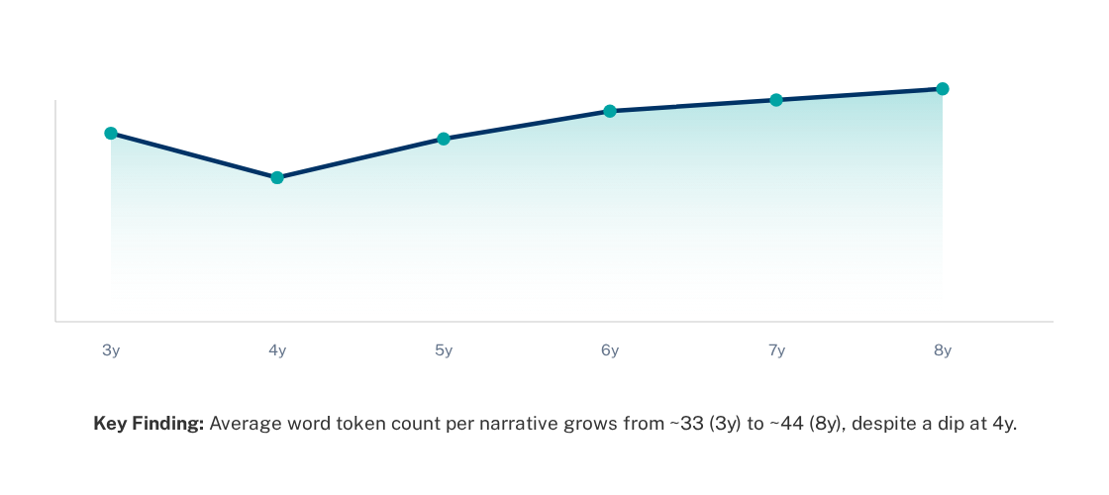
Average no. of Word Tokens
41,39
43,57
38,69
32,56
33,21
25,84

Slide 10
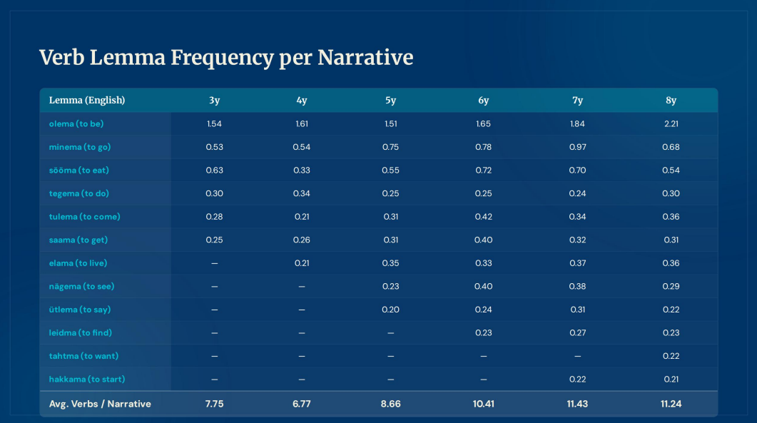
Verb Usage Variation
Most Frequent Lemmas | 3y | 4y | 5y | 6y | 7y | 8y
olema (to be) | 1.54 | 1.61 | 1.51 | 1.65 | 1.84 | 2.21
minema (to go) | 0.53 | 0.54 | 0.75 | 0.78 | 0.97 | 0.68
sööma (to eat) | 0.63 | 0.33 | 0.55 | 0.72 | 0.70 | 0.54
tegema (to do) | 0.30 | 0.34 | 0.25 | 0.24 | 0.24 | 0.30
Average Verbs/Narrative | 7.75 | 6.77 | 8.66 | 10.41 | 11.43 | 11.24

Slide 11
Most Frequent Morphological Forms
Frequency per narrative by age group (0,50+):
Form Category | 3y | 4y | 5y | 6y | 7y | 8y
Past Indicative, 3SG | 3.09 | 2.18 | 3.81 | 4.39 | 5.54 | 4.34
Past Indicative, 3PL | — | 0.64 | 1.18 | 1.32 | 1.36 | 0.77
Present Indicative, 3SG | 1.18 | 0.91 | — | 1.24 | 0.93 | 1.27
ma-infinitive | — | — | 0.54 | 0.59 | 0.62 | 0.59
da-infinitive | — | — | — | 0.54 | 0.58 | 0.59

Slide 12
Limitations of the Study
Data Set Imbalance: Significant variance in the number of unique participants and total narratives across age groups (e.g., 3y vs 6y).
Subjectivity: Reliance on human transcription and normalization of pronunciation errors may introduce bias.
Stimulus Freedom: Semi-spontaneous icon choice leads to varied story complexity.

Slide 13

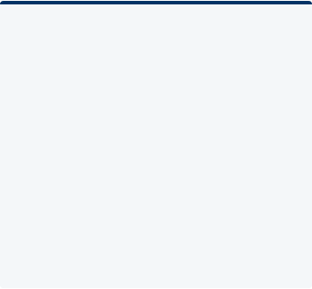



Core Findings I: Productivity
Discourse Growth
Duration vs. Lexis
Verb Scaffolding
Narrative length increases with age, reflecting growing ability to sustain long discourse and organize complex event chains.
Long 3-year-old recordings likely reflect pauses and planning time rather than lexical richness, peaking at ~33 tokens per story.
Children rely on semantically general verbs (be, go, eat) as early structural scaffolding for narrative cohesion.

Slide 14




Core Findings II: Grammar
Narrative Mode
Syntactic Integration
Motion Bridges
Strong dominance of Past Indicative 3SG forms across groups, reaching a peak at age 7, aligning with the "storytelling mode."
Infinitives (ma/da) emerge productively around age 5, supporting more advanced event chaining and clause combining.
Motion constructions act as bridges, simultaneously encoding spatial change and temporal narrative progression.

Slide 15
Future Research Directions
Continued formation and expansion of the ALPA Kids Corpus
Refining transcription workflows (pseudo and orthographic)
Integration of Latvian and Lithuanian language data for Baltic comparative studies
In-depth construction analysis of motion patterns, especially with the semantic layering option

Slide 16
Selected References
Allkivi, K., et al. (2024). ELLE – Estonian Language Learning and Analysis Environment. Baltic Journal of Modern Computing, 12(4), 560-569.
Argus, R. (2008). Eesti keele muutemorfoloogia omandamine. Tallinn: Tallinna Ülikooli Kirjastus.
Argus, R., & Kõrgesaar, H. (2011). Hakkama-verb lapsekeeles: kas aspektilisuse või tuleviku tähistaja? Emakeele Seltsi aastaraamat, 57, 9–24.
Argus, R., & Parm, S. (2010). Eesti keele ajakategooria omandamisest – ajavormid ja ajasõnad. ERÜ aastaraamat, 6, 25–41.
Gagarina, N., et al. (2019). MAIN: Multilingual Assessment Instrument for Narratives. ZAS Papers in Linguistics.
Kütt, A. (2018). MAIN-testi kasutamine eesti laste jutustamisoskuse hindamiseks. Eesti Rakenduslingvistika Ühingu Aastaraamat, 14, 95–115
Labov, W. (1972). The transformation of experience in narrative syntax. In W. Labov, Language in the inner city: Studies in the Black English vernacular (pp. 354–396). University of Pennsylvania Press.
Stein, N. L., & Glenn, C. G. (1979). An analysis of story comprehension in children. In R. Freedle (Ed.), New directions in discourse processing.

Slide 17
Acknowledgements
This work was partly supported by the Enterprise Estonia applied research grant The Training of Estonian Children’s Speech Recognition Models (RE.5.04.23-0505) and by the Estonian Research Council grant Expanding the Scope of a Multi-Purpose Lexicographic Resource to Grammar and L2 Competence (PRG1978). I also express my sincere gratitude to my PhD supervisors, Jelena Kallas and Reili Argus, for their guidance and support.

Slide 18
Thank you for listening!
Contact: kelly.lilles@eki.ee

