Slide 1

Narrative Microstructure in Retellings by Preschool and Pre-Primary Lithuanian Children
Jonas Stepšys
2026-04-24, Talinn
Notes:
Hello everyone, my name is Jonas Stepšys. I am from Vytautas Magnus University in Lithuania. I am currently a PhD student focusing on storytelling and retelling by preschool children with developmental language disorder, using MAIN. Today, I will present a study that examines narrative microstructure in Retellings by Preschool and pre-primary typically developing Lithuanian children.

Slide 2
Narratives in Child Language Research
Storytelling is a common activity in early childhood, as children constantly hear stories or are told stories (Hughes, McGillivray, & Schmidek, 1997), and for older children, it becomes part of learning activities;
Storytelling requires cognitive and social abilities, including story structure, structural complexity, internal state language, cohesion, morphosyntax, and lexical diversity and productivity (Gagarina & Bohnacker, 2022);
Narrative skills are essential for children because encouraging them to tell stories improves their linguistic competence, cognitive functions, emotional intelligence, academic success, and cultural understanding (Westerveld, Gillon and Moran 2008).
Terms | Background | Aim | Methods | Results | Conclusions
Notes:
Storytelling is common in early childhood and later supports learning. It involves cognitive and social skills, including structuring stories and using language. Strong narrative skills are important for language, thinking, emotional development, academic success, and cultural understanding.

Slide 3
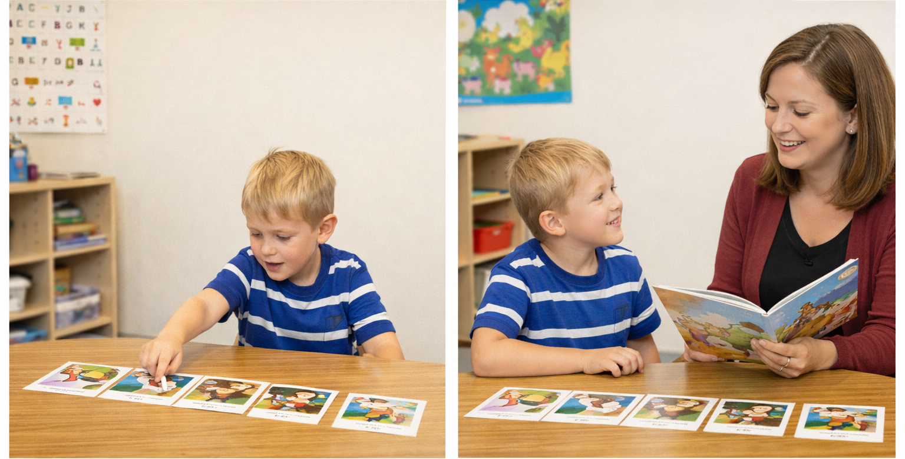
Storytelling
Story retelling
Prašant vaiko papasakoti istoriją (angl. storytelling, narrating) pagal paveikslėlių seką, dėl veikliosios (arba darbinės) atminties (angl. working memory) gebėjimų (kūrybiškumo ir kalbos žinių), vaikas geba sukurti istoriją;
Atpasakojimo (angl. story retelling) užduotis reikalauja pirmiausia sutelkti dėmesį į girdimąją informaciją (angl. sustained auditory attention), nes vaikas, nesiklausydamas visų istorijos komponentų, negebės atpasakoti rišlios istorijos (Duinmeijer, De Jong, & Scheper 2012).
Terms | Background | Aim | Methods | Results | Conclusions
Notes:
Various narrative elicitation methods exist, but this study uses two: picture-based storytelling, relying on working memory, creativity, and language skills; and retelling tasks, which require sustained auditory attention, as missing parts leads to incoherent narratives.

Slide 4
Typically Developing Children’s Narratives
The narrative production abilities of TD preschool-aged children are continuously improving:
–A significantly richer vocabulary and more complex sentence structures are used in the older children’s group when comparing the narratives of monolingual Croatian TD children aged 6 and 8 (Košutar, Kramarić, & Hržica 2022);
–When comparing monolingual Swedish TD children aged 4 to 9, narrative measures such as mean length of utterance (in words) and syntactic complexity increase with age (Lindgren 2018; 2022);
–Monolingual Lithuanian TD pre-primary children demonstrate higher lexical diversity and a greater total number of words in narrative production compared to preschool-aged children (Balčiūnienė 2022).
Terms | Background | Aim | Methods | Results | Conclusions
Notes:
Narrative skills in typically developing preschool children improve with age, with older children using richer vocabulary, more complex sentences, and producing longer, better-structured narratives across languages.

Slide 5
Atypically Developing Children’s Narratives
Pre-primary-aged children with developmental language disorder experience difficulties in narrative production across all microstructural levels compared to age-matched typically developing children.
Such results have been reported in studies of Dutch (Zwitserlood et al. 2015), Russian (Balčiūnienė & Kornev 2019), Finnish (Mäkinen et al. 2014), Greek (Tsimpli, Perister, & Andreou 2016), and Lithuanian (Dabašinskienė et al. 2024) languages.
Terms | Background | Aim | Methods | Results | Conclusions
Notes:
In contrast, children with developmental language disorder experience difficulties in narrative production across all microstructural levels.

Slide 6
(A)Typically Developing Children’s Retellings
Cross-linguistic studies of storytelling and story retelling have shown that both macrostructure and microstructure measures are generally higher in story retelling tasks in both typically and atypically developing children (Otwinowska et al. 2020; Andreou, Lemoni 2025; Liu et al. 2025; Olsen, Jensen de López 2025) , however:
–Dutch 7-year-old children with developmental language disorder demonstrate significantly lower microstructural measures compared to age-matched TD children (Duinmeijer et al. 2012);
–The influence of language development on macrostructural outcomes has been demonstrated in studies of the Croatian (Kraljevic et al. 2020) and Swedish (Lindgren 2023) languages.
To date, story retelling has not been studied in the Lithuanian language.
Terms | Background | Aim | Methods | Results | Conclusions
Notes:
Cross-linguistic studies show higher macro- and microstructure scores in retelling tasks, though children with developmental language disorder still perform worse, especially in microstructure; retelling has not yet been studied in Lithuanian.

Slide 7
Study Aim
To examine the linguistic features in storytelling and story retelling among Lithuanian-speaking typically developing preschool and pre-primary children aged 4;0–6;11 years.
Terms | Background | Aim | Methods | Results | Conclusions
Notes:
This study examines the linguistic features in storytelling and story retelling among Lithuanian-speaking typically developing preschool and pre-primary children aged 4;0–6;11 years.

Slide 8
Research Questions
Do story retelling tasks elicit more linguistically complex narratives than spontaneous storytelling?
How do microstructural features of storytelling and story retelling develop in children aged 4–6 years?
Terms | Background | Aim | Methods | Results | Conclusions

Slide 9
Sample Size
Age group | Study Group 1 |  |  | Study Group 2
 | Number of participants | N of the TE Dog | N of RE Baby Birds | Number of participants | N of the TE Baby Birds | N of the RE Dog
4;0–4;11 | 17 | 15 | 15 | 15 | 15 | 15
5;0–5;11 | 15 | 15 | 15 | 18 | 15 | 18
6;0–6;11 | 24 | 24 | 23 | 23 | 19 | 23
Terms | Background | Aim | Methods | Results | Conclusions
Notes:
A total of 112 typically developing Lithuanian children (4;0–6;11) completed storytelling and retelling tasks using LITMUS-MAIN, with groups assigned different story versions to enable controlled analysis of narrative production. Twelve participants (11%) completed only one task; their data were included, but the study focuses on overall narrative features rather than individual performance.

Slide 10
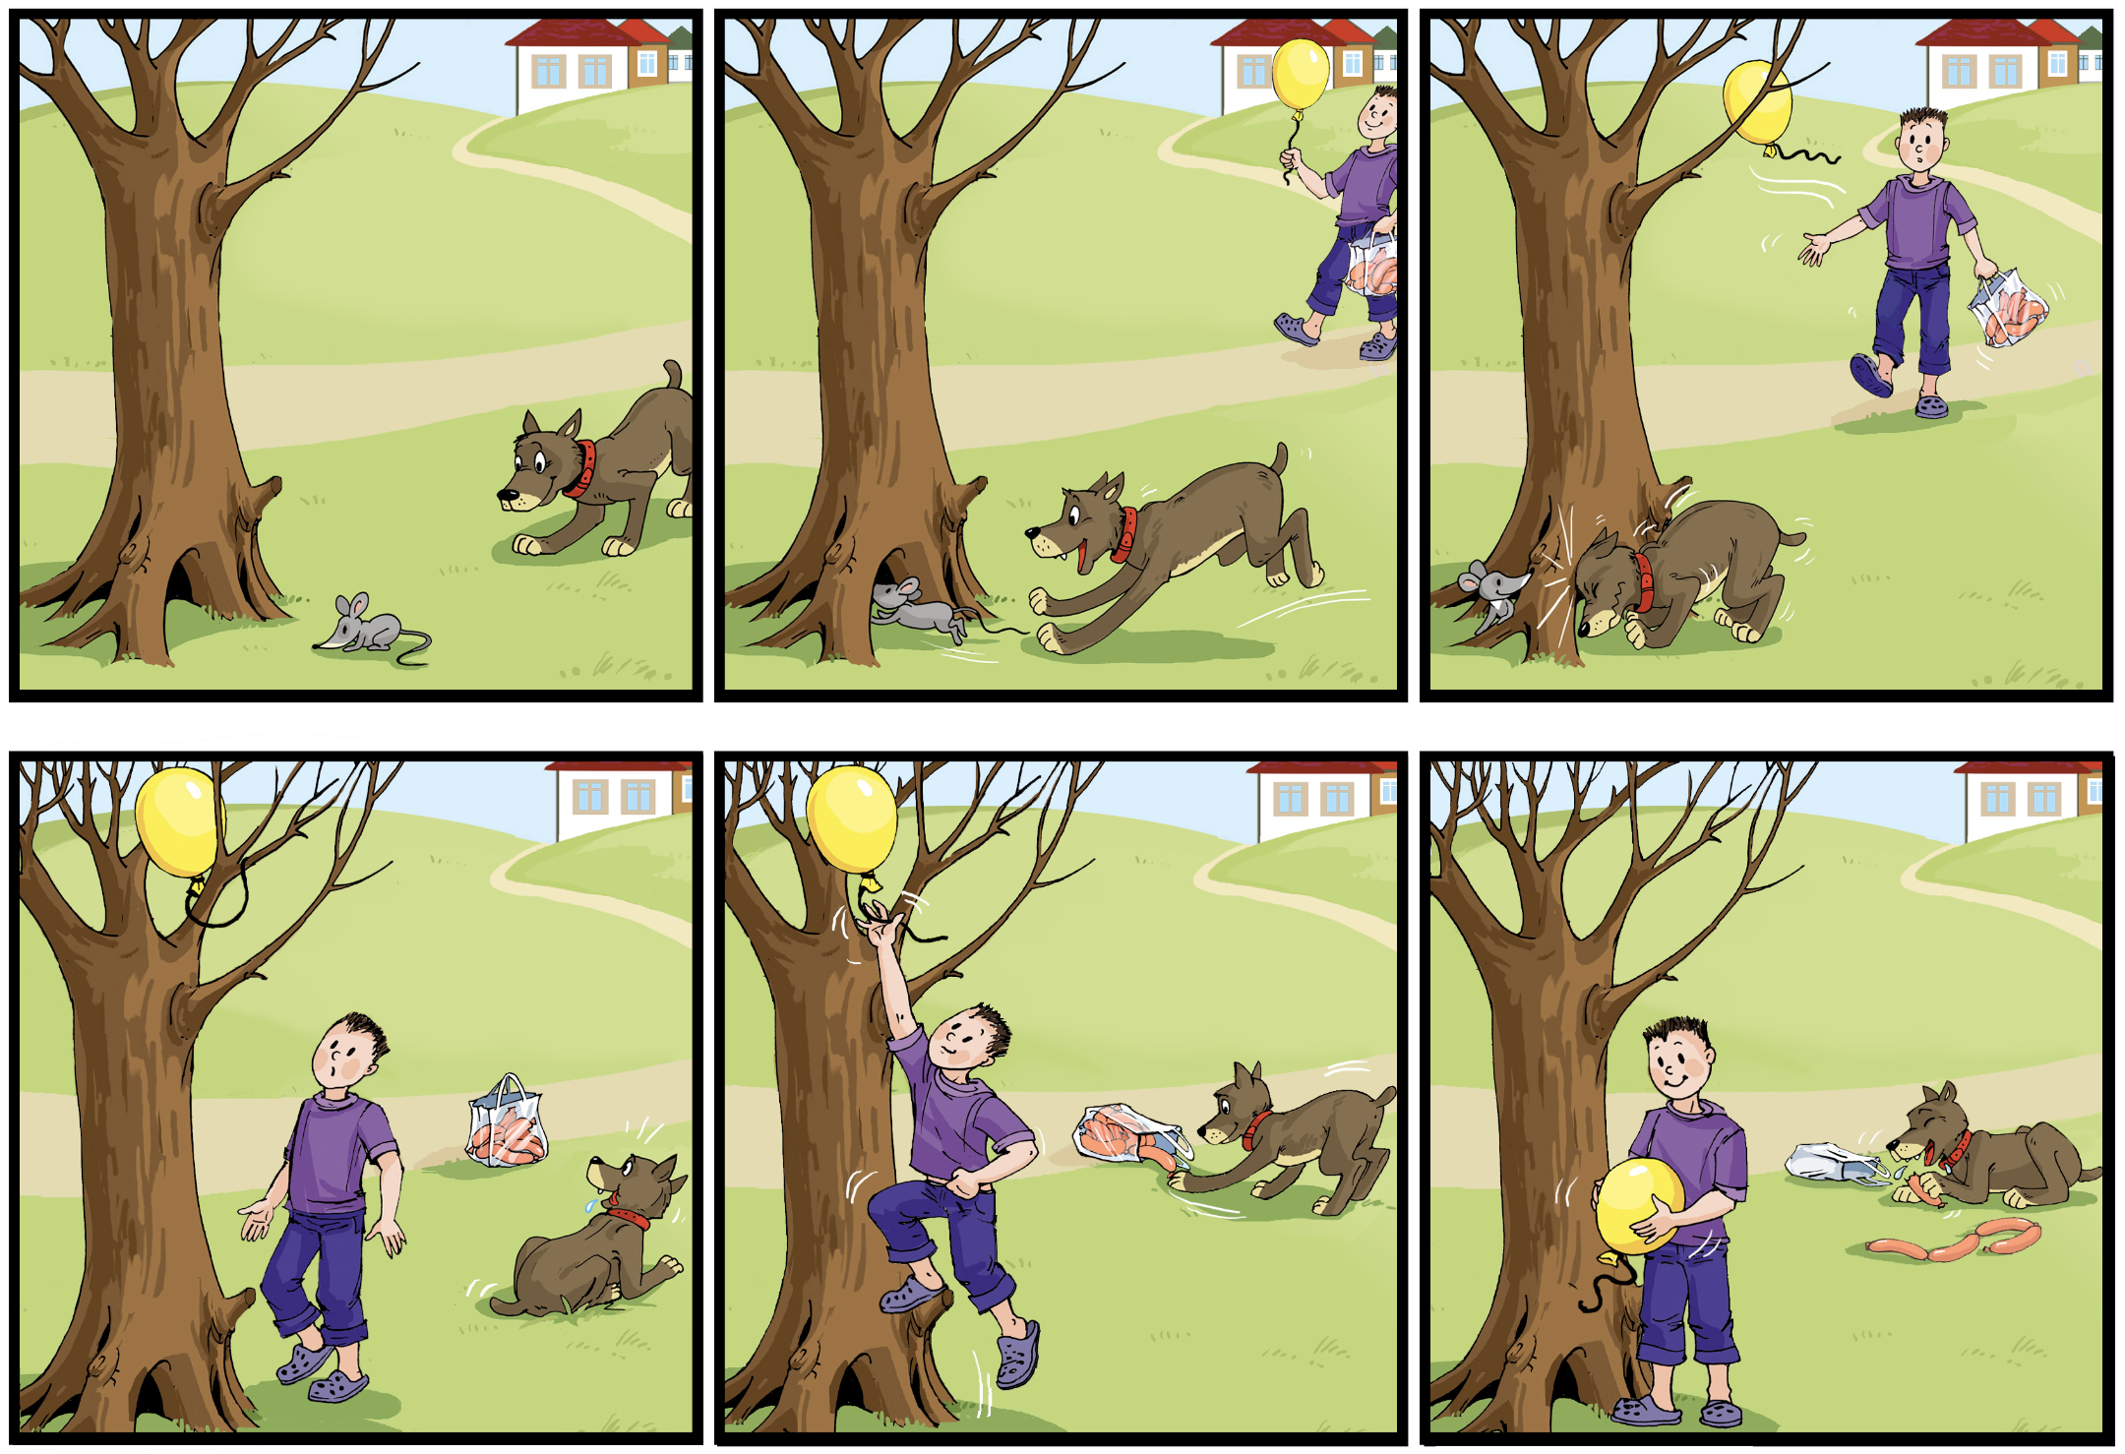
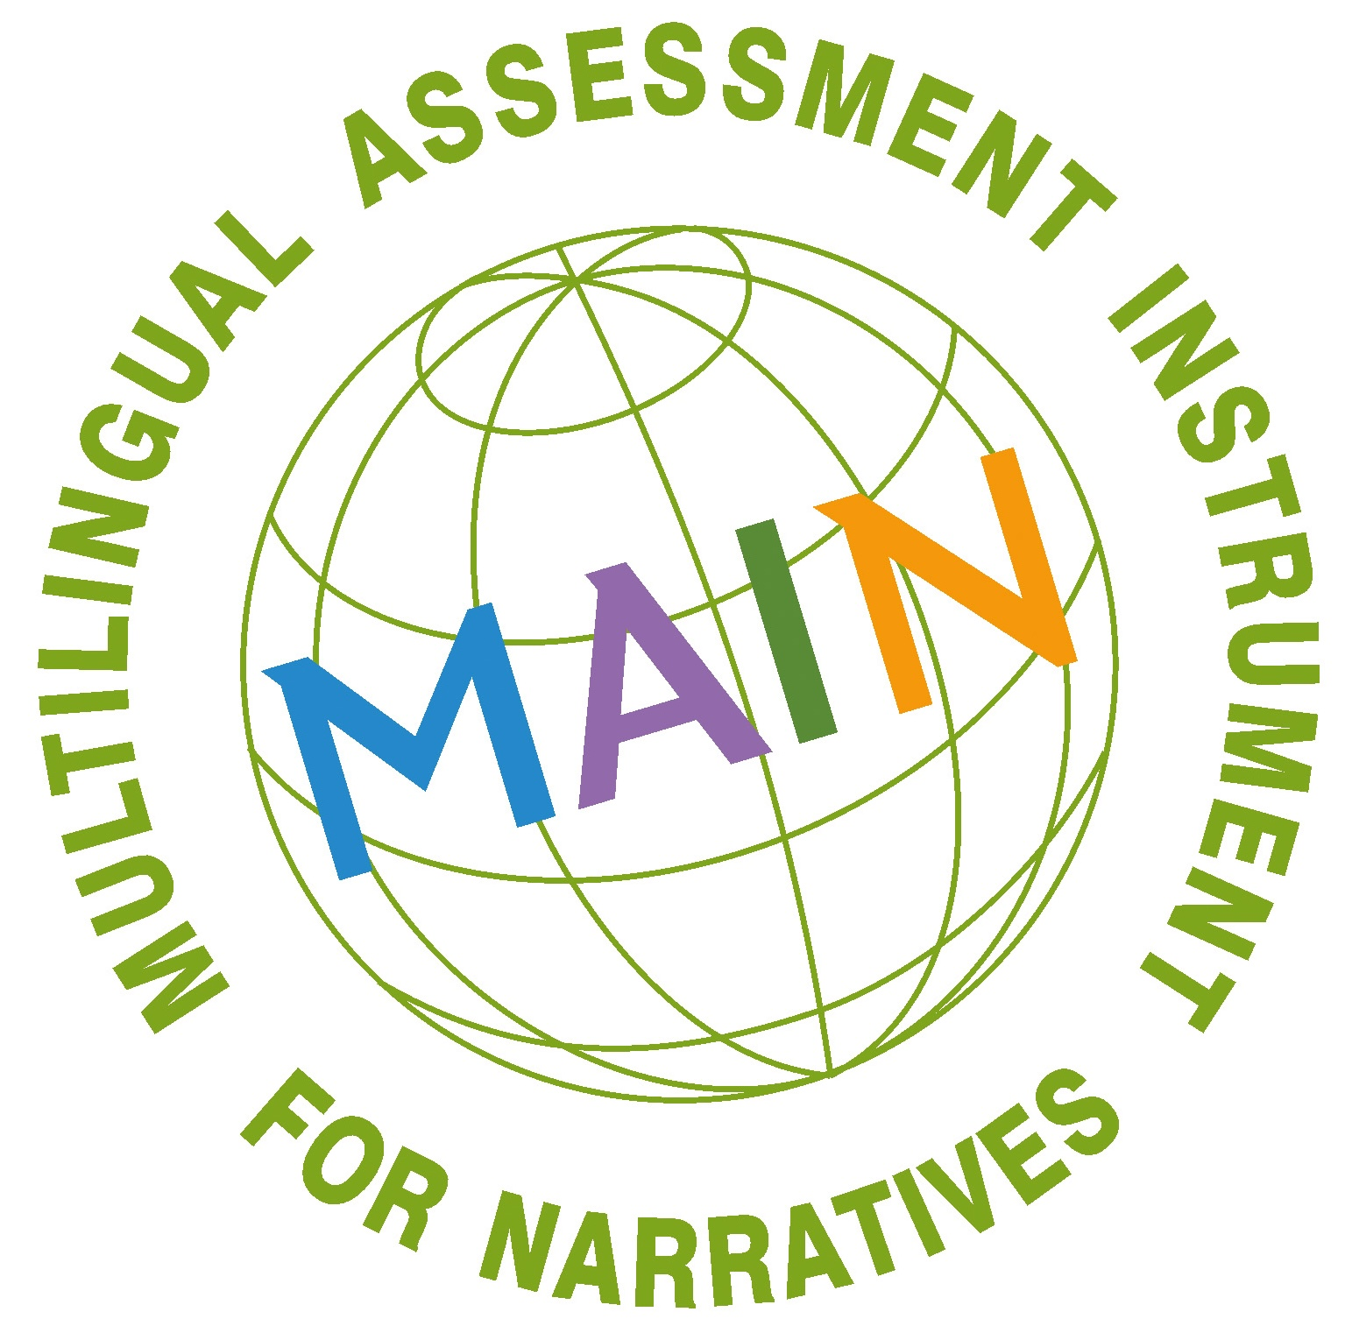
Dog
(Gagarina, N., Klop, D., Kunnari, S., Tantele, K., Välimaa, T., Bohnacker, U. & Walters, J. 2019)
Terms | Background | Aim | Methods | Results | Conclusions
Notes:
The first pair of picture sequences consists of the Dog story.

Slide 11
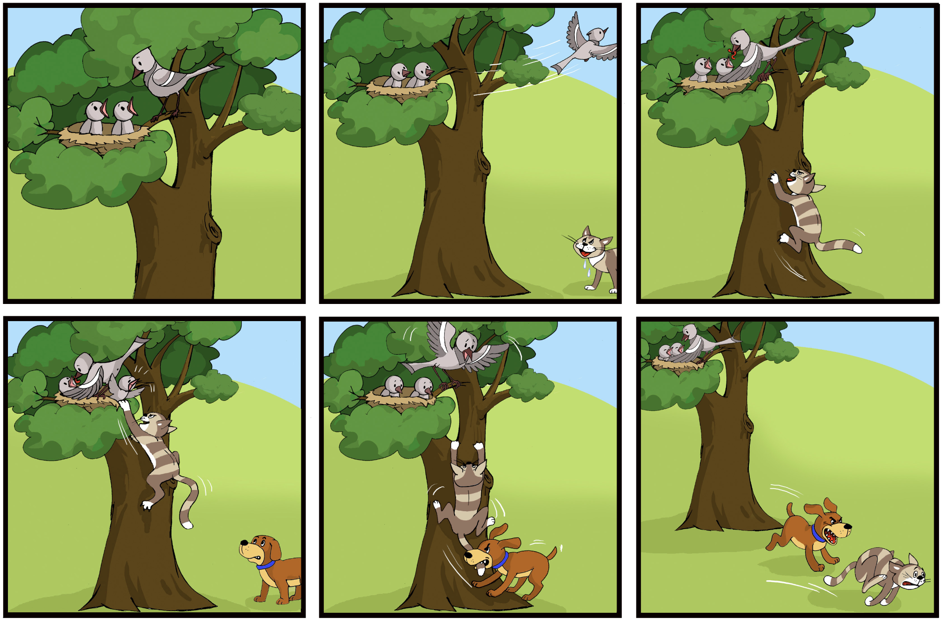
(Gagarina, N., Klop, D., Kunnari, S., Tantele, K., Välimaa, T., Bohnacker, U. & Walters, J. 2019)
Baby Birds
Terms | Background | Aim | Methods | Results | Conclusions
Notes:
The second pair of picture sequences consists of the Baby Birds story. The Dog and the Baby Birds stories are structurally different, making the Baby Birds story more complex, with three episodes and five characters; analysis compares patterns by task, content, and age, not direct results between Baby Birds and Dog.

Slide 12
Productivity
Total number of words
Total number of communication units
Lexical diversity
Number of different words
Syntactic complexity
Mean length of utterance
Terms | Background | Aim | Methods | Results | Conclusions
Notes:
In this study, narrative production is analysed using in the slide presented microstructural measures.

Slide 13
Total Number of Words (Mean)
 | Dog |  | Baby Birds
Age | TE | RE | TE | RE
4;0–4;11 | 55,2 | 61,93 | 53,46 | 39,46
5;0–5;11 | 53,33 | 59,27 | 57,73 | 43,86
6;0–6;11 | 64,83 | 71,86 | 49,57 | 66,13
Terms | Background | Aim | Methods | Results | Conclusions
Notes:
First, the total number of words produced by 4-year-old children in the Dog story retelling is comparable to that of 6-year-old children in Dog story storytelling.

Slide 14
Total Number of Words (Mean)
 | Dog |  | Baby Birds
Age | TE | RE | TE | RE
4;0–4;11 | 55,2 | 61,93 | 53,46 | 39,46
5;0–5;11 | 53,33 | 59,27 | 57,73 | 43,86
6;0–6;11 | 64,83 | 71,86 | 49,57 | 66,13
Terms | Background | Aim | Methods | Results | Conclusions
Notes:
The overall total number of words in the Dog story is higher in the story retelling task.

Slide 15
RE Dog 5;5
<...> pelė turėjo urvą, kuris kur šuo negalėjo pralįsti. <...> Jis nustebo ir net ir jo balionas net išsprūdo iš rankų ir susirišo į medį. <…> Berniukas šoktelėjo visų iš visų jėgų aukštyn, iš visų jėgų aukštyn. <…> Berniukas apsidžiaugė atgavęs balioną ir xxx, ir iš džiaugsmo nepastebėjo, kad šuo valgo jos jo žuvis. Oj, ne žuvis, o dešreles. <...> Ir taip ir taip berniukas išėjo be dešrelių namo su maišeliu.
Terms | Background | Aim | Methods | Results | Conclusions
Notes:
But in the presented retelling sample of a 5-year-old child, frequent repetitions and self-corrections are observed, which contribute to a higher total number of words.

Slide 16
RE Dog 6;9
Vieną dieną šuo pamatė pilką pelytę ir nusprendė ją gaudyt(i). Pelytė įlindo į urvą, šuo bandė pagaut(i). Berniukas ėjo su dešrelėm(is) ir balionais. Ei, ką čia darai? Berniukas taip nustebo, kad net iš rankų net iškrito balionas. O šuo pamatė dešrelių maišelį ir nusprendė pavalgyti jų. Berniukas stryktelėjo, paėmė balioną, net nepamatė, kaip šuo skaniai valgo dešreles.
Terms | Background | Aim | Methods | Results | Conclusions
Notes:
Compared to 6-year-old children, narratives in this group are more coherent, with fewer repetitions and no observed self-corrections.

Slide 17
Total Number of Words (Mean)
 | Dog |  | Baby Birds
Age | TE | RE | TE | RE
4;0–4;11 | 55,2 | 61,93 | 53,46 | 39,46
5;0–5;11 | 53,33 | 59,27 | 57,73 | 43,86
6;0–6;11 | 64,83 | 71,86 | 49,57 | 66,13
Terms | Background | Aim | Methods | Results | Conclusions
Notes:
In storytelling of the Baby Birds story, the total number of words decreases with age, which may be influenced by macrostructural parameters or picture content.

Slide 18
Total Number of Words (Mean)
 | Dog |  | Baby Birds
Age | TE | RE | TE | RE
4;0–4;11 | 55,2 | 61,93 | 53,46 | 39,46
5;0–5;11 | 53,33 | 59,27 | 57,73 | 43,86
6;0–6;11 | 64,83 | 71,86 | 49,57 | 66,13
Terms | Background | Aim | Methods | Results | Conclusions
Notes:
Compared to story retelling task results, the total number of words increases markedly with age. This may be explained by the transitional period around the age of five, during which narrative production abilities develop significantly.

Slide 19
Total Number of Communication Units (Mean)
 | Dog |  | Baby Birds
Age | TE | RE | TE | RE
4;0–4;11 | 9,93 | 10,73 | 8,33 | 8,86
5;0–5;11 | 9,2 | 9,33 | 10,2 | 8,2
6;0–6;11 | 8,83 | 8,69 | 9,39 | 9,21
Terms | Background | Aim | Methods | Results | Conclusions
Notes:
In storytelling and story retelling based on the Dog picture sequence, younger children produce a higher number of sentences compared to the oldest age group.

Slide 20
TE Dog 6;11
LT:
Vieną kartą šuo užsimanė pelės, bet pamatė einantį žmogų.
Po_to jis bandė lįst(i), bet pamatė dešreles ir nubėgo jas suėsti.
Ir suėdė.
EN:
Once, the dog wanted a mouse, but he saw a man walking by.
Then he tried to sneak in, but he saw sausages and ran to eat them.
And he ate them.
Terms | Background | Aim | Methods | Results | Conclusions
Notes:
As shown in the example, narratives produced by the oldest children include compound sentences. At the same time, narratives are relatively short but informative, with a clear structure.

Slide 21
Total Number of Communication Units (Mean)
 | Dog |  | Baby Birds
Age | TE | RE | RE | RE
4;0–4;11 | 9,93 | 10,73 | 8,33 | 8,86
5;0–5;11 | 9,2 | 9,33 | 10,2 | 8,2
6;0–6;11 | 8,83 | 8,69 | 9,39 | 9,21
Terms | Background | Aim | Methods | Results | Conclusions
Notes:
The same results are observed in both storytelling and story retelling of the Baby Birds stories.

Slide 22
Mean Length of Utterance
 | Dog |  | Baby Birds
Age | TE | RE | TE | RE
4;0–4;11 | 5,55 | 5,77 | 6,03 | 4,73
5;0–5;11 | 5,79 | 6,35 | 5,66 | 5,34
6;0–6;11 | 7,33 | 8,26 | 5,38 | 6,97
Terms | Background | Aim | Methods | Results | Conclusions
Notes:
With age, children produce fewer but longer utterances. Longer utterances are observed in story retelling tasks. An exception is storytelling with the Baby Birds stories, where older children produce more but shorter utterances. This finding should be re-evaluated, as it may be influenced by picture complexity or the linguistic annotation of the narratives.

Slide 23
TE Dog 5;11
LT
Pelė bėgo į savo mažiuką namelį, šuo paskui jį.
Peliukas įėjo, šuo vis_tiek prie jo buvo.
Žmogus su balionu ėjo.
Po_to pelė įlipo ten.
Šuo užsigavo ir žmogus paleido balioną.
O šuo o šuo gulėjo.
O žmogus, nu, paleido balioną.
O žmogus užlipo po_to ir tą balioną paėmė.
O šuo paėmė dešreles.
O čia jisai paėmė tą balioną.
O šuo viską išėmė ir pradėjo valgyti.
EN
The mouse ran to its little house, and the dog followed it.
The little mouse went inside, but the dog was still there by it.
A man was walking with a balloon.
Then the mouse climbed up there.
The dog got hurt, and the man let go of the balloon.
And the dog was lying there.
And the man, well, released the balloon.
Then the man climbed up and took that balloon.
And the dog took the sausages.
And here he took that balloon.
And the dog took everything out and started eating.
Terms | Background | Aim | Methods | Results | Conclusions
Notes:
For example, in storytelling of the Dog story, there is an equal number of simple and compound sentences.

Slide 24
TE Baby Birds 6;10
LT
Buvo trys paukšteliai.
Vienas nuskrido, katinas pamatė.
Po_to atskrido vienas xxx, šuo pamatė.
Šuo pagavo už uodegos ir nugainiojo.
Kad paukštelis dar čia bandė nuskristi.
O šuo jį nugainiojo.
EN
There were three little birds.
One flew away, and the cat saw it.
Then another xxx flew in, and the dog saw it.
The dog grabbed it by the tail and chased it away.
The bird was still trying to fly away.
And the dog chased it away.
Terms | Background | Aim | Methods | Results | Conclusions
Notes:
In the next example, in storytelling of the Baby Birds picture sequence, a 6-year-and-10-month-old participant produced significantly fewer sentences. However, there is an equal number of simple and compound sentences.

Slide 25
Mean Number of Parts of Speech
Age | Noun | Verb | Adjective
TE Dog
4;0–4;11 | 16,86 | 17,0 | 0,20
5;0–5;11 | 18,13 | 14,46 | 0
6;0–6;11 | 19,83 | 18,54 | 0,29
RE Dog
4;0–4;11 | 18,06 | 19,6 | 0,26
5;0–5;11 | 19,66 | 17,27 | 0,72
6;0–6;11 | 22,91 | 19,91 | 1,08
Terms | Background | Aim | Methods | Results | Conclusions
Notes:
The selected parts of speech carry the greatest semantic load and are important for narrative linguistic quality. In story retelling, children tend to use a higher number of nouns and verbs. There is a slight but non-significant increase in the use of adjectives in story retelling task. Lithuanian studies show that adjectives are relatively difficult to acquire before the age of six due to the large variety of lexical-semantic categories.

Slide 26
Mean Number of Parts of Speech
Age | Noun | Verb | Adjective
TE Baby Birds
4;0–4;11 | 14,06 | 12,26 | 0,33
5;0–5;11 | 16,80 | 18,53 | 0,93
6;0–6;11 | 14,10 | 15,42 | 0,63
RE Baby Birds
4;0–4;11 | 12,06 | 12,13 | 1,2
5;0–5;11 | 13,46 | 13,0 | 1,33
6;0–6;11 | 17,47 | 21,69 | 1,69
Amžiaus grupė | Daiktavardis | Veiksmažodis | Būdvardis
Pasakojimas Šuo
4;0–4;11 | 16,86 | 17,0 | 0,20
5;0–5;11 | 18,13 | 14,46 | 0
6;0–6;11 | 19,83 | 18,54 | 0,29
Atpasakojimas Šuo
4;0–4;11 | 18,06 | 19,6 | 0,26
5;0–5;11 | 19,66 | 17,27 | 0,72
6;0–6;11 | 22,91 | 19,91 | 1,08
Terms | Background | Aim | Methods | Results | Conclusions
Notes:
Considering the total number of words in storytelling and story retelling of the Baby Birds task, children also use an equal number of nouns and verbs in both tasks.

Slide 27
Number of Different Words (Lexical Diversity)
Age | Noun | Verb | Adjective
TE Dog
4;0–4;11 | 0,300 | 0,776 | 1,000
5;0–5;11 | 0,437 | 0,733 | 0
6;0–6;11 | 0,458 | 0,734 | 0,857
RE Dog
4;0–4;11 | 0,491 | 0,711 | 1,000
5;0–5;11 | 0,474 | 0,726 | 0,777
6;0–6;11 | 0,441 | 0,750 | 0,909
Terms | Background | Aim | Methods | Results | Conclusions
Notes:
There is no effect of task on lexical diversity in the Dog picture sequence.

Slide 28
Number of Different Words (Lexical Diversity)
Age | Noun | Verb | Adjective
TE Baby Birds
4;0–4;11 | 0,327 | 0,463 | 0,600
5;0–5;11 | 0,292 | 0,745 | 0,571
6;0–6;11 | 0,301 | 0,741 | 0,700
RE Baby Birds
4;0–4;11 | 0,478 | 0,839 | 0,571
5;0–5;11 | 0,400 | 0,804 | 0,600
6;0–6;11 | 0,470 | 0,701 | 0,692
Amžius | Daiktavardis | Veiksmažodis | Būdvardis
Pasakojimas Šuo
4;0–4;11 | 0,300 | 0,776 | 1,000
5;0–5;11 | 0,437 | 0,733 | 0
6;0–6;11 | 0,458 | 0,734 | 0,857
Atpasakojimas Šuo
4;0–4;11 | 0,491 | 0,711 | 1,000
5;0–5;11 | 0,474 | 0,726 | 0,777
6;0–6;11 | 0,441 | 0,750 | 0,909
Terms | Background | Aim | Methods | Results | Conclusions
Notes:
There is no effect of task on lexical diversity in the Baby Birds picture sequence.

Slide 29
Summary
With linguistic support (stimulus), children demonstrate higher overall microstructural performance compared to conditions without stimulus in the storytelling task.
Task influences 4–6-year-old children’s narratives, as they produce more coherent and structured output in story retelling than in storytelling.
Age influences narrative ability, with older children showing higher microstructural performance, especially in story retelling.
Terms | Background | Aim | Methods | Results | Conclusions
Notes:
With linguistic support, children show better microstructure in storytelling. Retelling also leads to more coherent narratives than storytelling. Overall, narrative skills improve with age, especially in retelling.

Slide 30
Conslusions (1)
Story retelling is characterized by a higher total number of words. This is driven by younger children’s frequent repetitions and self-corrections, whereas older children’s narratives are more coherent.
Story retelling tasks stimulate the production of longer and more complex utterances, as children rely on linguistic support.
Inconsistent microstructural patterns in Baby Birds' storytelling and retelling may be determined by a linguistically complex story structure. Further macrostructural analysis is required.
Terms | Background | Aim | Methods | Results | Conclusions
Notes:
Storytelling produces more words overall, mainly because younger children repeat and self-correct more, while older children are more coherent. The storytelling task also encourages longer and more complex sentences due to linguistic support. However, results for the Baby Birds story are inconsistent, likely due to its complexity, so further macrostructural analysis is needed.

Slide 31
Conclusions (2)
In both storytelling and story retelling, the lexical diversity of verbs is higher than for nouns, indicating that children use a wider range of verbs to express actions. This may be partly related to the content of the picture stimuli in MAIN.
The use of adjectives in children’s narratives remains limited. A higher rate is observed only in the story retelling of older children, which may be influenced by task type.
Terms | Background | Aim | Methods | Results | Conclusions
Notes:
In both tasks, children show greater lexical diversity for verbs than nouns, suggesting they rely more on varied action words, possibly influenced by the picture stimuli. However, adjective use remains limited overall, increasing only in older children during story retelling, likely due to task effects.

Slide 32
Literature
Andreou, G., Lemoni, G. 2025. Narrative skills of children with developmental language disorder: retelling in macrostructure, Frontiers in Education, 10, 1–12. DOI:https://doi.org/10.3389/feduc.2025.1626433.
Balčiūnienė Ingrida, & Kornev Aleksandr N. 2019: Evaluation of narrative skills in language-impaired children: Advantages of dynamic approach. – In Atypical language development in Romance languages, edited by Eva Aguilar-Mediavilla, Lucía Buil-Legaz, Raúl López-Penadés, Victor A. Sanchez-Azanza and Daniel Adrover-Roig, Amsterdam: John Benjamins, 127–141.
Balčiūnienė Ingrida. 2022: Narrative Development: Transition from Preschool to School Age. – 8th Congress of Baltic States SLTs „Speech and Language Therapy Across The Age Span“ / Book of Abstracts, eds. Kairienė Daiva, Daniūtė Simona, Kaffemanienė Irena, Ališauskienė Stefanija / Lithuania, 12-13 May 2022, 38–39.
Dabašinskienė Ineta, Kamandulytė-Merfeldienė Laura, Balčiūnienė Ingrida, Prameneckienė Ieva. 2024: Rišliojo pasakojimo kūrimas: kalbinės patirtys vaikystėje: monografija, Kaunas: Vytauto Didžiojo universitetas.
Duinmeijer Iris, De Jong Jan, & Scheper Annette. 2012: Narrative Abilities, Memory and Atten- tion in Children with a Specific Language Impairment. – International Journal of Language Communication Disorders, 47, 542–555. DOI:https://doi.org/10.1111/j.1460-6984.2012.00164.x.
Gagarina Natal‘ja, & Ute Bohnacker. 2022: Storytelling in bilingual children: How organization of narratives is (not) affected by linguistic skills and environmental factors. – Linguistic Approaches to Bilingualism, 12, 4, 407–412.
Gagarina Natal‘ja, Klop Daleen, Kunnari Sari, Tantele Koula, Välimaa Taina, Bohnacker Ute, & Walters Joel. 2019: MAIN: Multilingual Assessment Instrument for Narratives – Revised. – ZAS Papers in Linguistics, 63, 1–36.
Gagarina Natal‘ja, Klop Daleen, Kunnari Sari, Tantele Koula, Välimaa Taina, Balčiūnienė Ingrida, Bohacker Ute, & Walters Joel. 2012: MAIN: Multilingual Assessment Instrument for Narratives. – ZAS Papers in Linguistics, 56, 1–140.
Hughes Diana, McGillivray LaRae, & Schmidek Mark. 1997: Guide to Narrative Language. Procedures for Assessment, Austin: PRO-ED.

Slide 33
Literature
Košutar Sara, Kramarić Matea, & Hržica Gordana. 2022: The relationship between narrative microstructure and macrostructure: Differences between six-and eight-year-olds.– Psychology of Language and Communication, 26, 1, 126–153.
Kraljevic, J. K., Hržica, G., Gorup, I. V. 2020. A Comparative Macrostructural Analysis of Narrative Discourse in Children with Typical Language Development and Children with Developmental Language Disorder, Drustvena Istrazivanja 29, 453–470. DOI:https://doi.org/10.5559/di.29.3.06.
Lindgren Josefin. 2018: Developing narrative competence: swedish, swedish-german and swedish-turkish Children Aged 4–6. Doctoral dissertation, Acta Universitatis Upsaliensis.
Liu, H. M., Hsu, C. Y., Tsai, C. L., Spencer, L., Weiler, B., Guo, L. Y. 2025. Using the Multilingual Assessment Instrument for Narratives for Evaluating Language Skills in Mandarin-Speaking Children at Early School Ages: Initial Validity, Language Speech and Hearing Services in Schools 56, 1011–1028. DOI: https://doi.org/10.1044/2025_LSHSS-24-00150.
Lindgren Josefin. 2022: The development of narrative skills in monolingual Swedish-speaking children aged 4 to 9: a longitudinal study. – Journal of Child Language, 49, 1281–1294.
Mäkinen Leena, Loukusa Soile, Laukkanen Päivi, Leinonen Eeva, & Kunnari Sari. 2014: Linguistic and pragmatic aspects of narration in Finnish typically developing children and children with specific language impairment. – Clinical linguistics & phonetics, 28, 6, 413–427.
Otwinowska Agnieszka, Mieszkowska Karolina, Białecka-Pikul Marta, Opacki Marcin, & Haman Ewa. 2020: Retelling a model story improves the narratives of Polish-English bilingual children. – International Journal of Bilingual Education and Bilingualism, 23, 9, 1083–1107.

Slide 34
Literature
Olsen, L. S., Jensen de López, K. 2025. Microstructure competences and grammatical errors of Danish‐speaking children with developmental language disorder when telling and retelling narratives and engaging in spontaneous language, International Journal of Language & Communication Disorders, 60(1). DOI:10.1111/1460-6984.13131.
Tsimpli Ianthi Mmaria, Perister Eleni, & Andreou Maria. 2016: Narrative production in monolingual and bilingual children with specific language impairment. – Applied Psycholinguistics, 37, 195–216.
Zwitserlood Rob, Van Weerdenburg Marjolijn, Verhoeven Ludo, & Wijnen Frank. 2015: Development of Morphosyntactic Accuracy and Grammatical Complexity in Dutch School-Age Children with SLI. – Journal of Speech, Language, and Hearing Research, 58, 891–905. DOI: https://doi.org/10.1044/2015_JSLHR-L-14-0015.
Westerveld, M. F., G. T. Gillon ir C. A. Moran. 2008. „A Longitudinal Investigation of Oral Narrative Skills in Children with Mixed Reading Disability“. International Journal of Speech-Language Pathology 10 (3): 132–145. https://doi.org/10.1080/14417040701422390.

Slide 35
Narrative Microstructure in Retellings by Preschool and Pre-Primary Lithuanian Children
Jonas Stepšys
2026-04-24, Talinn

