Slide 1

From Non-verbal Communication to Early Sentence Formation:
A Longitudinal Case Study of a Lithuanian Autistic Child
Paulina Ulozienė, assoc. prof. Laura Kamandulytė-Merfeldienė
paulina.uloziene@gmail.com laura.kamandulyte@vdu.lt Vytautas Magnus University, Lithuania

Slide 2
Aim & Relevance
Study Aim
Research Significance
Examine the emergence of early spoken language in a Lithuanian-speaking autistic child
Describe developmental patterns in relation to Gestalt Language Processing (GLP)
Identify evidence of transition from echolalic to more flexible, self-generated speech
Autistic language development is highly heterogeneous and not fully understood
Echolalia and formulaic speech are often under-theorised or misinterpreted
Existing research is heavily biased toward English-speaking population
Lithuanian provides a morphologically rich, underrepresented linguistic context

Slide 3
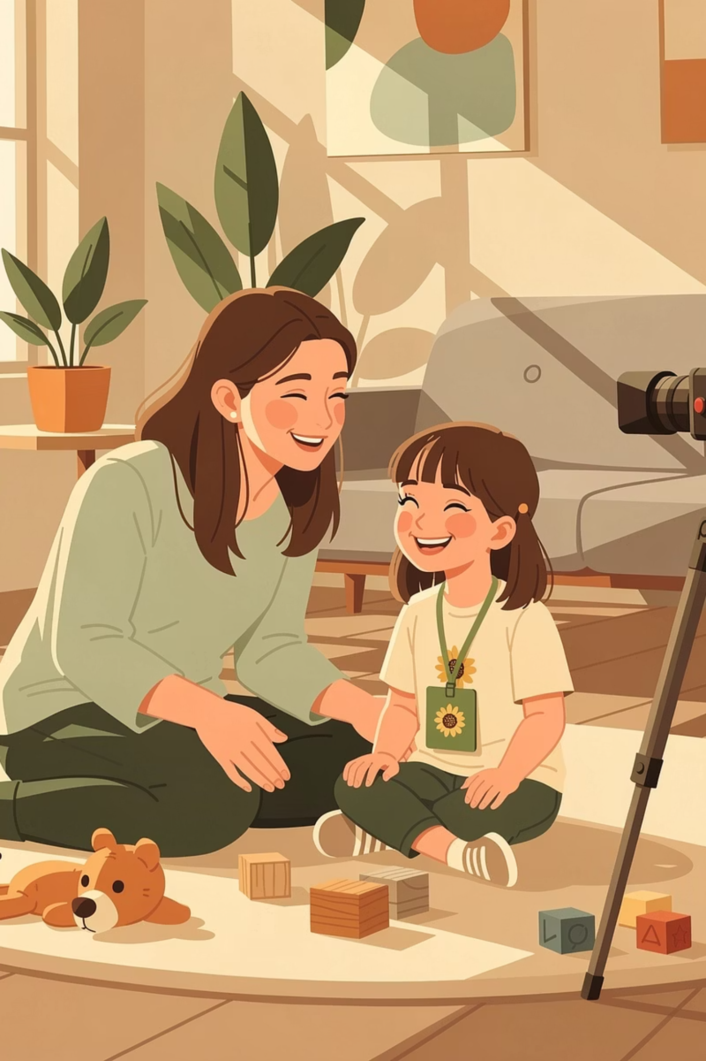
Data & Method
Data
Method
Participant - one Lithuanian-speaking autistic child
Age 2;0 - 5;8 (data collection ongoing)
Multiple sessions per week, ranging from 10 minutes to 30 minutes
Naturalistic video recordings in a home environment, including play-based interaction and everyday communication
18 hours (2;0-5;2), 14 hours (5;2-5;8)
Detailed analysis conducted from age 5;2 onwards (since the beginning of meaningful spontaneous speech)
Longitudinal observation: case study
Recordings were transcribed according to CHILDES (Child Language Data Exchange System) requirements
Qualitative analysis of data transcriptions of recordings

Slide 4
Theoretical framework
Some children begin language development using whole phrases (“gestalts”) rather than single words (Peters 1983).
Blanc (2012) expanded this idea, outlining stages from echolalia to self-generated language in Natural Language Acquisition on the Autism Spectrum.
There is an apparent lack of empirical evidence in the form of treatment studies to examine, evaluate, or support NLA for children identified as “gestalt language processors” (GLPs).
Notes:
In the 1983 book Peters “The Units of Language Acquisition,” it is described that for some children, language development begins not from individual words, but from whole phrases—so-called “gestalts”—as meaningful units.
Later, in the clinical field, Marge Blanc (2012), in the book “Natural Language Acquisition on the Autism Spectrum: The Journey from Echolalia to Self-Generated Language,” expanded this perspective and defined several stages of language development (from echolalia to self-generated language).
There is an apparent lack of empirical evidence in the form of treatment studies to examine, evaluate, or support NLA for children identified as “gestalt language processors” (GLPs). Clinicians working with children with neurodevelopmental communication disability have an ethical responsibility to ensure parents are informed of the apparent lack of research into these practices.

Slide 5
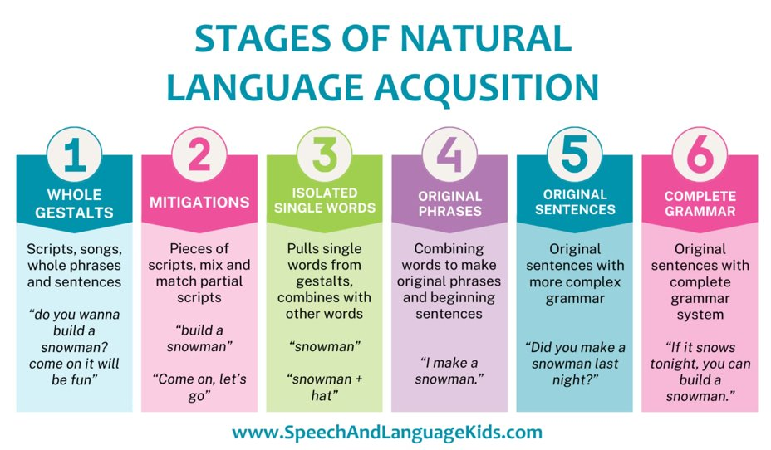
Gestalt language processing
Language may be acquired in multi-word units (“gestalts”) rather than single words
Echolalia can be a meaningful step in language development
Development is described as progressing through chunk-based processing stages
Transition stages may include partial or modified utterances
Notes:
Gestalt language processing
Based on Blanc (2012) and the Natural Language Acquisition (NLA) framework
Language may develop through gestalt units (whole phrases) rather than single words
Early stages involve echolalia used with communicative intent
Development progresses from echolalia to recombined phrases and eventually to self-generated language

Slide 6
Research questions
01
02
03
Language Emergence
GLP Patterns
Flexibility
How does spoken language emerge over time in this child?
Which patterns can be interpreted in relation to GLP stages?
Is there evidence of a transition toward more flexible, self-generated speech?

Slide 7
Developmental Trajectory: Early Stage
1–3.5 YEARS OLD
Linguistic Profile
Largely Non-speaking
Echolalia
Vocalisations
Only a few isolated words (tėtis, ne, miau)
High frequency of scripted and repeated sequences (both immediate and delayed)
Prominent non-lexical sound productions; limited spontaneous word combinations
Example 1 (Echolalia)
AGE: 2 YEARS, 3 MONTHS
The child is engaged in independent play. She spontaneously produces a recurring scripted sequence from a favourite cartoon, associated with a positive emotional state.
Lithuanian
English
VAI: Ėjau ėjau, ping pong, ėjau ėjau.
CHI: Hey-oh, hey-oh, ping pong, hey-oh, hey-oh.
VAI: Va va aaa, tiu iu iu.
CHI: Va va aaa, tiu u u.
Example 2 (Vocalisations)
AGE: 2 YEARS, 7 MONTHS
The child initiates a vocal exchange with her mother. She repeats a vocalisation pattern, responding positively to the mother's mirroring.
Lithuanian
English
VAI: A aaa.
CHI: A aaa.
MAM: Mmm, aha.
MOM: Mmm, aha.
VAI: Mmm, a aaa.
CHI: Mmm, a aaa.
MAM: Mmm, aha.
MOM: Mmm, aha.
VAI: Mmm, a aaa.
CHI: Mmm, a aaa.

Slide 8
Developmental Trajectory: Transitional Stage
3.5–5 YEARS OLD
Linguistic Profile
Echolalia Reduced
First Multi-word Combinations
Echolalia persists but decreases in frequency; scripted sequences become less dominant
Early word combinations emerge around 4;1; but very rare rare occurrences until age 5
Example 1 (Echolalia)
AGE: 3 YEARS, 10 MONTHS
The child is engaged in play with toy cars. She repeatedly produces a scripted utterance each time a car moves, suggesting echolalic use tied to a recurring action.
Lithuanian
English
VAI: Eina mašina, einam, einam, einam, einam.
CHI: Car walks, walking, walking, walking, walking.
VAI: Einam, einam. Einam, einam, einam.
CHI: Walking, walking. Walking, walking, walking.
Example 2 (Early multi-word combination)
AGE: 4 YEARS, 1 MONTH
The child presents a family drawing to her mother and attempts to label the figures. The exchange shows early multi-word combinations and emerging referential use of names.
Lithuanian
English
VAI: Ko mytė [=mamytė].
CHI: Mmy [=mommy].
MAM: Aha.
MOM: Okay.
VAI: Mytė [=mamytė].
CHI: Mmy [=mommy].
MAM: Aha, o kas čia?
MOM: Okay, and what is here?
VAI: Tiše [=čia] mytė [=mamytė], tėtė, mytė [=mamytė].
CHI: Here mmy [=mommy], dad, mmy [=mommy].
MAM: Ooo, čia tėtis ir mamytė?
MOM: Oh, here is dad and mommy?
VAI: Mamytė, mytė [=mamytė], tėtis.
CHI: Mommy, mmy [=mommy], dad.

Slide 9
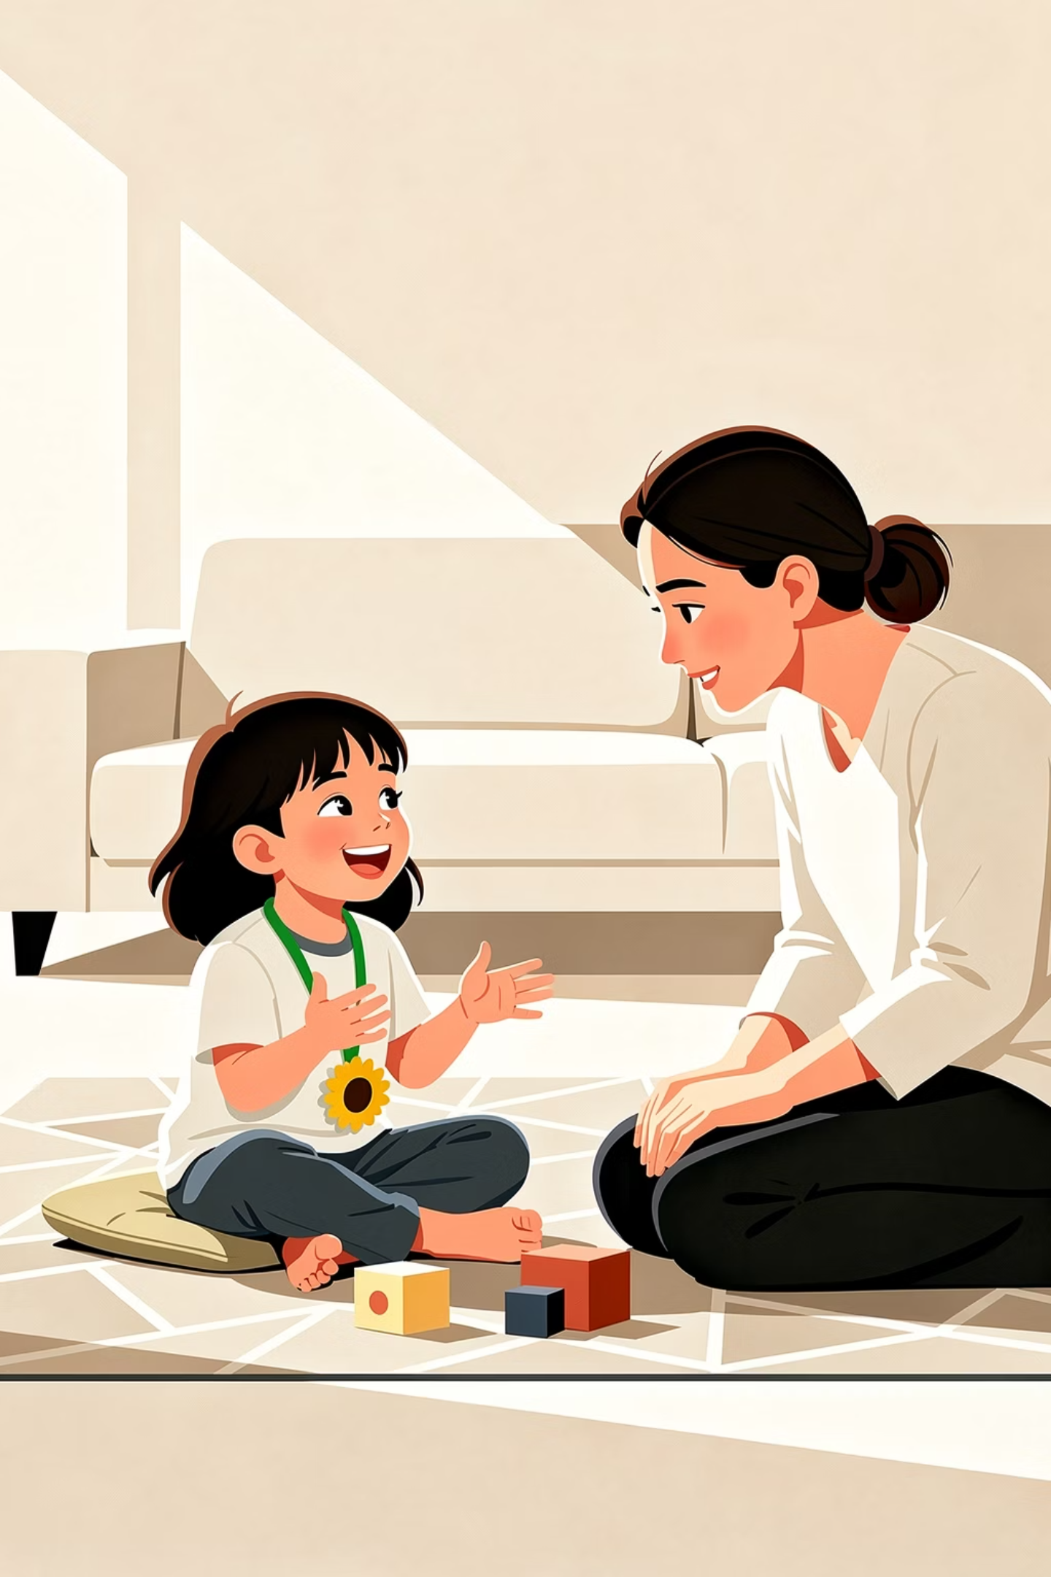
Developmental Trajectory: Current Stage
5 YEARS OLD – PRESENT (5;2–5;8)
Multi-word Combinations
Contextual Appropriateness
2–3 word utterances increasingly frequent and structurally varied
Responses more aligned with conversational context and partner expectations
Lexical Flexibility
Emerging evidence of lexical selection and active recombination of stored units

Slide 10
Contextual Appropriateness
AGE: 5 YEARS, 6 MONTHS, 26 DAYS
The child responds to her mother's questions about her day at kindergarten. Her answers are brief but contextually appropriate, demonstrating emerging conversational responsiveness.
Lithuanian
English
MAM: O daržely tau patiko?
MOM: Did you like it at kindergarten?
VAI: Taip.
CHI: Yes.
MAM: Patiko daržely.
MOM: You liked kindergarten.
VAI: Pajagei [=pavalgei].
CHI: Ate [=you ate].
MAM: Ir pavalgei, o ką valgei?
MOM: And you ate — what did you eat?
VAI: Siubytę [=sriubytę].
CHI: Soup [=soup].
AGE: 5 YEARS, 7 MONTHS, 15 DAYS
The child responds to a series of yes/no questions about her bus journey to other kindergarten. She consistently provides accurate, contextually appropriate single-word responses.
Lithuanian
English
MAM: Važiavai šiandien autobusu?
MOM: Did you travel by bus today?
VAI: Teip [=taip].
CHI: Yes.
MAM: Patiko autobusas?
MOM: Did you like the bus?
VAI: Teip [=taip].
CHI: Yes.
MAM: Važiavai su auklėtoja?
MOM: Did you travel with the teacher?
VAI: Teip [=taip].
CHI: Yes.
MAM: O važiavo Herkus?
MOM: And did Herkus travel?
VAI: Ne.
CHI: No.
MAM: O važiavo Tomas?
MOM: And did Tomas travel?
VAI: Ne.
CHI: No.
MAM: O važiavo Paulytė?
MOM: And did Paulytė travel?
VAI: Teip [=taip].
CHI: Yes.

Slide 11
Multi word combinations
AGE: 5 YEARS, 7 MONTHS, 15 DAYS
The child is engaged in pretend cooking play with her mother. She produces several self-initiated multi-word utterances, including subject-verb-object constructions, demonstrating emerging syntactic complexity.
Lithuanian
English
MAM: Tada reikia įdėti truputėlį cukraus.
MOM: Then we need to add a little sugar.
VAI: Mamytė dės sukraus[=cukraus].
CHI: Mummy will add sugar.
VAI: Tėti, aš maisau[=maišau] totus [=tortus].
CHI: Daddy, I am mixing cakes.
VAI: Žiek[=žiūrėk], va, sumaišiau Paulina.
CHI: Look, I mixed it, Paulina.
VAI: Maisom [=maišom], maisom [=maišom].
CHI: Mixing, mixing.
The child responds to her mother's question about plans at home. She produces a two-word combination followed by a noun phrase, indicating early productive word combination.
Lithuanian
English
MAM: Ne, o ką namuose veiksi?
MOM: So what will you do at home?
VAI: Mmm, zaisi [=žaisi].
CHI: Mmm, play.
MAM: Žaisi, o ką žaisi?
MOM: Play — what will you play?
VAI: Zaisi[=žaisi] jėjytės [=lėlytės].
CHI: Play dollies.

Slide 12
Lexical flexibility
AGE: 5 YEARS, 2 MONTHS, 23 DAYS
The child is sorting objects into coloured boxes with her mother. She demonstrates emerging lexical flexibility by selecting and producing contextually appropriate nouns in response to questions.
Lithuanian
English
MAM: Čia dėžutė geltona?
MOM: Is this box yellow?
VAI: Taip.
CHI: Yes.
MAM: Ką dėsi į geltoną dėžutę?
MOM: What will you put in the yellow box?
VAI: Mmm, sūjį [=sūrį].
CHI: Mmm, cheese.
MAM: Sūrį?
MOM: Cheese?
VAI: Taip.
CHI: Yes.
AGE: 5 YEARS, 6 MONTHS, 26 DAYS
The child and her mother are looking at clothing items. The child asks a question using a noun phrase and then confirms the label, showing active lexical retrieval and recombination.
Lithuanian
English
VAI: Kos [=kas] čia, kos [=kas] čia?
CHI: What is this, what is this?
MAM: Kas čia? Čia kelnės.
MOM: What is this? These are trousers.
VAI: Kenės [=kelnės]?
CHI: Trousers?
MAM: Kelnės.
MOM: Trousers.
VAI: Čia jėjytės [=lėlytės] kenės [=kelnės]?
CHI: Are these the dolly's trousers?
MAM: Taip.
MOM: Yes.
VAI: Va, čia kenės [=kelnės].
CHI: Look, these are trousers.

Slide 13
Conclusions & Contributions
Key Findings
Limitations
Clear developmental transition from echolalia → modification → recombination
Data collection and transcription are ongoing; current analysis focuses on qualitative first-emergence patterns, with quantitative analysis to follow
Echolalia persists but becomes increasingly functionally integrated
Findings are broadly consistent with the GLP framework
Our findings support an autism-affirming, neurodiversity-oriented approach, viewing echolalia and non-typical language patterns as meaningful communicative resources rather than deficits.

Slide 14
Literature list
Blanc, M. (2012). Natural Language Acquisition on the Autism Spectrum: The Journey from Echolalia to Self-Generated Language. Communication Development Center.
MacWhinney, B. (1991). The CHILDES Project: Tools for Analyzing Talk. Lawrence Erlbaum Associates.
Peters, A. M. (1983). The Units of Language Acquisition. Cambridge University Press.
Sterponi, L., & Shankey, J. (2014). Rethinking echolalia: Repetition as interactional resource in the communication of children with autism. Journal of Child Language, 41(2), 275–304.
Wray, A. (2002). Formulaic Language and the Lexicon. Cambridge University Press.
American Speech-Language-Hearing Association (ASHA). (n.d.). Evidence-based practice in speech-language pathology.https://pubs.asha.org/doi/abs/10.1044/2020_AJSLP-20-00194

Slide 15
From Non-verbal Communication to Early Sentence Formation:
A Longitudinal Case Study of a Lithuanian Autistic Child
Paulina Ulozienė, assoc. prof. Laura Kamandulytė-Merfeldienė
paulina.uloziene@gmail.com laura.kamandulyte@vdu.lt Vytautas Magnus University, Lithuania

