Slide 1
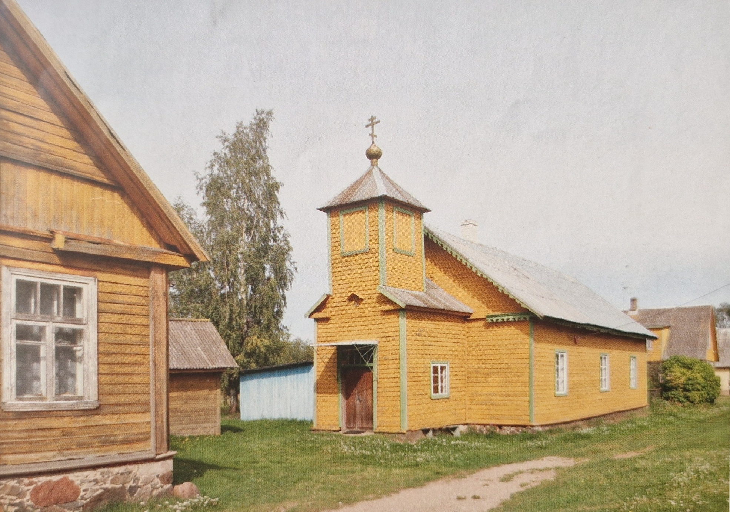

Multilingual Repertoires and Symbolic Heritage Identity among Old Believer Descendants in Estonia
A pilot study
Anastasiia Ryko, anastasiia.ryko@ut.ee
Alessandra Dezi, alessandradezi@gmail.com
24.04.2026

Slide 2
Ethnoconfessional minority fleeing religious persecution in Russia→ shared history
Settled along Lake Peipsi (early 18th c.)→ space
Centuries-long preservation of traditional socio-religious life → religion
Russian dialect (Pskov-type), shaped by sustained Estonian contact→ language
Who are Old Believers in Estonia?
Historical background

Slide 3
Soviet period: partial disruption of traditional life
  Russification
  Antireligious campaigns
Contemporary dynamics
  Mobility
  Globalization
  Secularization
Main identity components
  Space?
  Language?
  Religion?
  Shared history→ (intergenerational transmission)?
Who are Old Believers in Estonia?
Change over time

Slide 4
1) Do descendants of Old Believers retain key identity components?
→ Space; language; religion; shared history
2) If so, how are these elements reshaped through individual experiences and life trajectories?
3) What role do family and community narratives play in this process?
Research questions

Slide 5
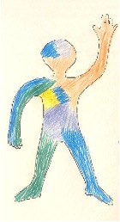
Body mapping
Questionnaire focused on Old Believer experience
Methods

Slide 6
Identity operates across multiple levels (linguistic, interactional, social, ideological)
Requires a multi-dimensional approach linking language, space, and time
Chronotope (Bakhtin 1981)
→ time + space shape meaning, narratives, and identities
Extended to sociolinguistics (e.g. Blommaert 2015)
→ shared representations of time, place, and personhood
Communication is always situated in specific time–space contexts
These contexts activate norms, meanings, and social expectations
Meaning emerges through locally used, historically shaped semiotic resources
Chronotope in sociolinguistics

Slide 7
First set of participants (n = 3)
  age 24, 33, 38
  different level of education
  different language experience
  different spatial experience
  different religious experience
Second set of participants (n = 3)
  same age group (18-19)
  same education (Russian school with Estonian language immersion)
  similar spatial experience
  similar religious experience
Participants

Slide 8
Three main interview themes linked to identity components (shared history, space, religion, language)
Language
Religion and related practices
The Old Believer image
Main themes

Slide 9
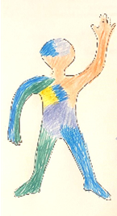
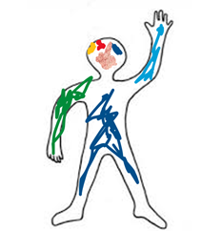

Informants A and B reveal both bilingual and multilingual dimensions of their identity shaped by modernity and globalization
Informants C reveal a mainly local bilingual identity
No traces of Old believers’ dialect
Language

Slide 10
Memories and awareness of older generation’s distinctive dialect
  B notes that the older generation of Old Believers speaks a distinct local dialect, marked by unique vocabulary and a particular “accent”
  A associates the Peipsi region dialect with a blending of Estonian and Russian, citing examples such as pirožki rasxaxanúlis’ (‘pies opened’) and parkván (‘carrot’), highlights the use of predicative participles ending in -ši (e.g., ne spamši ‘without sleeping’, ne emši ‘without eating’) as a dialectal feature of the Lake Peipsi region
  Informant C is aware that a distinct dialect of Russian was spoked by her ancestors
Dialect as remembered heritage

Slide 11
Not active religious practices
Childhood experience with religious life
Old Believers by baptism
Old Believers by family background
Emotional or cultural connections to Old Believer practices
Religion and related practices

Slide 12
Old Believer vs “Old Believer Old Believer”
  Strict ritual observance
  Hard work
  Diligence
  Resilience
  Kindness and helpfulness
  Older people
Participants’ symbolic connection to the “Old Believer Old believer”
  Old Believers by tradition
  Positive attitudes towards the older generation
The image of the “true” Old Believer

Slide 13
Do descendants of Old Believers retain key identity components?
Traditional elements such as dialect and religious practice are largely absent in daily life. However, they are retained as symbolic and emotional resources, especially through family memory, shared history, and a sense of origin.
How are these elements reshaped through individual experiences and life trajectories?
They are reshaped into a more flexible and hybrid identity. Informants adapt language, practices, and meanings to their personal lives and modern contexts, often describing themselves as “Old Believers by tradition.
What role do family and community narratives play in this process?
They play a central role. Family and community narratives preserve cultural memory, shape the image of the “typical Old Believer,” and support the intergenerational transmission of identity, even without active practice.
Conclusions

Slide 14
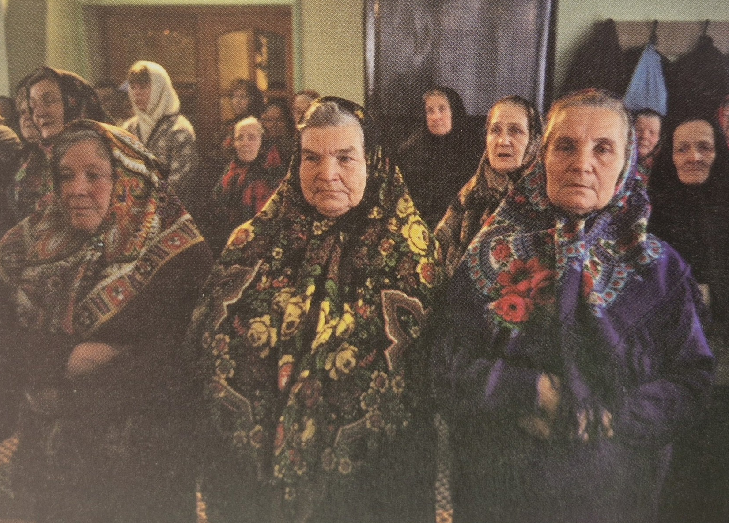


Thank you for your attention!

