Slide 1
Russian as a lingua franca of post-Soviet migrants in South Korea
Kapitolina Fedorova
Tallinn University

Slide 2
The study was conducted in collaboration with Nam Hye Hyun (Yonsei University) and Kim Bora (Gyeongsang National University) and will be published as a chapter of the book Decentralized variants of Russian and their speakers: World Russians,
ed. by Kapitolina Fedorova and Vlada Baranova for the series
Routledge Studies in Language and Identity

Slide 3
TABLE OF CONTENTS
01
02
03
04
05
06
Background
Linguistic landscape
Public use
Post-Soviet migration to South Korea
Visual presense of Russian in public space
Presence of Russian in official domains
Digital space
“Korean Russian”
Conclusions
Use of Russian in online communication
Linguistic hybridization of Russian in Korea
Who are Korean “Russians”?

Slide 4
01
Background
Post-Soviet migration to South Korea

Slide 5
Migration to South Korea
Foreign workers now play a systemically important role in South Korea’s labour market, especially in low- and mid-skilled sectors
Nearly half of migrant workers are in manufacturing, around 20% in wholesale/retail and services, and the rest in construction, agriculture, fisheries
Migrants are predominantly from Asia-Pacific countries (mostly China and Vietnam)
8% (116,000 people) from the officially registered foreign nationals residing in South Korea are citizens of the post-Soviet countries (mainly Uzbekistan, Russia, Kazakhstan, and Kyrgyzstan)

Slide 6
Russian speaking migrants
Koryo-saram
L1 speakers
People of Korean origin repressed and relocated in the 1930s from the Far East to (mostly) Central Asia
L2(3,4) speakers
Russians, Ukrainians, Kazakhs, Kyrgyz, etc.
Kazakhs, Kyrgyz, Uzbeks, Mongols, etc.

Slide 7
02
Linguistic landscape
Visual presence of Russian in public space

Slide 8
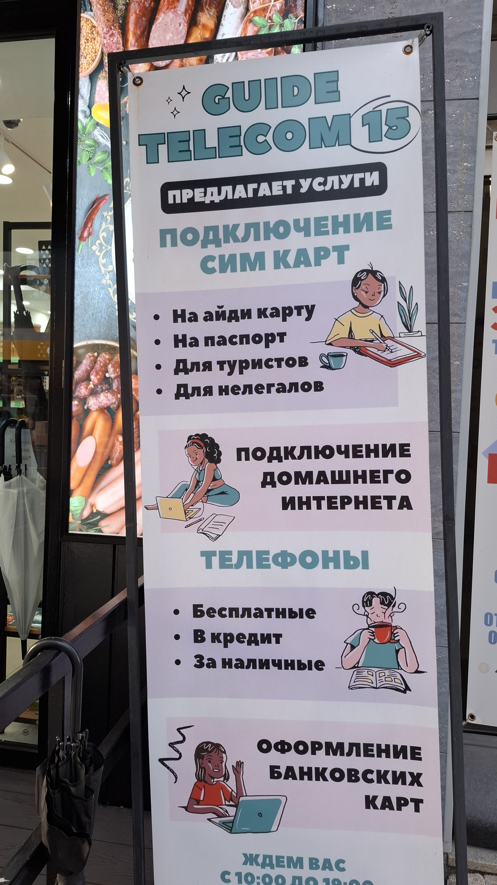
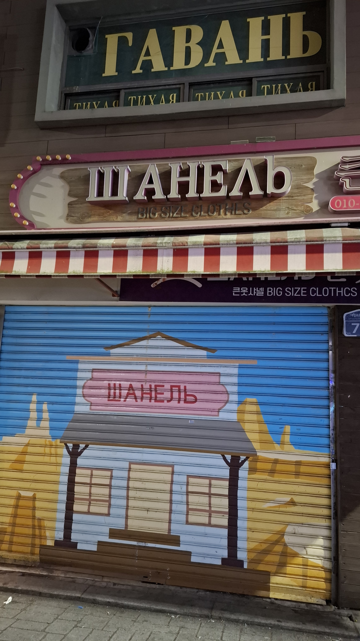

Slide 9
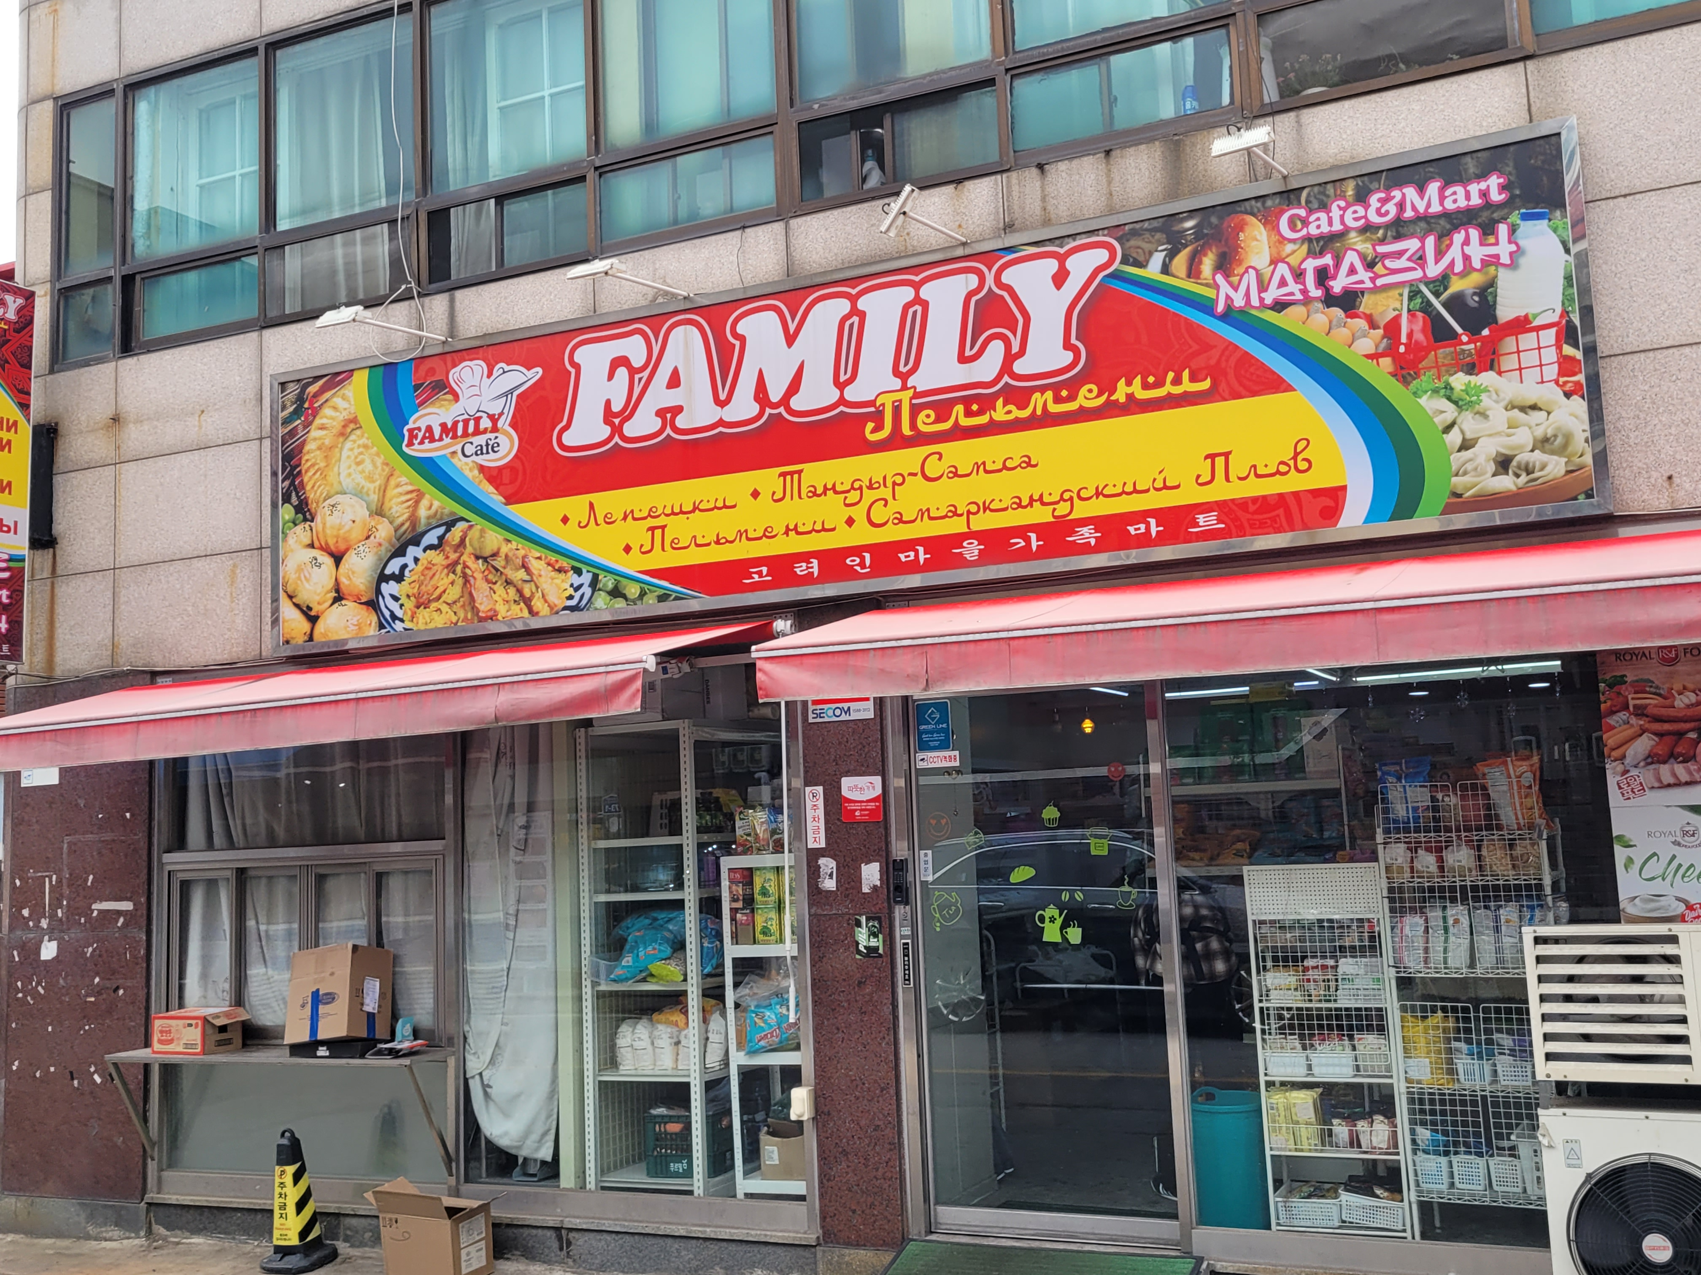

Slide 10
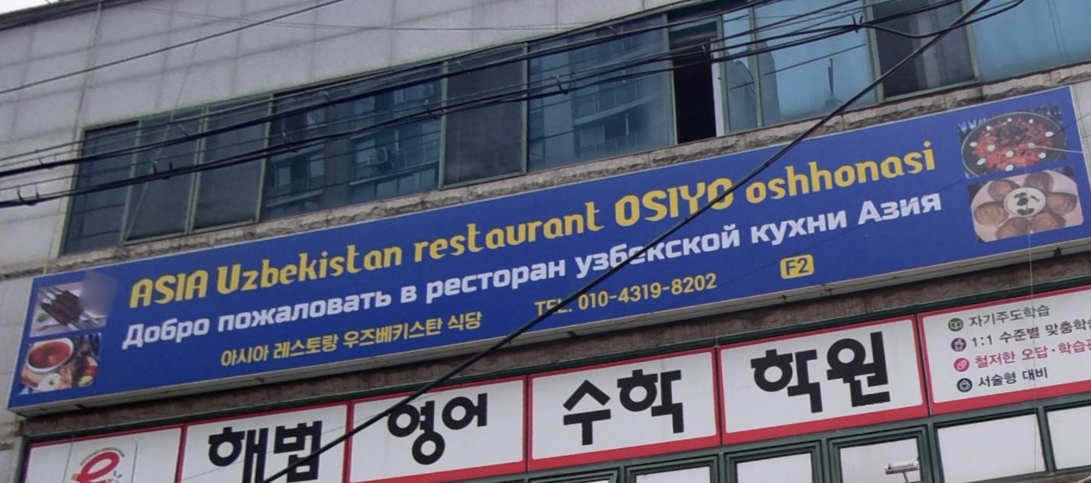

Slide 11
03
Public use
Presence of Russian in official domains

Slide 12
Domains of official/semiofficial use of Russian
Education: notices and internal announcements in schools located within Koryoin communities; language maintenance classes and activities; Russian-language books and learning materials in libraries
Official media: e.g. GBS Koryo Broadcasting Station in Gwangju (70% of the programming in Russian)
Religion: Orthodox and protestant churches

Slide 13
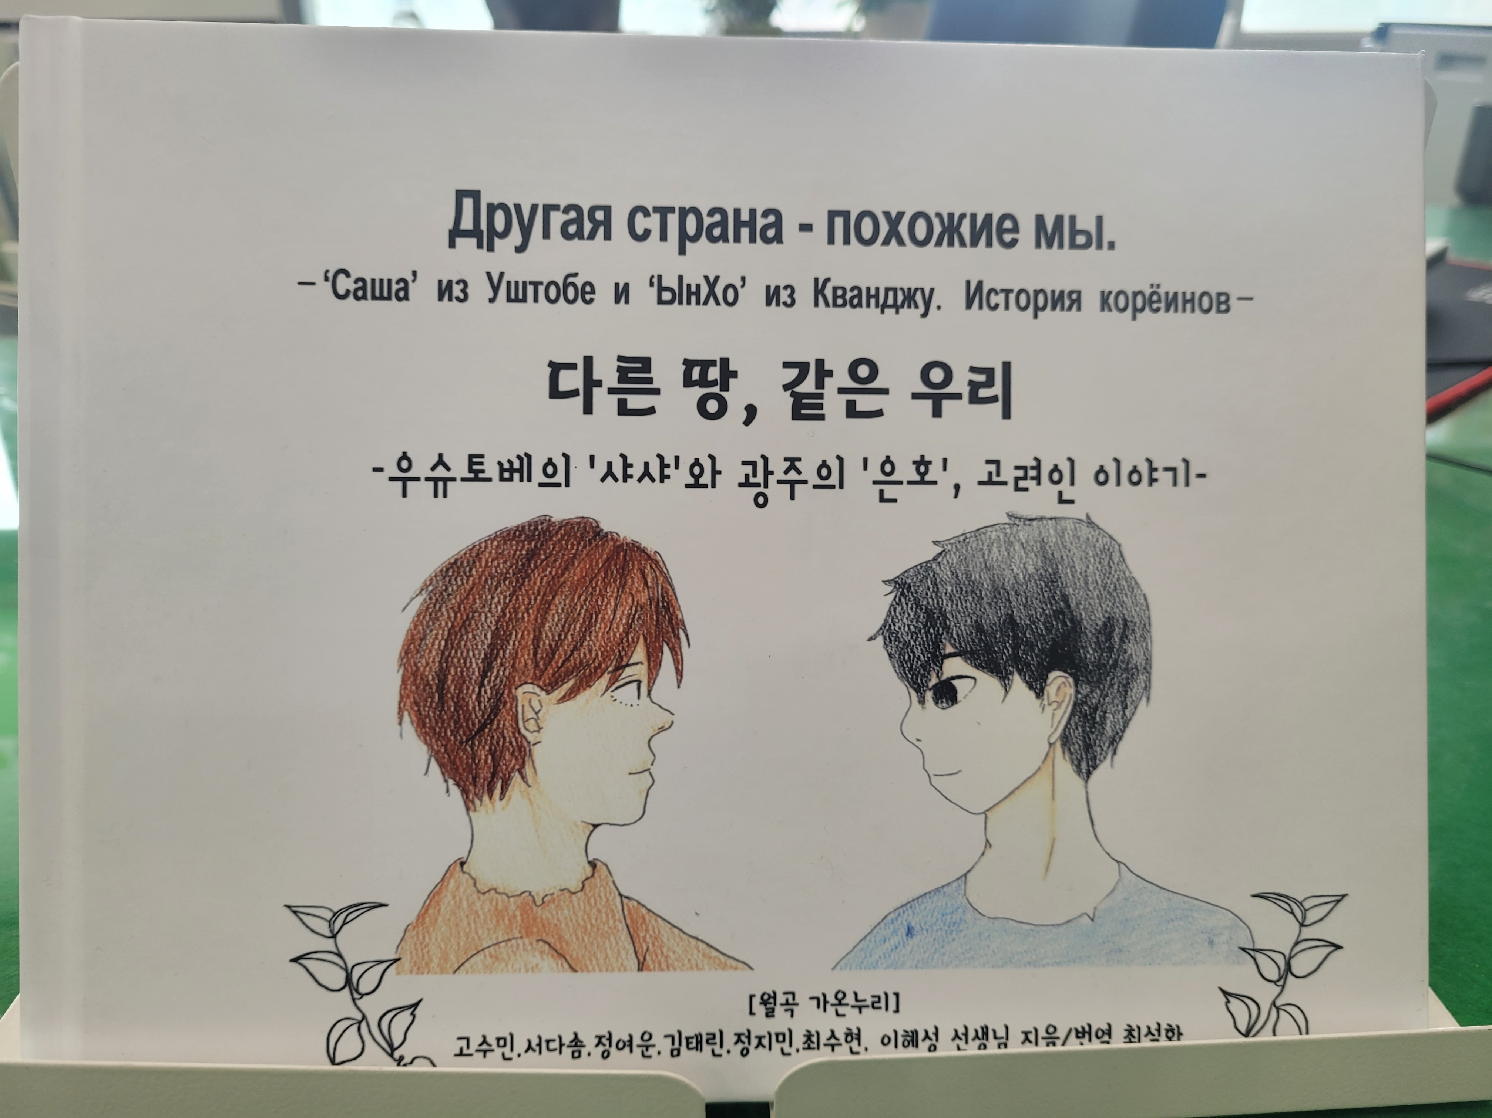

Slide 14
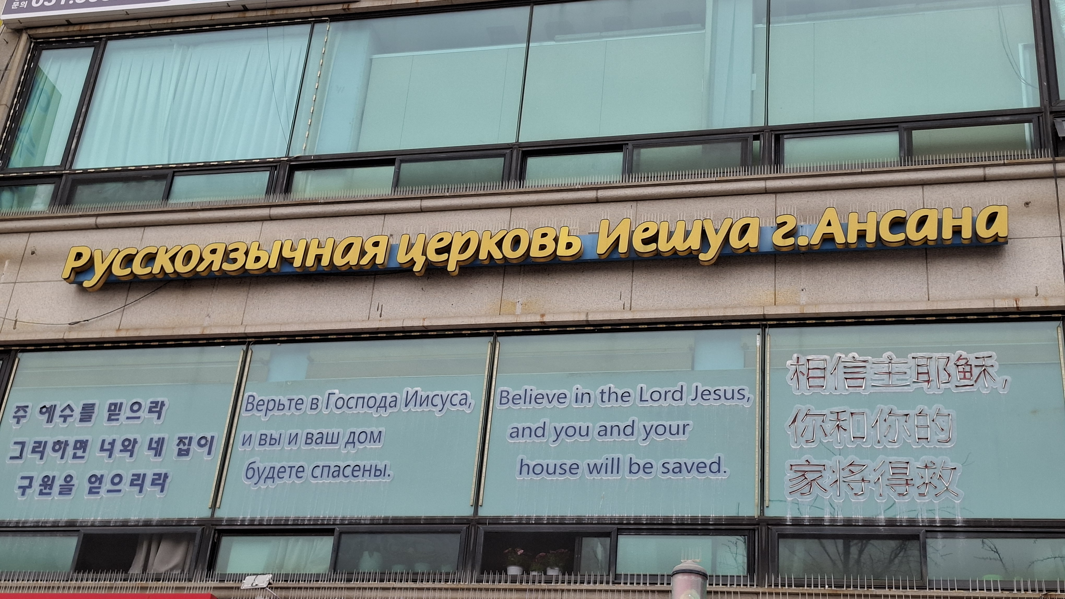

Slide 15
04
Digital space
Use of Russian in online communication

Slide 16
Main Facebook groups
Вместе в Корее (“Together in Korea”, 125,300 members
Живая Корея: Работа в Корее (“Living Korea: Work in Korea”) 91,800 members
82 авеню – Наши в Корее (“82 Avenue – Ours in Korea”) 53,700 members; former names (until 2021) Желтые страницы; Работа в Корее. Купля-продажа. Услуги (“Yellow Pages”; “Work in Korea. Buy-Sell. Services”)
МЫ В КОРЕЕ 우리는 한국에서 (“We in Korea”) 48,400 members

Slide 17
Ethnic-oriented Facebook groups
Казахстанцы в Южной Корее (“Kazakhstanis in South Korea”) 11,000 members
Кыргызстан & Южная Корея (“Kyrgyzstan & South Korea”) 3,400 members
Украинцы в Корее (“Ukrainians in Korea”) 4,300 members
Узбекистанцы в Корее (“Uzbeks in Korea”) 1,400 members
Uzbeks in Korea / Koreyadagi o'zbeklar, 5,100 members

Slide 18
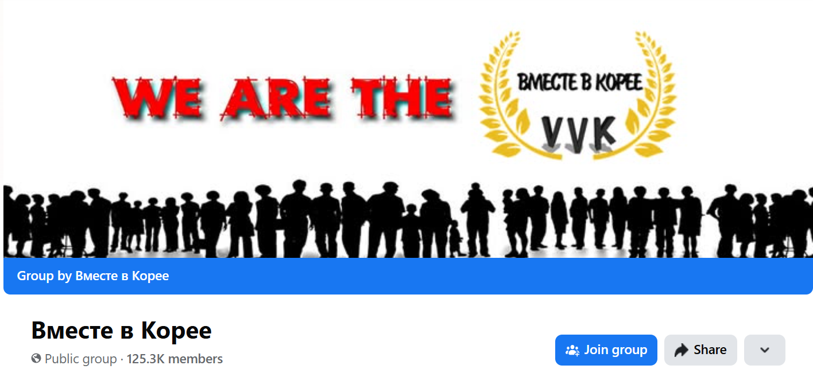
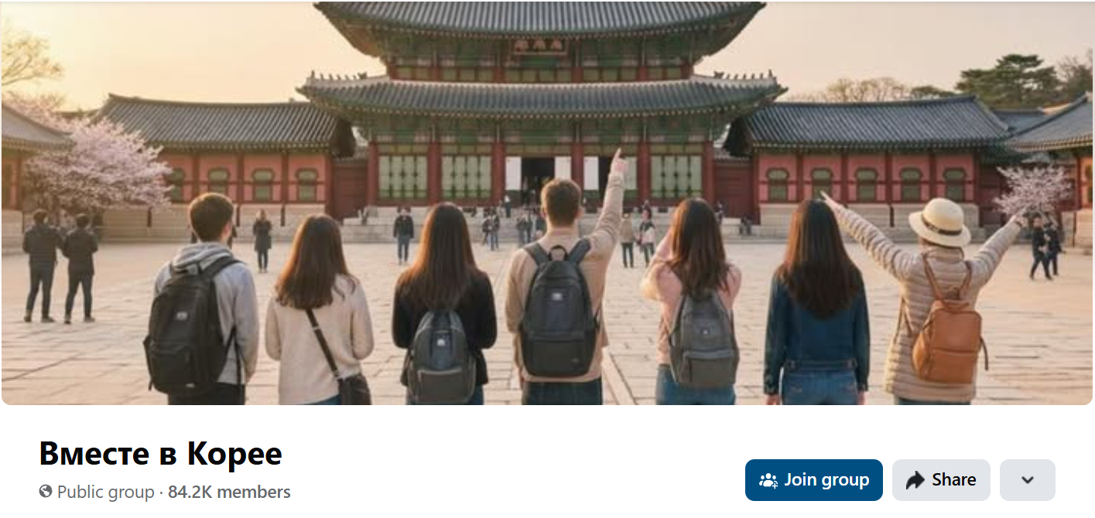
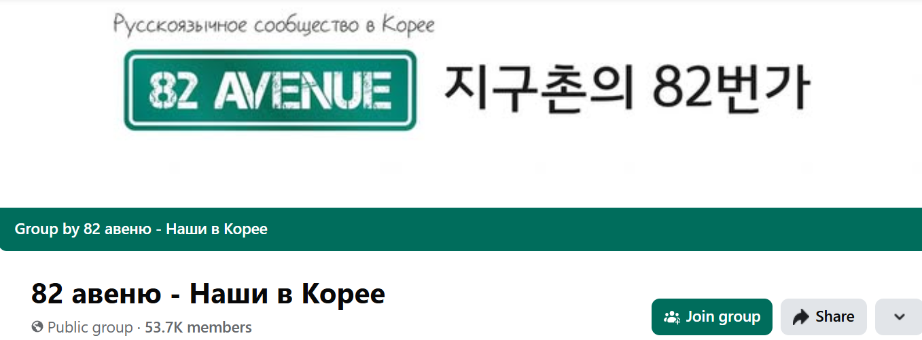

Slide 19
05
“Korean Russian”
Linguistic hybridization of Russian in Korea

Slide 20
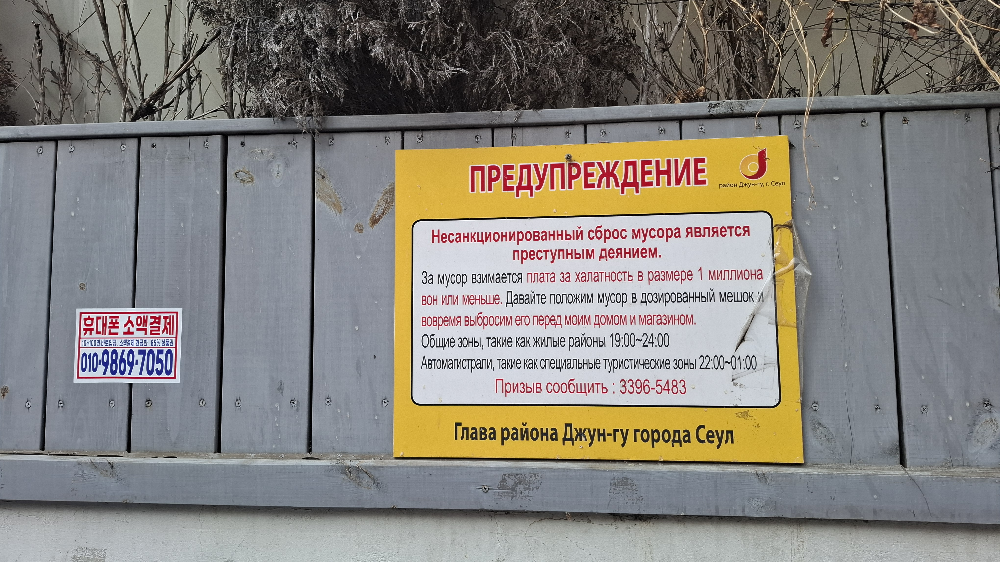

Slide 21
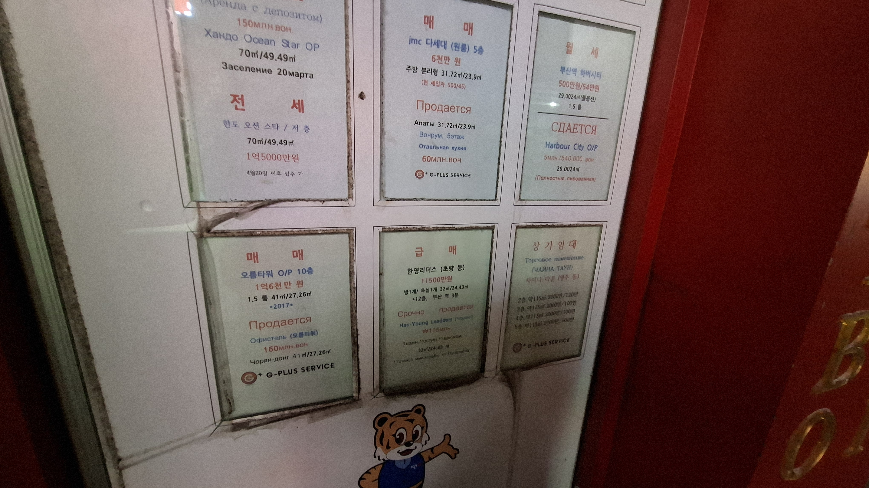
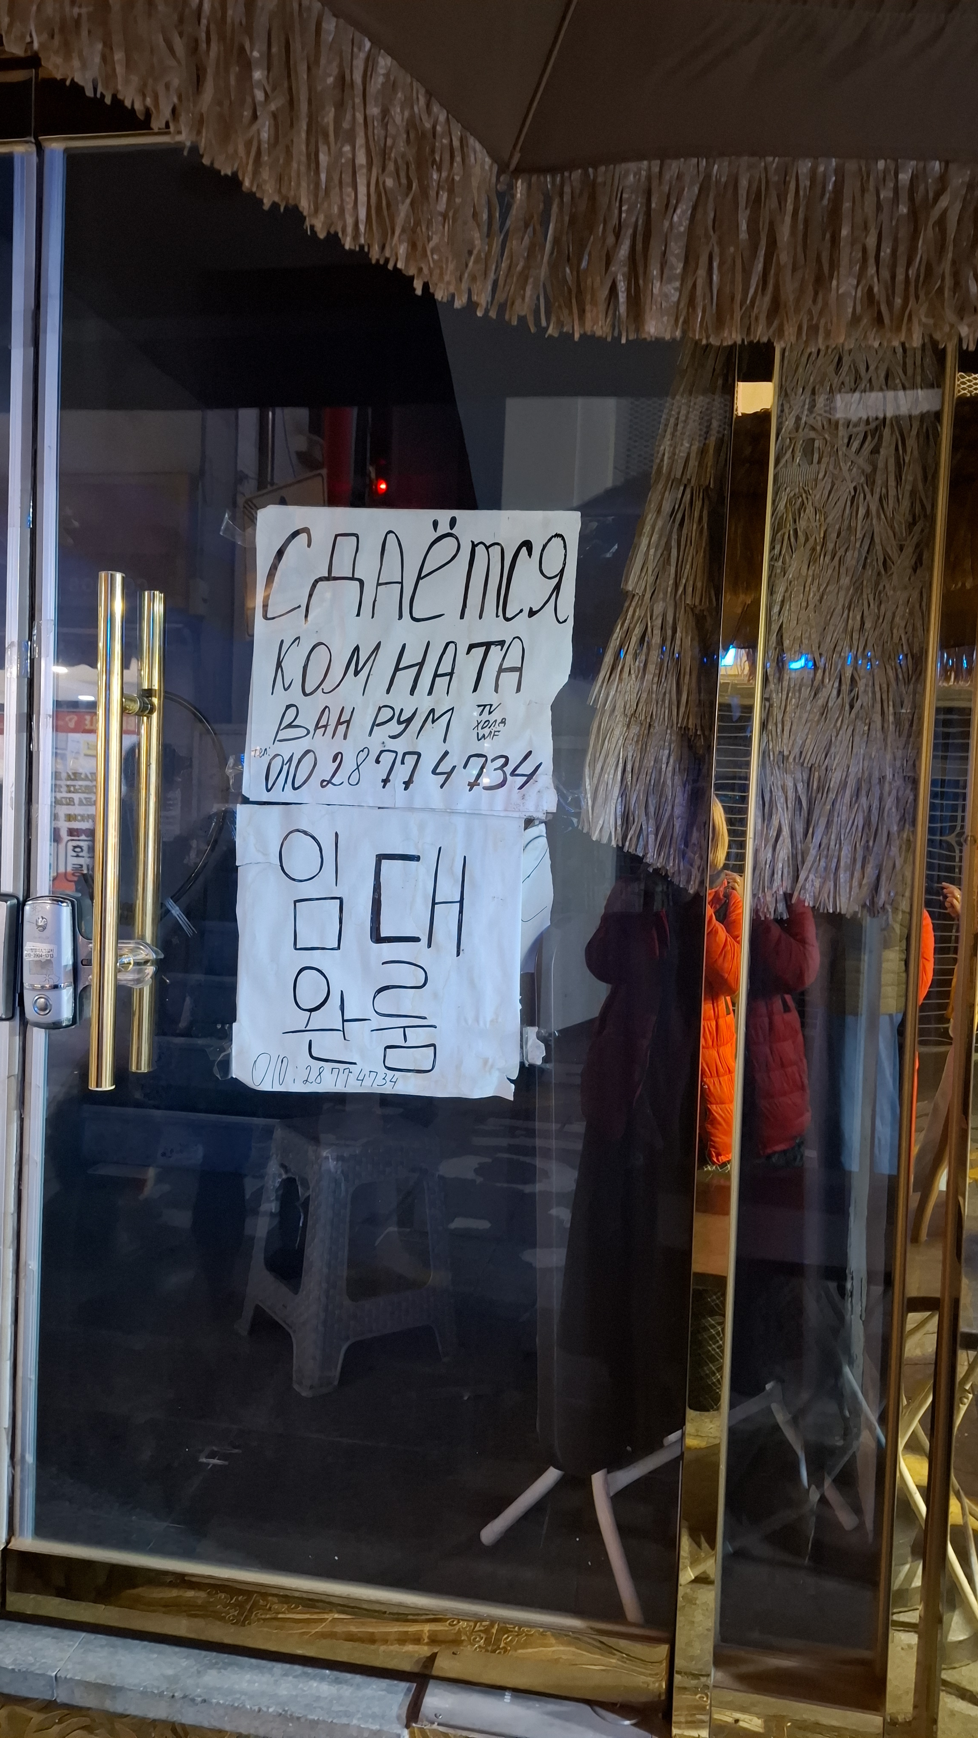

Slide 22
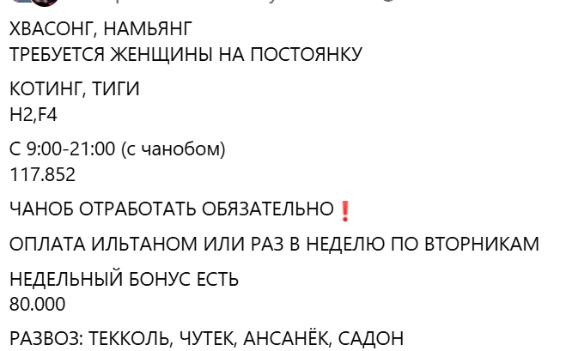

Slide 23
Top 10 Most Frequently Used Korean Loanwords in Работа Вся Корея Telegram channel (N = number of usages in 2022–2024 data)
Rank | Loanwords | N
1 | чаноб 잔업 (extra work) | 59,305
2 | чуган 주간 (day shift) | 49,429
3 | яган 야간 (night shift) | 32,362
4 | чуча 주차 (weekly day off) | 31,255
5 | ильтан 일당 (daily wage) | 19,112
6 | вольча 월차 (monthly leave) | 18,204
7 | тыккын 특근 (extra work) | 11,992
8 | самущиль 사무실 (office) | 10,919
9 | комса 검사 (inspection) | 10,141
10 | сачуль 사출 (injection molding) | 9,942

Slide 24
06
Conclusions
Who are Korean “Russians”?

Slide 25
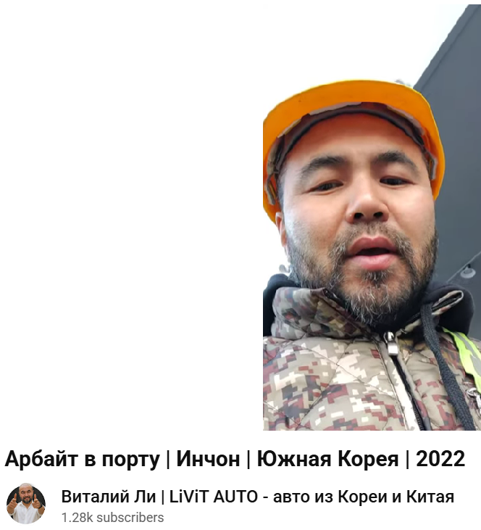
Мне тут нравится. Здесь одни хангуки, русских нет. Значит, наверно, хорошо – вряд ли хангуки будут работать на какой-нибудь тяжелой работе, грязной. Единственное, конечно, языковой барьер, но тут по-английски можно шпрехать с ними
I like it here. There are only khanguks [Koreans], no Russians. So, it’s probably good – it’s unlikely that khanguks will work at any hard, dirty work. The only thing is, of course, the language barrier, but here you can shprekhat’ [talk – from a German verb sprechen] to them in English

Slide 26
Russian used as a lingua franca among post-Soviet migrants in South Korea demonstrates how language both reflects and shapes transnational mobility, identity, and community life. While rooted in Soviet legacies of Russian dominance, this language today functions in Korea not merely as a pragmatic tool of communication but also as a cultural resource that enables migrants of diverse ethnic and national backgrounds to construct shared spaces, offline and online, where new forms of belonging are negotiated.
At the same time, the growing visibility of other languages such as Uzbek, as well as the incorporation of Korean loanwords into everyday Russian usage, reveal that these linguistic practices are dynamic, adaptive, and deeply entangled with the lived realities of migration.

Slide 27
Спасибо!
감사합니다!
Thank you!
Aitäh!

