Slide 1
Language Contact in Russian-Language Media in Estonia: Findings from an Analysis of Spoken Language
Inna Adamson
Tallinn University

Slide 2
Linguistic material is documented by researchers in various ways. Some researchers have collected recordings of spontaneous speech in public places such as markets and bus stations, as well as in educational institutions such as schools and universities (Zabrodskaja 2007). Others have compiled a corpus of Estonian television programs in Russian (ibid.). Some researchers extract material from the work of bilingual students (Zamkovaja, Moiseenko 2013), while others use product labels, advertising and media texts, including those from the Internet, as well as observations of live speech (see, for example, Külmoja, Kostandi 2013; Evstratova 2012; Palikova 2009; Adamson 2010, 2011, 2019, 2023). The study of internet discourse (Dezi 2025) and research by expand the empirical base by focusing on bilingual practices, language contact phenomena, and the functioning of Russian in Estonia within media and everyday communication. Thus, a wide range of linguistic material is covered (Tshuikina, Fedorova (2022, 2024)).

Slide 3
The author of this message is compiling a list of lexical items and constructions that can be considered regularly used in Russian-language media texts in Estonia.
The author has been observing the features of the Russian language in Estonia over a long period, since 2009.
The number of lexical items currently amounts to just over 300. These are mainly terms from the public sphere, names of goods and services, as well as instances of code-switching. The list is being reviewed and expanded.
venekeeleestis.blogspot.com
https://venekeeleestis.blogspot.com/2023/07/sonastik-vene-keel-eestis-phd-autor-ja.html

Slide 4
Examples
1. Insertions: taotlus (Est. petition/application), avaldus (Est. statement/application), õppekava (Est. curriculum/study programme), arvestus (Est. pass/fail assessment, credit), bussijaam (Est. bus station), väljak (Est. square), iseteenindus (Est. self-service), isikukood (Est. personal identification code), keskus (Est. centre), küsimus (Est. question), käibemaks (Est. value-added tax, VAT), koosolek (Est. meeting), etc.

Slide 5
Examples
Loan translation: infochas (Est. infotund); druzhestvennye ceny (Est. sõbralikud hinnad); opornoe lico (Est. tugiisik) – approximately corresponds to the concept of “consultant”

Slide 6
Examples
Hybrid borrowings: poljahmeli (from est. lähme − 'let’s go'); zakilevat'– 'put it in a plastic sleeve' (from est. kile – plastic (sleeve)); kjul'movato – ‘cold, cool' (from est. külm – cold); pihviki (from est. pihvid) – small chopped meat patties sold ready-made; pomytlit' – 'to think (for a while)' (from est. mõtlema – ‘to think’) and other cases. The use of such words can be observed in spontaneous speech.

Slide 7
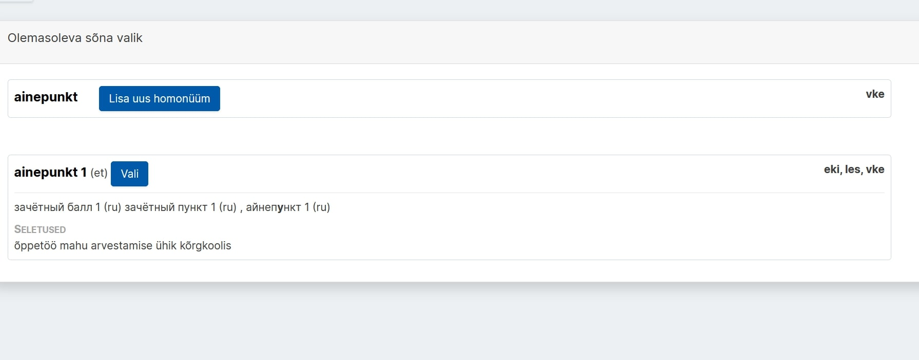
Dictionary in EKI

Slide 8
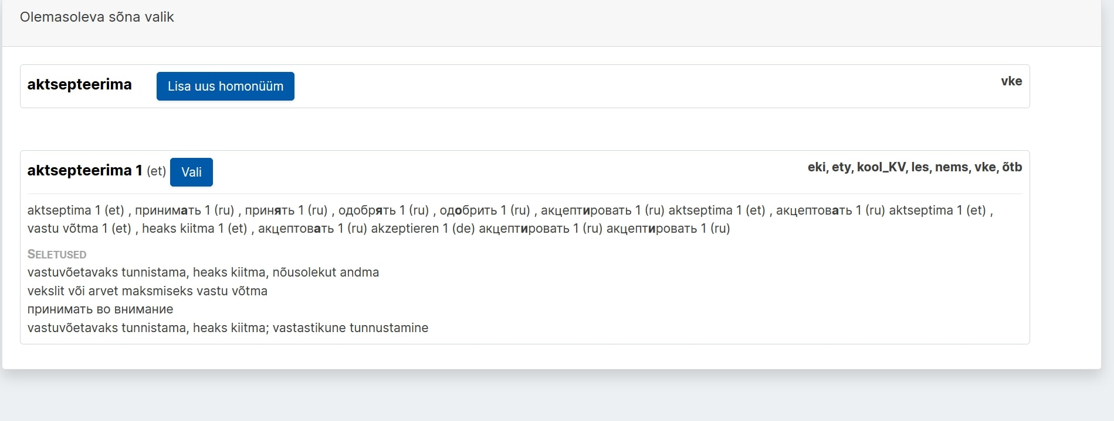
Словарь в EKI

Slide 9
To enhance the persuasiveness of the study, a broader range of materials is needed, including spoken language. One possible approach is to conduct interviews with Russian-speaking residents of Estonia, although this may involve certain difficulties. To some extent, this method can be implemented through student initiatives aimed at collecting real-time data from respondents (for example, “one speech day”).

Slide 10
Examples from the Internet and other media
(1) Математик, интересует именно математика, желательно прикладная.
-X3-, ого, про ТТУ я не знала. А какие там условия для приема в магистратуру? Есть ли такое, что нужно иметь какое-то определенное количество связанных с математикой/физикой айнепунктов? Просто у меня с этим напряжно... есть 2 АП за матан, еще есть теормех, сопромат и статика, но в сумме это довольно мало… https://forum.ee/t83436/matematika/page-2
(2009 год)
(2) “Есть так много хороших рецептов, да и домашняя еда будет сделана из хороших ингредиентов. Например, приготовьте из домашнего теста пипаркоки или конфеты ручной работы. // Школьная медсестра: сладкое - под контроль! МК-Эстония, № 52 (913), 29.12.21 - 04.01.2022. С. 49.
(3) Да не парься - нормальный валик, если арвестус без оценки https://forum.ee/t1827/tallinna-tervisehoiu-krgkool/page-130 (2004)

Slide 11
Another effective method that is actively used is the analysis of spontaneous speech in media broadcasts. For example, analyzing dialogues between hosts and guests, in my view, provides valuable material for advancing research.

Slide 12
Examples from spoken language (based on TV), 2025
https://jupiterpluss.err.ee/1609589861/zhiteli-jestonii-nesut-v-lombardy-vsjo-bolshe-vewej (29.01.2025)
6:15 - isikukood
https://jupiterpluss.err.ee/1609802337/sokrawenija-v-teatre-sjudalinna-mnenie-profsojuza (16.09.2025)
0:05 – театр Südalinna
0:57 – vabakutseline
1:45 – кандидировать

Slide 13
https://jupiterpluss.err.ee/1609872918/gotovim-prazdnichnye-sladosti-vmeste-s-elizavetoj-kaluginoj (01.12.2025)
3:10 - пипаркоок
https://jupiterpluss.err.ee/1609872894/segodnja-vsemirnyj-den-borby-so-spidom
00:35 - Terviseamet

Slide 14
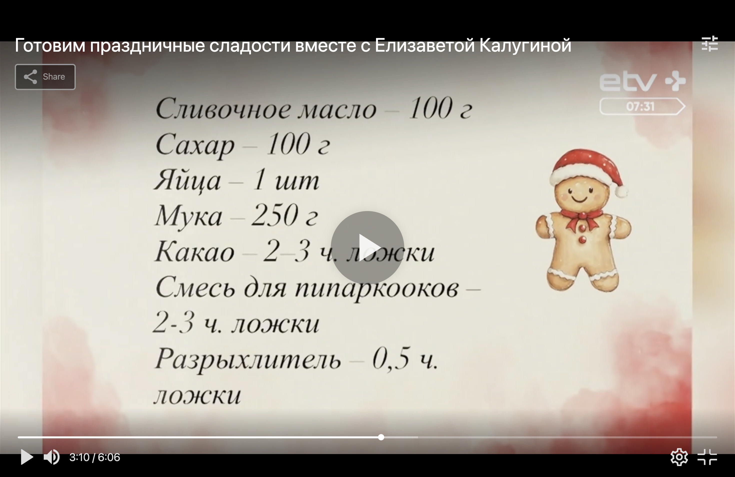

Slide 15
The program “Svoya Pravda,” (One’s own truth) ETV+
The discussion program “Svoya Pravda” has been broadcast since 2019 and comprises nine seasons. Using a random sampling method, six episodes were analyzed, one from each year.

Slide 16
Each episode is 48 minutes long (a total of 432 minutes were viewed).
The program features four to six guests, who are experts or otherwise closely connected to the topic of the episode.
There is also a studio audience - invited viewers, some of whom may be related to the topic and have the opportunity to speak during the discussion.

Slide 17
Episode (02/09/2019): “Pora valit’?” (“Time to leave?”)
https://jupiterpluss.err.ee/972931/svoja-pravda
põhiseadus (Constitution)– a Russian-speaking viewer;
училась в keelekümblus/частная школа keelekümblus - a Russian-speaking guest
- в Харьюском районе – a Russian-speaking guest

Slide 18
Episode (02/11/2020): “I can’t stand it.” («Терпеть не могу»).
https://jupiterpluss.err.ee/1150160/svoja-pravda
In this episode, some of the guests were native speakers of Estonian, so the participants occasionally switched to Estonian; these utterances were translated into Russian via simultaneous voice-over (“overlay translation”).
See examples below:

Slide 19
Examples
Инфо собачка volinik точка ее (info@volinik.ee) – an Estonian-speaking expert
CV – an Estonian-speaking guest

Slide 20
Episode (03/05/2021): “Tourism: Between the Past and the Future.”
(«Туризм: между прошлым и будущим»).
https://jupiterpluss.err.ee/1608187840/svoja-pravda
Estonian-speaking guests:
рискантный (est. riskantne), фальшировать (est. falseerima), не можно (est. ei tohi), дигитальное решение (est. digitaalne lahendus), интресс (est. intress)

Slide 21
Examples from other episodes of “Svoya Pravda” (Russian-speaking participants)
Kinnisvara, кохтутяйтуры, каждый kohtutäitur, пособие от Töötukassa, Maakohus, krediidiinfo, гёрлфренды.
Haigla, SMS laen; mine koju, me ei saa mitte midagi teha; прихожу в толлу максуамет (est. tollimaksuamet).
Konkurentsiamet, palgavaesus, mikroettevõtte, в тойдуамете (est. toiduamet, один кома два (est. koma - comma), стать väikealkoholetootja.

Slide 22
The radio program “Zhenskaya Sila,” (Women’s Strength) ERR, Radio 4
https://r4.err.ee/1609147814/zhenskaja-sila
The radio program “Women’s Strength,” broadcast in Russian in Estonia, is a project featuring women from various professions and social backgrounds. The program addresses current issues related to work and personal life.
It is devoted to the stories of women whose experiences can inspire others to achieve their goals. The host of the program is Yulia Lukashenkina. The program aired ten times between 09 August 2023 and 11 October 2023, with each episode lasting on average 45 minutes. According to the host, the project was closed due to insufficient funding.

Slide 23
A distinctive feature of the program is its intercultural context: it is produced within the Russian-language media environment of Estonia, and the invited guests may include both native speakers of Russian and native speakers of Estonian who speak Russian.
The guests represented the following professions and fields of activity: director, pilot, factory director, marketing manager, air traffic controller, brewer, cinematographer, former politician, and workers.

Slide 24
Examples of insertions from the Estonian language
Perefirma, Kultuurkapital, rakendus kõrgkool, kaitseliit, Georg Otsa nimeline Tallinna Muusikakool, pereakadeemia, Haigekassa, Tallinna Tehnikaülikool, Eesti Energia, Riigikogu, кандидировать.
The use of Estonianisms ranged from zero to four instances per episode.

Slide 25
Conclusions
The analysis of spoken language in Russian-language media in Estonia demonstrates several types of contact-induced phenomena, which can be grouped according to the Code-Copying Framework.
1. Global copying (lexical insertions)
The most frequent and salient type is the insertion of Estonian lexical items into Russian speech. These include:
administrative and institutional terms (Töötukassa, Riigikogu, Maakohus, Konkurentsiamet),
everyday and sociocultural nominations (isikukood, vabakutseline, Südalinna).
These insertions are largely unintegrated or minimally adapted and reflect the sociolinguistic dominance of Estonian in the institutional domain. Their frequency suggests routinized usage in bilingual communication.

Slide 26
2. Selective copying (hybrid formations)
A smaller group consists of hybrid forms combining Russian and Estonian elements (e.g., kandidirovat’).
These cases indicate structural influence from Estonian on Russian and demonstrate partial integration of copied material into the recipient language. They reflect emerging patterns of contact-induced variation.

Slide 27
3. Code-switching (situational switching to Estonian)
In interactional contexts, especially when Estonian-speaking participants are involved, speakers may switch to Estonian:
short stretches of speech in Estonian,
followed by simultaneous translation into Russian.
This type is discourse-driven and depends on participant configuration and communicative needs rather than lexical necessity.

Slide 28
4. Functionally motivated insertions (language awareness)
Across all types, the use of Estonian elements is not purely automatic. It may serve:
reference to local realities,
indexing of institutional specificity,
construction of social identity,
signaling authenticity or expertise.
Thus, these phenomena reflect not only structural contact but also language awareness and speaker agency.

Slide 29
The data show that Russian-language media discourse in Estonia is characterized by a systematic interaction between Russian and Estonian, where:
global copying dominates quantitatively,
selective copying indicates deeper structural influence,
code-switching reflects interactional dynamics,
and all types are shaped by both cognitive mechanisms and sociolinguistic factors.

Slide 30
References
Адамсон И. В. Русский язык в Эстонии. Словарь. https://venekeeleestis.blogspot.com/ (см. также https://venekeelest.weebly.com), 21.04.2026.
Адамсон И. В. Особенности русского языка в Эстонии по данным поисковых систем. Humaniora: Lingua Russica. Труды по русской и славянской филологии. Лингвистика XIV. Развитие и вариативность языка в современном мире II. Тарту: Tartu Ülikooli Kirjastus, 2011, с. 29–47.
Адамсон И. В. Воздействие «среды обитания» на русский язык современной Эстонии. Экология родного языка и культуры. Москва: Флинта: Наука, 2014, с. 59–65.
Адамсон И. В. Особенности русского языка в Эстонии как следствие языковых контактов. Minderheiten in der slawischen Welt. Philologica Slavica Vindobonensia, Bd 5. Wien: Peter Lang, 2019, с. 59–70.

Slide 31
Адамсон И. В. О значении некоторых номинаций социальной сферы современной Эстонии и их российских соответствий. VALODA–2020. Valoda dažādu kultūru kontekstā. XXX Zinātnisko rakstu krājums. Daugavpils: Daugavpils Universitātes Akadēmiskais apgāds „Saule”, 2020, с. 177–185.
Бурдакова О. Н., Нымм Е. Ю. Из опыта составления словарей локального текста городов постсоветского культурного пространства. Альманах североевропейских и балтийских исследований. Nordic and Baltic Studies Review. Issue 2. Петрозаводск, 2017, с. 116–138.
Деци, Алессандра. 2025. Функции иноязычных вкраплений в интернет-дискурсе русскоязычных жителей Италии и Эстонии: сопоставительный аспект. University of Tartu Press.
Лензо К. Живая речь гостей радиопередач («женская сила», радио 4. Эстония). Бакалаврская работа. Таллинн, 2025.
Петрова Е. Особенности речи гостей телепередач в эстонии (на примереПередачи «своя правда»). Бакалаврская работа, Таллинн, 2024.
Backus, Ad. 2020. Usage-based approaches. In Evangelia Adamou, Yaron Matras (ed.) The Routledge Handbook of Language Contact. London, Routledge. 110─126.
Verschik, Anna. 2017. Language Contact, Language Awareness, and Multilingualism. In Jasone Cenoz, Durk Gorter, Stephen May (ed.). Language Awareness and Multilingualism. Springer. 99─111.

Slide 32
Thank you for your attention!

